Slide 1


Zor Vakalar Eşliğinde
Akciğer Kanserinde RT Pratiği
İnterstisyel akciğer hastalığında TRT
Ciddi pulmoner disfonksiyonda TRT
Dr. Esra Korkmaz Kıraklı
14 Ocak 2023
esrakirakli@gmail.com
Notes:
Radiation oncologists may not be familiar with the aspects of ILD that are relevant to their clinical practice, given the relatively recent identification of ILD as a risk factor for substantial morbidity in patients receiving high-dose techniques such as stereotactic radiation, and the changes in ILD classifications and diagnostic criteria that have been implemented
over the past decade. The aim of this review is to provide an overview of ILD, along with guidance and evidence-based recommendations to aid the thoracic radiation oncologist with the provision of safe and highquality treatment for this vulnerable patient population.-GOODMAN
For the patients with poor pulmonary function or pulmonary diseases such as interstitial lung disease (ILD), even RT can result in significant complications; however, no universally accepted criteria to define patient suitability for RT have been described.-KIM PROTON

Slide 2
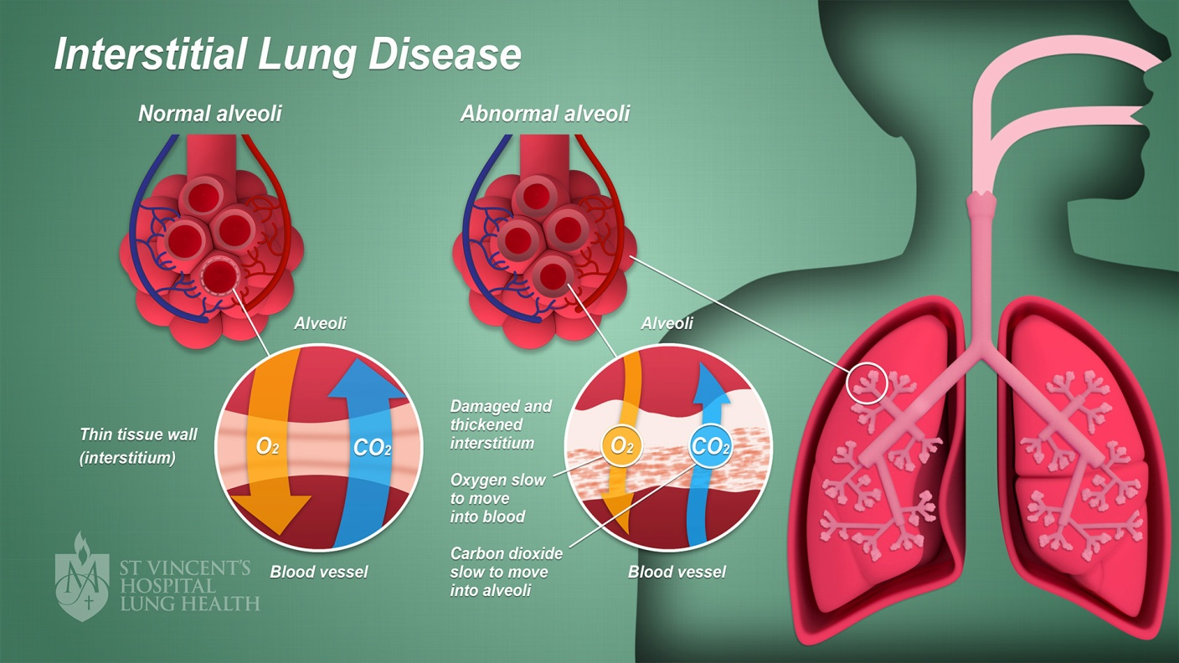
Intestisyel Akciğer Hastalığı (IAH)
Notes:
IAH, diffüz parenkim tutulumu yapan-restriktif akciğer fizyolojisine sahip, yaklaşık 200 farklı tek şemsiye altında toplayan çok genel bir tanımdır. Bilinen maruziyet, iyatrojenik ya da çoğunlukla idyopathik olarak anormal tamir mekanizmasının tetiklenmesiyle oluşur.
IAH aslınd cok heterojen bir hastalık grubunu tanımlamakta
Interstitial lung diseases (ILDs) are characterised by pathological changes in the pulmonary parenchyma, sometimes triggered by inflammation, but sometimes with an epithelial–fibrotic athogenesis, in which nflammation is believed to play little part. –KEWALRAMANI
ILD is also known as diffuse parenchymal lung disease. Diffuse parenchymal lung disease and ILD are the umbrella terms for more than 200 different noninfectious,
acute, or chronic diseases affecting the parenchyma of the lung. ILD can involve the alveolar epithelium, interstitium, perivascular, or perilymphatic tissue. Identifiable or idiopathic injuries trigger an abnormal healing response resulting in inflammation and fibrosis.10 Identifiable causes can include environmental triggers, pneumotoxic drugs, occupational exposures, radiation therapy, and systemic diseases (e.g., connective tissue disease-GOODMAN

Slide 3
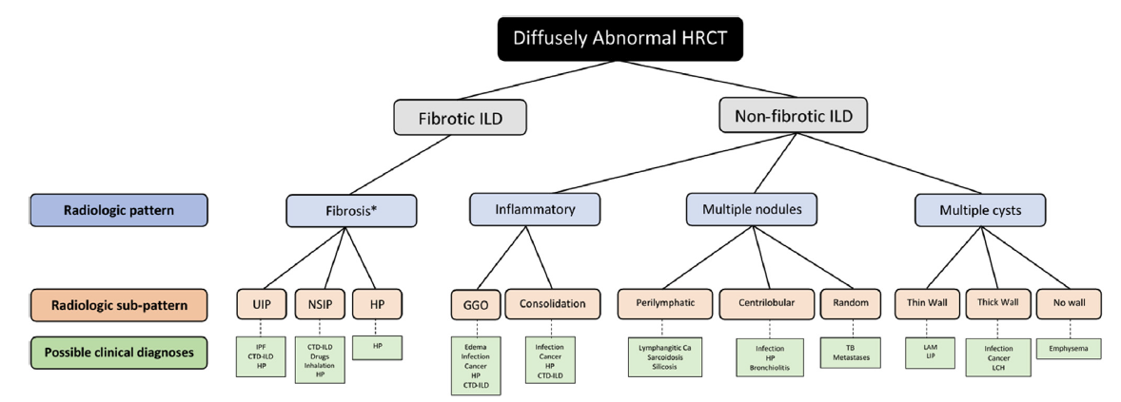
Sınıflandırma
Goodman ve ark JTO-2020
Notes:
Eskiden altta yatan sebebe göre sınıflandırılırken, günümüzde artık fibrotik vs non-fibrotik olara sınıflandırlmaka
Non-fibrotik grup azınlığı oluşturmakta ve fibrotik IAH’na göre daha iyi prognoza sahip
ILD was historically approached according to whether the underlying cause was known or unknown but is now typically subclassified as fibrotic or nonfibrotic
A UIP pattern in IPF and other disorders tends to progress [2]. Other fILDs can develop a progressive phenotype. Once progression despite management has occurred, the disease ourses usually similar to IPF [3]. Acute exacerbations are acute flares of ILD, sometimes overtly triggered, e.g. by infection or surgery and associated with high short-term mortality [4]. Acute exacerbations can also increase mortality in patients with other fILDs-KEWALRAMANI
ILD was historically approached according to whether the underlying cause was known or unknown but is now typically subclassified as fibrotic or nonfibrotic, given the greater clinical relevance of this stratification.13 Fibrotic ILDs are likely to be more relevant as predictors of radiation toxicity.-between fibrotic and nonfibrotic ILD is typically made on
the basis of high-resolution computed tomography (HRCT) findings of fibrosis, specifically including findings of reticulation, traction bronchiectasis, and honeycombingGOODMAN
Fibrotic ILDs: Fibrotic ILDs are typically progressive disorders that can be further subclassified as either idiopathic pulmonary fibrosis (IPF) or non-IPF ILD. Virtually all fibrotic ILDs are characterized by reticulation or traction bronchiectasis, which can both occur with or without honeycombing. Fibrotic ILDs can have an element of inflammation; however, it is the presence of fibrosis that typically drives prognosis and response to therapy. IPF is a form of idiopathic interstitial pneumonia that has a distinctly poor prognosis and often a different approach to pharmacotherapy compared with non-IPF fibrotic ILDs. Non- IPF fibrotic ILDs include a variety of connective tissue disease–associated ILDs (CTD-ILDs), fibrotic hypersensitivity pneumonitis, some drug-induced ILDs, pneumoconioses, and many other less common subtypes.14
2. Nonfibrotic ILDs: Nonfibrotic ILDs include a variety of inflammatory, multinodular, and cystic lung diseases. These are collectively less common than fibrotic ILDs and almost always have a better prognosis and response to therapy.

Slide 4
Sınıflandırma
Goodman ve ark JTO-2020
Notes:
Eskiden altta yatan sebebe göre sınıflandırılırken, günümüzde artık fibrotik vs non-fibrotik olara sınıflandırlmaka
Non-fibrotik grup azınlığı oluşturmakta ve fibrotik IAH’na göre daha iyi prognoza sahip
ILD was historically approached according to whether the underlying cause was known or unknown but is now typically subclassified as fibrotic or nonfibrotic
A UIP pattern in IPF and other disorders tends to progress [2]. Other fILDs can develop a progressive phenotype. Once progression despite management has occurred, the disease ourses usually similar to IPF [3]. Acute exacerbations are acute flares of ILD, sometimes overtly triggered, e.g. by infection or surgery and associated with high short-term mortality [4]. Acute exacerbations can also increase mortality in patients with other fILDs-KEWALRAMANI
ILD was historically approached according to whether the underlying cause was known or unknown but is now typically subclassified as fibrotic or nonfibrotic, given the greater clinical relevance of this stratification.13 Fibrotic ILDs are likely to be more relevant as predictors of radiation toxicity.-between fibrotic and nonfibrotic ILD is typically made on
the basis of high-resolution computed tomography (HRCT) findings of fibrosis, specifically including findings of reticulation, traction bronchiectasis, and honeycombingGOODMAN
.14
2. Nonfibrotic ILDs: Nonfibrotic ILDs include a variety of inflammatory, multinodular, and cystic lung diseases. These are collectively less common than fibrotic ILDs and almost always have a better prognosis and response to therapy.

Slide 5
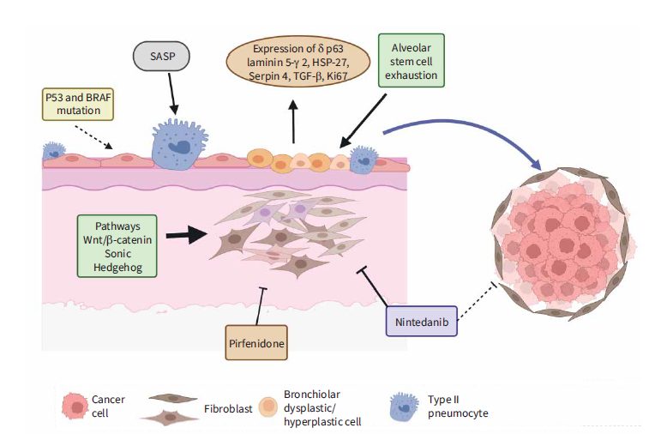
Fibrotik IAH
Idyopatik pulmoner fibrozis (IPF) %80-90
Non-IPF fibrotik IAH
  Bağ dokusu hastalıkları
  Hipersensitivite reaksiyonu
  İlaç reaksiyonu
  İnhalasyon
  Slikozis
  Sarkoidozis
  Enfeksiyon
  Lenfanjitik karsinomatozis
  Amfizem
  TBC/mantar enf
  Vaskülit
  LCH…….
Sha ve ark. Clinical Oncol 2022
Notes:
Fibrotik IAH progresif kliniğe sahiptirler
IPFolguların %80-90’ının oluşturmakta, en kötü prognoza sahip. Bunun yanında fibrotik patern RT’ye bağlı toksisiteyi belirleyici faktör olduğu için bu grup ayrıca önemli bizler için), Non-IPF fibrotik IAH ise bağ dokusu hastalıklarına, hipersensitivite yada ilaç reaksiyonlarına sekonder gelişen durumlardır.
Fibrotic ILDs are likely to be more relevant as predictors of radiation toxicity.-between fibrotic and nonfibrotic ILD is typically made on
the basis of high-resolution computed tomography (HRCT) findings of fibrosis, specifically including findings of reticulation, traction bronchiectasis, and honeycombingGOODMAN
Interstitial lung diseases (ILD) or idiopathic interstitial pneumonias (IIPs) are a diverse group of diffuse parenchymal lung diseases with the most common variants being usual interstitial pneumonia (UIP)/idiopathic pulmonary fibrosis (IPF), which account for 80e90% of cases ve en kötü prognozlu olan[2]-SAHA
Fibrotic ILDs: Fibrotic ILDs are typically progressive disorders that can be further subclassified as either idiopathic pulmonary fibrosis (IPF) or non-IPF ILD. Virtually all fibrotic ILDs are characterized by reticulation or traction bronchiectasis, which can both occur with or without honeycombing. Fibrotic ILDs can have an element of inflammation; however, it is the presence of fibrosis that typically drives prognosis and response to therapy. IPF is a form of idiopathic interstitial pneumonia that has a distinctly poor prognosis and often a different approach to pharmacotherapy compared with non-IPF fibrotic ILDs. Non- IPF fibrotic ILDs include a variety of connective tissue disease–associated ILDs (CTD-ILDs), fibrotic hypersensitivity pneumonitis, some drug-induced ILDs, pneumoconioses, and many other less common subtypes
Nintedanib-small molekül-tirozin kinaz i
Pirfenidone- GF ve pro-collogenI-II inh
Bu ikisi RT sırasında kullanılabilir, belki daha da iyi olur
MTX gibi RT sensitizer immun suppresive ajanlar eş zamanlı kullanılmamalı.
Idiopathic pulmonary fibrosis (IPF) is the most common type of fibrosing ILD (fILD); almost always progresses (at a highly variable rate); and has the worst prognosis.-KEWALRAMANI
This review will focus on fibrotic ILDs because these ILD subtypes are most often associated with radiation toxicity. Nonfibrotic ILDs are less frequently associated
with malignancy and complications arising from treatment of malignancy when this is required. Nonfibrotic ILDs are thus not as relevant in planning radiation therapy.-GOODMAN

Slide 6
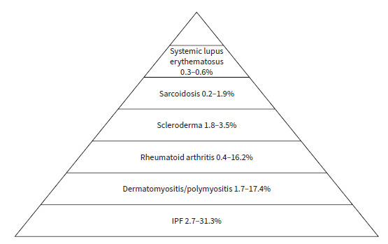
IAH - Akciğer kanseri
Archontogeorgis et al. Lung cancer and interstitial lung diseases: a systematicreview. Pulm Med 2012; 2012: 315918.
Notes:
IAH’nda Akciğer kanseri insidansı
IAH tipine göre akc ca insidansı büyük değişiklik göstermekte, IPF en korkutucu ve IPF DE AKC KANSER GELİŞİMİ YILLAR İÇİNDE KÜMÜLATİF ARTIŞ GÖSTERİR
yıllar içinde izlem süresine göre bu risk katlanarak artmakta. 3 yılda %60lara varıyor
IPF: Akciğer kanser insidansı 7-14 x↑
IPF: %10-30 akciğer kanseri (+)
1y %37
3y %62-MOHAMMED

Slide 7
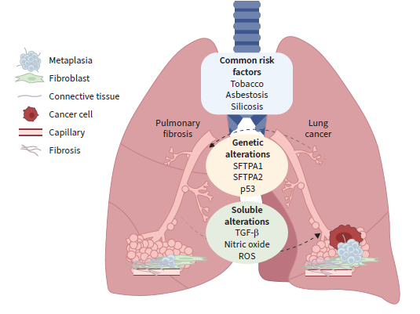
IAH - Akciğer kanseri: Ortak etyoloji
Sigara
İleri yaş
Çevresel faktörler
genetik-epigenetik anomali
  mikrosatelit instabilite
  epigenetic mutasyonlar
  mikro-RNA ekspresyon anomalileri
  apopitoz inhibisyonu
  ….
Saha ve ark. Clinical Oncol 2022
Goodman ve ark JTO-2020
Notes:
Çünkü iksi de ortak etyolojiye sahip, sigara, ileri yaş çevresel f ve geneti anomaliler gibi.ayrıca Fibrotik alanlardaki anormal bronkiolar proliferasyon-preneoplastik süreçİ UYARIR
Fibrozis gelişiminde rol alan mekanizmalar pre-neoplastik moleküler süreci de başlatabilirler
The pathobiological paradigm for lung cancer in ILD. Common risk factors (tobacco, asbestosis and silicosis) and common pathophysiology (cellular abnormalities). Note that we suggest a reciprocal association between pulmonary fibrosis and lung cancer, such that the genetic alterations (e.g. in surfactant protein (SFTP) genes and p53) and soluble mediator alterations (e.g. in TGF-β, nitric oxide and ROS) could affect both ILD and lung cancer progression.-ERS rehberi
mikrosatelit instabilite
epigenetic mutasyonlar
telomere attrition and
impaired cellular bioenergetik
(micro-RNA expression abnormalities
İnhibition of apoptosis associated with the activation of ntracellularsignal transduction
the weakening of cellularinteraction)
The pathogenesis of the relationship between ILD and lung cancer remains unclear. We must consider shared risk factors; for example, smoking is a risk factor for lung cancer and IPF [15] (figure 2), but in a systematic review analysing this association, IPF was an independent risk factor for lung cancer even after accounting for smoking status [16].
In ILD, genetic, environmental and behavioural factors contribute to developing pneumonitis or fibrosis, and in lung cancer the same factors could be involved. The primary data in this regard have been associated with IPF [17]; however, recent data from other diseases with a fibrosing phenotype have led to fibroblasts and myofibroblasts being described as the critical cellular players in these diseases, since their proliferation and activation under profibrotic stimuli lead to the secretion and deposition of extracellular matrix proteins, which are responsible for causing Fibrosis-ERS
Pathomechanisms of lung cancer and fibrosing interstitial lung disease. Dysplastic bronchial cells accumulate near fibroblastic foci. Senescence-associated secretory phenotype (SASP) and stem-cell exhaustion contribute to dysplastic bronchial cell development. Fibrotic processes including epithelial–mesenchymal transition, Wnt/β-catenin and Sonic Hedgehog pathways contribute to cancer development. Antifibrotic drugs inhibit fibrosis and might have potential effects on cancer-KEWALRAMANİ
In summary, bronchiolar hyperplastic–dysplastic cells are possibly the driver of lung cancer in ILD. Bronchiolisation of distal areas within UIP patterns is promoted by a profibrotic microenvironment, and the mechanisms involved in fibrosis development may also activate molecular processes able to induce pre-neoplastic, and in more advanced stages, cancerous lesions, as shown in figure 1.
Along with these typical fibrosis-related mechanisms, a genomic study carried out by HWANG et al. [47] has provided a new perspective on the origin of lung cancer in ILD. The genomic profile of lung cancer associated with IPF showed a significantly higher prevalence of mutations in TP53 and BRAF in their cohort, genes implicated in cell proliferation and survival, suggesting a genetic susceptibility to lung cancer in patients with IPF-KEWALRAMANI
The increased prevalence and accumulative incidence of lung cancer in fILD suggest that ILD may itself promote lung cancer development [14]. Specifically, in IPF, some molecular and genetic features of its pathogenesis and progression are linked to mechanisms that favour development of malignancy [12]. Unfortunately, the evidence for pathogenesis of lung cancer in ILD patients is vague. The following hypotheses are drawn from studies in patients with fILD or lung cancer.-KEWALRAMANI
Histopathological studies in IPF, the archetype of fILD with a UIP pattern as the histological background, suggest that abnormal bronchiolar proliferation in fibrotic areas might be the pre-neoplastic lesion [35]. An immunohistochemistry study of 33 cases of lung cancer arising in patients with IPF demonstrated that neoplastic cells express bronchial markers including the transcription factor-1, napsin-A and surfactant protein A, expressed also in a minority of cases of adenocarcinoma-KEWALRAMANI
Abnormal activation of the Wnt/β-catenin pathway was documented in fibrotic areas in lung samples obtained from patients with IPF, and this pathway could be involved in squamous dysplasia and in promoting squamous carcinoma differentiation-kewalramanı
One of the cardinal mechanisms that may promote bronchial pre-cancerous lesions in IPF lungs is alveolar epithelial cell exhaustion [41]. Both intrinsic (e.g. genetic, ageing) and environmental factors (e.g. smoking, pollution) contribute to alveolar stem cell dysfunction in patients with IPF. These cells express senescence markers and are unable to rebuild the lung parenchyma properly after endogenous or exogenous insults. However, they acquire a senescence-associated secretory phenotype inducing aberrant activation of important regulators of cell transformation, growth and migration signals and epithelial– mesenchymal transition (EMT) [37, 38] such as Wnt/β-catenin and Sonic Hedgehog pathways [42]. Along with formation of a fibrotic microenvironment [38], these processes lead to bronchial overgrowth and cancer cell development and progression-KEWALRAMANI

Slide 8
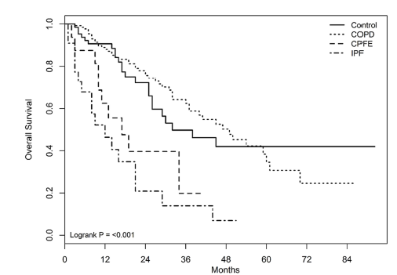
IAH - Akciğer kanseri
Akciğer kanseri : % 5-10 IAH (+)
KHAK/KHDAK prognozu daha kötü
    IAH’nın akut alevlenmesi
    Ciddi / ölümcül RP
    Suboptimal onkolojik tedavi
Evre I-II
Definitif RT
Kontrol
KOAH
IPF
Saha ve ark. Clinical Oncol 2022
Goodman ve ark JTO-2020
Taya ve ark. JJCO 2019
Kim ve ark IJCOPD 2019
Notes:
Akciğer kanseri vakalarının %5-10’unda eşlik eden IAH bulunabilmektedir.-GOODMAN
IAH ve akciğer kanseribirlikteliği onkolojik yaklaşımda büyük sorun teşkil etmekte
KHAK/KHDAK prognozu daha kötü, tedavi ilişkili toksisite ve AE çok yüksek olabilir, bu endişeyle suboptimal tedaviler uygulanmaktadır ve sonuçta px daha kötü sonuçlanabilmektedir.
IAH’nın %15’i akciğer kanseri nedeniyle ex
Hiç de düşük bir oran olmadığını görüyoruz, peki buna klinikte ne kadar dikkat ediyoruz?
Hele subklinik tanı almamış ILA(abnormality) daha da yüksek olabilir (HİGO’da %32.5 oranında)-LANSCLC’da gerçek insidansı bilinmemekte.-HIGO
KHAK/KHDAK prognozu daha kötü (5y S %%15 vs %39 p<0.001)
Comorbidity with IPF has a poor prognosis in conjunction with lung cancer [25e29]. Similarly, comorbidity with lung cancer has a poor prognosis in IPF-japon rapor ogura
because the comorbidity rate increases over time, and depends largely on the duration of the follow-up period of the IPF. Ogura
Five to ten per cent of lung cancer patients have coexistent ILD; possibly due to common aetiologies, such as smoking, environmental factors and patho-genetic abnormalities, e.g. microsatellite instability, epigenetic alterations, telomere attrition and impaired cellular bioenergetics [3e7].-SAHA
Tek başına IPF akc ca için bağımsız risk f
1 y %3.3
5 y %15.4
10y %54.7
Patients with lung cancer (both small cell lung cancer [SCLC] and non-small cell lung cancer [NSCLC]) associated with ILDs have a worse outcome compared with those without ILDs [12e14]. This is often due to acute exacerbation of ILD and severe or even fatal pneumonitis.-SAHA
Emerging evidence suggests that patients with ILD undergoing any treatment, including thoracic radiotherapy (TRT), are at a higher risk of treatmentrelated toxicities, compounding their baseline risk of morbidity from life-threatening ILD exacerbations.5-9 Thus, patients with concomitant diagnoses of ILD and lung cancer represent a unique challenge in oncologic management. Despite the urgent need for cancer therapy, any treatment requires careful consideration of patient-, ILD-, and cancer-specific factors. –GOODMAN IASLC
ILD and NSCLC share common risk factors (e.g., older age, cigarette smoking), but there is also a recognized link between ILD itself and the development of lung cancer,
even when controlling for other risk factors. In a recent literature review, the relative risk of lung cancer was 3.5 to 7.3 times higher in the presence of ILD. Lung cancer
incidence was estimated at 10% to 20% in ILD, with more than 15% of patients with ILD likely to die from malignancy.-GOOLDMAN
Patients with SCLC and fILD respond well to standard treatment if they can tolerate chemotherapy. Theprognosis of SCLC in patients with ILD is comparable to those without ILD-KEWALRAMANI
Increased survival due to delayed disease progression in IPF and other progressive fILD patients leads to an increased prevalence of comorbidities and complications, with their optimal management complicated by concurrent ILD. Lung cancer as a comorbidity in ILD-KEWALRAMANI
Survival differences between IPF without lung cancer and IPF with lung cancer were statistically significant (p<0.001) [16], with lower survival over time for those with IPF and cancer-KEWALRAMANI
Particularly, 10–30% of patients with IPF have concurrent lung cancer (2–7). Patients with IPF have a 7–14-fold higher risk of lung cancer than people without IPF, indicating that IPF is an independent risk factor for lung cancer-TAYA
cumulative incidence of LC increases remarkably overtime after the initial diagnosis of IPF. Furthermore, these data confirm the crucial importance of a prospective protocol for follow up of IPF patients with annual HRCT scanning.-MOHAMMED
The median survivals in the control, COPD, CPFE, and IPF groups were 32, 49, 17, and 12 months, respectivelyEVRE I-II OLGULARDA BİLE-RT sonuçları-kontrol grubu diğer nedenlerle medikal inop olgularKIM ŞEKİL
Kim et al. [24], in their series of stage IeII lung cancer patients treated with radical radiotherapy and SABR, showed that the presence of combined pulmonary
fibrosis and emphysema-SAHA
However, the treatment outcome of definitive radiotherapy for patients with early-stage NSCLC and chronic pulmonary diseases such as COPD, CPFE, and
IPF have not been fully elucidated. In this context, we evaluated the impact of co-existing COPD, IPF, and CPFE on overall survival following definitive radiotherapy in
patients with medically inoperable stage I-II NSCLC. The results of this current study demonstrated that underlying COPD was not associated with the outcome of
definitive radiotherapy, while the presence of IPF and CPFE resulted in poorer survivals than those of patients without underlying pulmonary disease such as COPD,
CPFE, and IPF.-KIM
Kanaji et al. [30], in their retrospective review, showed that the patients with IPF had shorter PFS and overall survival at both the Limited (LD) and Extensive (ED) stages. Patients who underwent CTRT had longer PFS and overall survival compared with chemotherapy in the Limited (LD)-stage patients with IPF.-SAHA
There are several possible reasons that could explain the lower response rate and shorter survival f patients with IPF. First, patients with IPF more frequently received fewer cycles of irst-line hemotherapy, and fewer cycles of chemotherapy was a poor prognostic factor. IPF could include a disturbed drug-delivery system due to the architectural distortion of the lung in IPF, transforming growth factor-beta associated with drug resistance,20 and lung fibroblasts activated in IPF contributing to cancer progression-KANAJİ

Slide 9
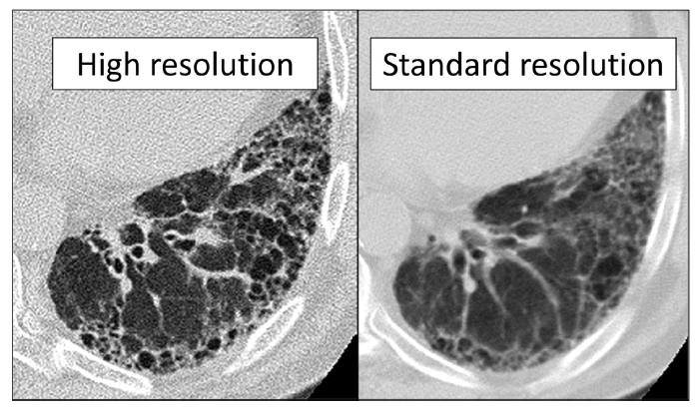
IAH-Tanı
Yüksek rezolüsyonlu toraks BT (HRCT):
Herhangi bir akciğer zonunda >%5 alan kaplayan ↑akciğer dansitesi
    Retiküler anomali
    Traksiyon branşiektazi
    Bal peteği görünümü
    Yoğun santro-lobüler nod
    Non-amfizematöz kistler
    Buzlu cam
Spirometre: restriktif
FVC↓ Total akc kapasitesi↓
DLCO
CO diff ↓ 02 sat↓
Sha ve ark. Clinical Oncol 2022
Notes:
HRCT is essential
The diagnosis of ILD is often based on certain findings on high-resolution computed tomography chest, such as increased lung density affecting >5% of any lung zone, BUNLAR NELER?
Comparison of a high-resolution computed tomography (HRCT) versus a standard computed tomography image taken on the same day in a 75-year-old male patient with idiopathic pulmonary fibrosis. The HRCT with 1.25 mm slice thickness provides superior visualization of the lung architecture compared with the standard computed tomography with 5 mm slice thickness. The HRCT reveals features consistent with a usual interstitial pneumonia pattern, which allows a confident noninvasive diagnosis of idiopathic pulmonary fibrosis in this patient who lacked an alternative etiology after a comprehensive multidisciplinary assessment.-GOOLDMAN

Slide 10
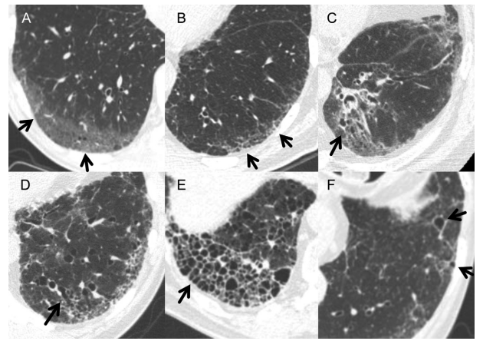
IAH-Tanı
Yüksek rezolüsyonlu toraks BT (HRCT):
Herhangi bir akciğer zonunda >%5 alan kaplayan ↑akciğer dansitesi
    A. Buzlu cam
    B. Retiküler anomali
    C. Traksiyon branşiektazi
    D. Yoğun santro-lobüler nodülarite
    E. Bal peteği görünümü
    F. Non-amfizematöz kistler
Pirometre: restriktif
FVC↓ Total akc kapasitesi↓
DLCO
CO diff ↓ 02 sat↓
Sha ve ark. Clinical Oncol 2022
Notes:
In patients with IPF, there are pathologic changes in the alveolar architecture, which appear morphologically as a honeycomb pattern. The affected alveoli easily collapse and become infected. This may be one reason why patients with IPF frequently develop pulmonary complications or die after surgery.-KAWASAKİ
Figure 2: Thin-section CT scans show typical findings of interstitial lung abnormalities. (A) Ground-glass abnormality (arrows) is seen in peripheral lung zone. (B) Reticular abnormality with ground-glass opacity (arrows) is seen in subpleural area. (C) Lung distortion is suggested by volume loss and displacement of bronchi and vessels toward medial side (arrow). Distortion accompanies ground-glass abnormality and traction bronchiectasis. (D) Traction bronchiectasis (arrow) is conspicuous in left lower lobe. Ground-glass and reticular abnormalities are also seen in subpleural area. (E) Honeycombing is demonstrated as appearance of clustered cystic air spaces (arrow). (F) Nonemphysematous cysts can be seen as lucencies with well-defined walls (arrows). Surrounding ground-glass and reticular abnormalities are also seen.

Slide 11
IAH-Tanı
Yüksek rezolüsyonlu toraks BT (HRCT):
Herhangi bir akciğer zonunda >%5 alan kaplayan ↑akciğer dansitesi
    A.Buzlu cam
    B. Retiküler anomali
    C. Traksiyon branşiektazi
    D. Yoğun santro-lobüler nodülarite
    E. Bal peteği görünümü
    F. Non-amfizematöz kistler
Spirometre: restriktif
FVC↓ Total akc kapasitesi↓
DLCO
CO diff ↓ 02 sat↓
Sha ve ark. Clinical Oncol 2022
Notes:
Spirometry disük FVC değeri ile restriktif paterni gösterir. Spirometri is used as an important modality in patient selection for lung resection [1–3]. However, the test has limited sensitivity and specificityileri düzeye kadar belirgin düşüş göstermeyebilir.
Bozulmuş alveolar yapı diffüzyon kapasitesini düşürür ve Ancak Düşük DLCO ileri evre IAH göstergesi olduğu daha nettir.
Spirometri is used as an important modality in patient selection for lung resection [1–3]. However, the test has limited sensitivity and specificityibecause it shows static pulmonary functions. IPF is characterized by progressive interstitial fibrosis leading to restrictive lung change, decreased diffusing capacity, and ultimately, cor pulmonale [17]. However, static lung function remains intact until IPF progresses to the advanced stage [18]. Patients with advanced IPF have dismal lung function, which precludes lung resection.-KAWASAKİ
Furguson and colleagues [3] reported that pulmonary capillary surface area and alteration in alveolar microarchitecture in the lung could be estimated based on measurement of diffusing capacity for carbon monoxide (DLco), and that patients with low Dlco experience greater morbidity after major lung resection. Some investigators have reported that DLco decreases in patients with diffuse pulmonary disease were associated with advanced disease [18,19]KAWASAKİ
Patients with ILD often present with nonspecific symptoms that include impaired exercise tolerance, progressive dyspnea, and cough. Pulmonary function tests typically exhibit a restrictive pattern (decreased forced vital capacity and total lung capacity) and impaired gas exchange (reduced diffusion capacity for carbon monoxide [DLCO]), leading to a decreased arterial oxygen saturation.-goodman

Slide 12
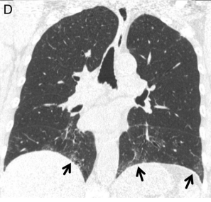
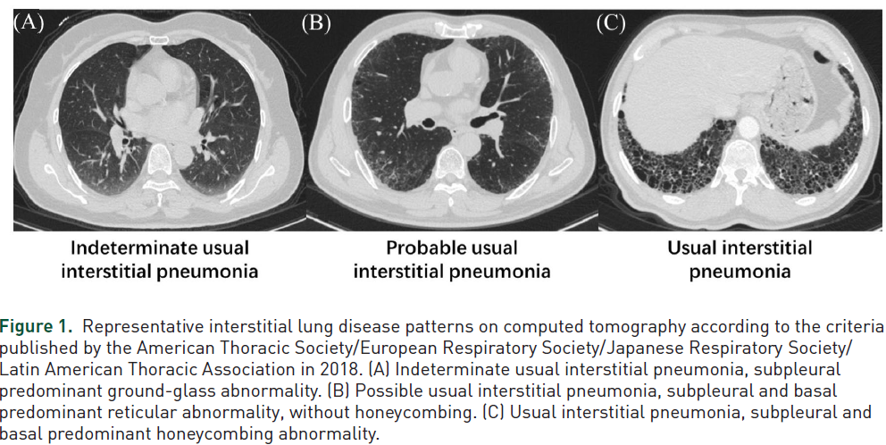
IAH - Radyolojik patern
UIP / non-UIP
Raghu ve ark. American Thoracic Society, European Respiratory Society, Japanese Respiratory Society, and Latin American Thoracic Society. Diagnosis of idiopathic pulmonary fibrosis. An official ATS/ERS/JRS/ALAT clinical practice guideline. Am J Respir Crit Care Med 2018; 198: e44–e68.
Usual İnterstisyel Pnömoni (UIP)
  Subplevral ve bazal tutulum +
  Retiküler anomali +
  Traksiyon bronşiektaziler+
  Bal peteği +
Notes:
Eşlik eden sebep eg. CTD, tanımlanamaıyorsa, HRCT’de UIP paternin görülmesi IPF tanısını biopsi olmadan koymaya yeterli.
ILD was divided into an usual interstitial pneumonia (UIP) or non-UIP pattern using thoracic CT. The diagnosis of a UIP pattern was based on the following CT features, as defined by he International onsensus Statement of the American Thoracic Surgery and the European Respiratory Society: subpleural distribution, honeycombing, traction bronchiectasis, and architectural distortion
The evaluation of ILD on high-resolution CT was made in accordance with the American Thoracic Society/European Respiratory Society/ Japanese Respiratory Society/Latin American Thoracic Society statement.15 The usual interstitial pneumonia (UIP) pattern was defined as having all four of the following features: (a) subpleural basal predominance; (b) reticular abnormality (c) honeycombing; (d) traction bronchiectasis or bronchiolectasis; and (e) the absence of features listed as alternative diagnosis.15 If honeycombing was absent but other features met the criteria forthe UIP pattern, the case was classified as having a probable UIP pattern-The clinical diagnosis of IPF was based on the following criteria: UIP or probable UIP patterns on high-resolution CT and exclusion of other known causes of ILD.15,16 KANAJİ
Figure 1. Representative interstitial lung disease patterns on computed tomography according to the criteria published by the American Thoracic Society/European Respiratory Society/Japanese Respiratory Society/ Latin American Thoracic Association in 2018. (A) Indeterminate usual interstitial pneumonia, subpleural
predominant ground-glass abnormality. (B) Possib e usual interstitial pneumonia, subpleural and basal redominant reticular abnormality, without honeycombing. (C) Usual interstitial pneumonia, subpleural and basal predominant honeycombing abnormality.-TANG
A histological pattern of usual interstitial pneumonia (UIP) can be diagnostic for IPF in the absence of other causes. A definite UIP pattern on computed tomography (CT) is reliably predictive of a UIP pattern at biopsy, and is characterised by honeycombing, reticulation, traction bronchiectasis and subpleural and basal predominance-KEWALRAMANI
hrct is frequently able to support a confident diagnosis in the appropriate clinical context without the need for confirmatory lung tissue sampling. For example, patients lacking an identifiable cause of their ILD who have a usual interstitial pneumonia (UIP) pattern on HRCT can be provided a diagnosis of IPF without needing a lung biopsy. However, a major challenge in distinguishing ILD subtypes is that many of the radiologic and histopathologic patterns are common to multiple forms of ILD, making definitive diagnosis based on radiologic or pathologic findings alone impossible. For example, the radiologic and histopathologic UIP pattern seen in IPF is also frequently seen in CTD-ILDs. As a result, the first step for the accurate diagnosis of ILD is to search for an identifiable cause. If a thorough search does not reveal an identifiable cause, many patients will require histopathologic tests to establish a definitive diagnosis.-GOODMAN
Use of HRCT can often supplant the need for lung biopsy in patients with fibrotic ILD.26 A lung biopsy for histopathology should only be considered when the clinical and radiologic information are nondiagnostic. Given the risks of periprocedural morbidity, including an approximate 3% risk of fatal complication in patients with ILD, biopsy should only be offered in
consultation with an expert ILD team and avoided in high-risk patients, including those with severely impaired lung function, high oxygen requirements, pulmonary hypertension, or other substantial pulmonary Comorbiditie-goodman

Slide 13
IAH - Radyolojik patern
UIP / non-UIP
Raghu ve ark. American Thoracic Society, European Respiratory Society, Japanese Respiratory Society, and Latin American Thoracic Society. Diagnosis of idiopathic pulmonary fibrosis. An official ATS/ERS/JRS/ALAT clinical practice guideline. Am J Respir Crit Care Med 2018; 198: e44–e68.
Usual İnterstisyel Pnömoni (UIP)
  Subplevral ve bazal tutulum +
  Retiküler anomali +
  Traksiyon bronşiektaziler+
  Bal peteği +
IPF
Notes:
Eşlik eden sebep eg. CTD, tanımlanamaıyorsa, HRCT’de UIP paternin görülmesi IPF tanısını biopsi olmadan koymaya yeterli.
ILD was divided into an usual interstitial pneumonia (UIP) or non-UIP pattern using thoracic CT. The diagnosis of a UIP pattern was based on the following CT features, as defined by he International onsensus Statement of the American Thoracic Surgery and the European Respiratory Society: subpleural distribution, honeycombing, traction bronchiectasis, and architectural distortion
The evaluation of ILD on high-resolution CT was made in accordance with the American Thoracic Society/European Respiratory Society/ Japanese Respiratory Society/Latin American Thoracic Society statement.15 The usual interstitial pneumonia (UIP) pattern was defined as having all four of the following features: (a) subpleural basal predominance; (b) reticular abnormality (c) honeycombing; (d) traction bronchiectasis or bronchiolectasis; and (e) the absence of features listed as alternative diagnosis.15 If honeycombing was absent but other features met the criteria forthe UIP pattern, the case was classified as having a probable UIP pattern-The clinical diagnosis of IPF was based on the following criteria: UIP or probable UIP patterns on high-resolution CT and exclusion of other known causes of ILD.15,16 KANAJİ
Figure 1. Representative interstitial lung disease patterns on computed tomography according to the criteria published by the American Thoracic Society/European Respiratory Society/Japanese Respiratory Society/ Latin American Thoracic Association in 2018. (A) Indeterminate usual interstitial pneumonia, subpleural
predominant ground-glass abnormality. (B) Possib e usual interstitial pneumonia, subpleural and basal redominant reticular abnormality, without honeycombing. (C) Usual interstitial pneumonia, subpleural and basal predominant honeycombing abnormality.-TANG
A histological pattern of usual interstitial pneumonia (UIP) can be diagnostic for IPF in the absence of other causes. A definite UIP pattern on computed tomography (CT) is reliably predictive of a UIP pattern at biopsy, and is characterised by honeycombing, reticulation, traction bronchiectasis and subpleural and basal predominance-KEWALRAMANI
hrct is frequently able to support a confident diagnosis in the appropriate clinical context without the need for confirmatory lung tissue sampling. For example, patients lacking an identifiable cause of their ILD who have a usual interstitial pneumonia (UIP) pattern on HRCT can be provided a diagnosis of IPF without needing a lung biopsy. However, a major challenge in distinguishing ILD subtypes is that many of the radiologic and histopathologic patterns are common to multiple forms of ILD, making definitive diagnosis based on radiologic or pathologic findings alone impossible. For example, the radiologic and histopathologic UIP pattern seen in IPF is also frequently seen in CTD-ILDs. As a result, the first step for the accurate diagnosis of ILD is to search for an identifiable cause. If a thorough search does not reveal an identifiable cause, many patients will require histopathologic tests to establish a definitive diagnosis.-GOODMAN
Use of HRCT can often supplant the need for lung biopsy in patients with fibrotic ILD.26 A lung biopsy for histopathology should only be considered when the clinical and radiologic information are nondiagnostic. Given the risks of periprocedural morbidity, including an approximate 3% risk of fatal complication in patients with ILD, biopsy should only be offered in
consultation with an expert ILD team and avoided in high-risk patients, including those with severely impaired lung function, high oxygen requirements, pulmonary hypertension, or other substantial pulmonary Comorbiditie-goodman

Slide 14
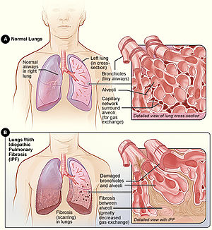
IPF
Kronik
Hızlı progresif
Fibrotik
GS: 3 y
Akut alevlenme
  %10-15 / y
  En sık ölüm nedeni
  İlk akut alevlenmede mortalite %30-50
  Akut alevlenme → S: 3ay
Solunum yetmezliği
Goodman ve ark JTO-2020
Notes:
IPF was found to be an independent risk factor for lung cancer even after accounting for smoking status-gooldmann
Disease progression is characterised by ongoing fibrosis, worsening dyspnoea, and decreasing pulmonary function tests (PFT), particularly forced vital capacity (FVC) and diffusing capacity for carbon monoxide (DLCO-HAN
the median overall survival (OS) of IPF patients was 35 months, and the most common cause of death was acute exacerbation (40%) [3]. Patients with IPF develop acute
exacerbation at a frequency of 10–15% per year during their natural course [10,11]. In addition, patients with idiopathic NSIP or IP associated with collagen vascular disease,
other than IPF, have also been reported to develop acute exacerbations, with a frequency of 3–5% per year [12]. Acute exacerbation is a fatal condition, and the mortality rate of the
first acute exacerbation is as high as about 30–50%. Even if improvement is achieved with treatment with corticosteroids, many patients have residual impaired pulmonary function
and hypoxemia, and the subsequent prognosis is poor.-IKEDA
acute exacerbation of IPF in 2016, acute exacerbations are further categorized as “triggered” or “idiopathic”, depending on whether an underlying trigger for acute exacerbation is found [13]. As for underlying triggers of acute exacerbation, pharmacotherapy, surgery, and radiotherapy for lung cancer are representative, as well as bacterial and viral infection. No matter how effective the treatment for lung cancer is, once an acute exacerbation of pre-existing IP occurs, it will be fatal to the patient at a high rate. Therefore, it is of utmost importance to choose a therapy that is unlikely to induce acute exacerbation of pre-existing IP.-IKEDA
A retrospective analysis by Khan et al. [44] showed that the outcome of lung cancer patients with IPF is poor, irrespective of stage or treatment. They concluded that therapeutic interventions did not result in any significant difference in the long-term survival of these patients regardless of stage of cancer or severity of IPF-Gerçekten 34 vakaya herşeyi denemeişler S/BSC/RT erken verelerde bile sağkalımı değiştirememişler IPF belirliyor her şeyi sankiSAHA
Ozawa et al. reported that the cumulative prevalence of LC is increased to 3.3%, 15.4%, and 54.7% after 1, 5, and 10 years from IPF diagnosis7-han
In the treatment of patients with LC-IPF, physicians are reluctant to treat LC because of the poor prognosis of IPF11. In addition, complications such as pneumonia, acute exacerbation of IPF (AE-IPF), acute respiratory distress syndrome, and air leakage after lung surgery are relatively more frequent in LC-IPF patients than in those with LC alone, thus resulting in higher mortality rates12,13. These complications and high mortality makes the treatment of LC difficult.-HAN
Tek başına IPF akc ca için bağımsız risk f
1 y %3.3
5 y %15.4
10y %54.7

Slide 15
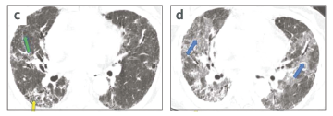
Akut alevlenme
Collard HR, Ryerson CJ, Corte TJ, et al. Acute Exacerbation of Idiopathic
Pulmonary Fibrosis. An International Working Group Report. Am J Respir
Crit Care Med. 2016;194:265-275.
‘Collard’ tanı kriterleri:
  Son 1 ay içinde dispne gelişmesi / var olan dispnenin kötüleşmesi
  Bazalde olan paterne yeni, bilateral buzlu cam konsolidasyon alanlarının eklenmesi
  Kalp yetmezliğ ve sıvı yüklenmesinin ekarte edilmesi
Retikülasyon
Yaygın buzlu cam
Bal peteği
Notes:
AE öncesi retiküler ve bal peteği görünümüne aynı hastada AE sonrası bilateral yaygın buzlu cam konsolidasyon alanlarının eklendiğini görmekteyiz
Patients with IPF develop acute exacerbation at a frequency of 10–15% per year during their natural course [10,11]. In addition, patients with idiopathic NSIP or IP associated with collagen vascular disease,other than IPF, have also been reported to develop acute exacerbations, with a frequency of 3–5% per year [12]. Acute exacerbation is a fatal condition, and the mortality rate of the first acute exacerbation is as high as about 30–50%. Even if improvement is achieved with treatment with corticosteroids, many patients have residual impaired pulmonary function and hypoxemia, and the subsequent prognosis is poor.-IKEDA
acute exacerbation of IPF in 2016, acute exacerbations are further categorized as “triggered” or “idiopathic”, depending on whether an underlying trigger for acute exacerbation is found [13]. As for underlying triggers of acute exacerbation, pharmacotherapy, surgery, and radiotherapy for lung cancer are representative, as well as bacterial and viral infection. No matter how effective the treatment for lung cancer is, once an acute exacerbation of pre-existing IP occurs, it will be fatal to the patient at a high rate. Therefore, it is of utmost importance to choose a therapy that is unlikely to induce acute exacerbation of pre-existing IP.-IKEDA
En üst foto c) A patient with idiopathic pulmonary fibrosis pre-exacerbation showing reticular change (green arrow) and honeycombing (yellow arrow) in the subpleural area of the right lung base.7 d) A patient during acute exacerbation of idiopathic pulmonary fibrosis showing typical diffuse ground-glass opacities in both lungs (blue arrows).-YIOE
The definition of AE of ILD was any acute respiratory event characterized by new bilateral ground glass-opacification/consolidation that was not fully explained by cardiac failure or fluid overload [32]. The severity of AE of ILD, including radiation pneumonitis, was evaluated with reference to pneumonitis grading using the National CanceIC v4-KOBAYASHI TANIMI COLLARD İLE YAPIYOR
we used the definition of AE advocated by Collard et al. (25) to conform to the diagnostic criteria of AEs. The diagnostic criteria involve examining the development of dyspnea or its unexplained worsening within the last 30 days. Moreover, HRCT is used to verify new bilateral ground-glass abnormalities and/or consolidation
superimposed on existing interstitial shadows. The final requirement is the exclusion of other etiologies including infection, left-sided heart failure, pulmonary embolism, and identifiable causes of acute lung İnjury-TAYA
The univariate analysis revealed that the patients with IPF (P = 0.0464) or UIP patterns (P = 0.0183) had significantly higher rates of AE than thosewith non-IPF or non-UIP patterns, respectively.-TAYA
UIP patterns on CT and each 10% decrease in %FVC were independent risk factors for AE-TAYA
Nintedanib has been reported to decrease the incidence of acute exacerbations of IPF (20), and has been recommended for the treatment of IPF by China’s 2019 “Diagnostic and Treatment Guidelines for Rare Diseases” (21). However, there is no record in the existing literatures of similar studies being performed of the peri-radiotherapy period in the lung cancer patients. Although corticosteroids are a common choice for the treatment of radiation pneumonitis, there is still a lack of evidence from relevant controlled trials supporting its use for the precaution of acute exacerbation of IPF (22). –LIU
If thoracic radiotherapy in NSCLC patients with comorbid IP induces the acute exacerbation of pre-existing IP, the mortality rate is extremely high [47,52]. Even if IP in the background is mild or subtle and there are no shadows in the irradiated area, radiation therapy can cause fatal acute exacerbation of pre-existing IP. Therefore, if the attending physician judges that the patient has IP based on reasons such as the presence of interstitial shadows on CT and fine crackles on auscultation, it would be safe not to perform thoracic radiotherapy in which the lung field is included in the irradiation field. Radiation therapy for brain metastases or bone metastases in the spine or ribs, where the irradiation field does not include the lung field, may be considered for use if necessary.-ıkeda
Iv PULSED DOSE STEROİD veriliyor.Because the prognosis of AE of IPF with comorbid lung cancer is poor, the indication for tracheal intubation should be assessed carefully. Non-invasive positive pressure ventilation (NPPV) and high-flow nasal cannula (HFNC), have been frequently used in recent years.-JAPAN-OKUDA

Slide 16
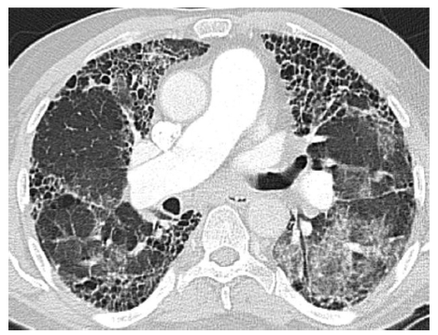
Akut alevlenme
Han S, Lee YJ, Park JS, Cho Y-J, Yoon HI, Lee J-H, et al. Prognosis
of non-small-cell lung cancer in patients with idiopathic
pulmonary fibrosis. Sci Rep 2019;9(1):12561.
İdyopatik
Tetiklenmiş
  IAH konv-RT
    ≈ %20-30
    %7.5-%83
  IAH SBRT
    Nadir
    Ancak ölümcül olabilir
Notes:
Akut alevlenme: bazaldeki paterne eklenen bilateral buzlu cam görüntüsü ile karakterize akut solunum yetmezliğidir. spontan olarak yılda %5-20 olarak görülen bu durum, iatrojenik olarak onkolojik tedavilerle de tetiklenebilir. İlk atakta mortalite yüksektir, sonrası klinik eski haline düzelemez, morbidite yüksektir.
Onkolojik tedaviye bağlı AE %3-30, mortalite %9-16 aralığında (%50) bildirenler bile var.AB ve steroid tedavisi+, ımmunsupresif tedavi IPF de verilmiyor, infeksiyöz IP de veriliyor.
Opere edilen olgularda adjuvant KT veya RT önerilmemekte.
Each year, approximately 10% of patients with IPF have an acute exacerbation, characterized by hypoxemic respiratory failure with bilateral ground-glass opacities and consolidations on HRCT superimposed on the preexistent UIP pattern (Fig. 5). The acute exacerbations can be idiopathic; however, similar accelerations can be triggered by infections, aspiration, drug toxicity, or Radiotherapy- Management options are limited, and median survival from the onset of an acute exacerbation of IPF is approximately 3 months. Guidelines make weak recommendations for the use of glucocorticoids and do not recommend the use of mechanical ventilation unless there is an option for lung transplantation.gooldman
RT sonrası için data yok.SADECE 2 YAYIN VAR-MORTALİTEYE BAK***
Spontan ve tetiklenen diye ayrılıyor G4-5 RP gibi düşünülebilir
GAPI’de aktif tedavi düşünülebilir-AE occurred commonly in advanced GAP stage.HAN
Tablo HAN’dan yaptım: From 2003 to 2016, 160 retrospectively enrolled patients were classified according to the LC clinical stage and GAP stage-RT detayı yok-konv?han
For the diagnosis of AE of IPF, it was previously necessary to rule out cardiac failure, infectious disease, drug-induced pneumonitis, etc [1]. Now, however, a new approach has
been proposed whereby these conditions are diagnosed collectively as AE of IPF, which are classified into either idiopathic AE,which has no trigger factors or triggered AE[2].
▪ In the new approach, AE of comorbid IP caused by anticancer therapy, including drugs, radiation, and surgery is classified as triggered AE. ▪ AE of IP occurs yearly in 5% to 15% of patients [3]. Associated predictive factors include a reduced forced vital capacity (FVC), plasma saturation (PaO2), and 6-minute walking distance at baseline. Comorbid pulmonary hypertension, past history of AE, and an elevated Krebs von den Lungen-6 (KL-6) value are also seen [4e10]. Predictive factors for triggered AE after surgery include, the extent of
pulmonary resection, reduced pre-surgical vital capacity (VC) and diffusing capacity (DLCO), and UIP-pattern [11,12]. ▪ High levels of serum KL-6 are a risk factor for AE among
patients with IPF [10]. Presently, there are no other blood biomarkers which actually predict AE-IPF.-JAPAN-OGURA
the patients with co-existing ILD, the frequency of acute exacerbation after conventional radiotherapy has been reported to be around 25% -LIU
Cerrahi sonrası post-operative acute exacerbation of ILD occurred in 164 (9.3%) patients with an overall mortality rate of 44% [91]. The timing peak ofacute exacerbation was at day 4. 64% developed acute exacerbation in the first 10 days post-surgery-KEWALRAMANI
An AE-ILD is a clinical diagnosis of exclusion. It has been defined as clinically significant respiratory deterioration of less than 1 month’s duration with new radiological abnormalities of diffuse bilateral ground-glass opacification (Fig 2c and 2d) without other clinical causes, such as heart failure or fluid overload, to cause the CT changes.7 –yıoe
Acute exacerbations can occur in many types of ILD but more frequently in those with fibrotic patterns on imaging (for example, IPF, fibrotic rheumatoid arthritis-related ILD and fibrotic hypersensitivity pneumonitis –YIOE
Due to its higher prevalence compared with other ILDs, the majority of AEs seen will likely be in patients with IPF. AEs in IPF have a particularly poor outcome with an in-hospital mortality of greater than 50% and high post-event morbidity.8,13 It is uncertain what triggers them. There may be some unidentified intrinsic factor that causes more rapid disease progression or they may simply represent a response to external factors –YIOE
low-dose steroids (<1 mg/kg) are preferable in IPF-AE but that for non-IPF-AE higher-dose steroids may be more effective.1-yıoe
Imm supp ajanlar IPF’de harmfull bulunmuuş, eskden veriliyormuş.
Previous studies have reported that patients with subclinical ILD are more susceptible to developing severe, extensive RP after TRT in lung tumor [10–16, 21, 23]. The classical RP changes in the lungs have been considered to be confined to the site of irradiation. However, in the early literature, there have been several reports of extensive RP occurring beyond the irradiated field [25, 33, 35]. Although there is currently no clear understanding of the pathophysiology underlying the increased rate and severity of RP in ILD patients, a hypothesis of lymphocyte- mediated hypersensitivity reaction induced by radiation therapy has been postulated [25, 33, 35].
Studies into radiotherapy that triggers severe pulmonary toxicities in these patients are scarce. More data are needed to clarify the mechanisms involved in this
phenomenon.-Lİ 2022
Mounting evidence is pushing clinicians away from an aggressive immunosuppressive approach in AE-IPF. The authors favour a low-dose steroid approach of 30–40 mg/day for 10–14 days until further research data are available. –YIOE
The treatment of an AE in an inflammatory ILD is different. Here aggressive dual immunosuppression is more likely to have an impact on improving the outcome of the AE event. Antibiotics are almost always indicated, at least initially, in the treatment of an AE for any type of ILD. –YIOE
Acute exacerbations have significant impact on IPF patients, particularly those with LC-IPF, with considerable morbidity and mortality. In the literature, the incidence of
treatment-related AEs in patients with LC-IPF ranged between 2.5 and 30% and mortality of treatment-related AE ranged between 9 and 16% [30, 31]. However, our results
revealed a higher incidence of treatment-related Aes (50%) and their related mortality (50%). Careful monitoring of patients for these AEs, and if possible, their prediction
[32], are warranted-mohammed
The causes of breathlessness and hypoxaemia in patients with ILD are usually diffusion impairment, V/Q mismatch and reduced pulmonary compliance (stiff lungs). –YIOE
Of the 14 patients who experienced AEs, 10 cases were associated with cancer treatment. The treatment-specific incidences were 3/40 (7.5%) for surgery, 5/50 (10.0%)
for chemotherapy, and 2/26 (7.7%) for radiation therapy-TAYA
In patients with concurrent lung cancer and IIPs, cancer treatment may cause AEs, and the reported incidences of AE associated with surgery, chemotherapy, or radiotherapy range from 9.3% to 42.9% (12–19). Therefore, the choice between the life-prolonging benefit of cancer treatment and the risk of AE onset is a challenging problem in clinical practice.-TAYA
During radiotherapy, two patients experienced AEs (7.4%) (Table 4). These two patients received palliative irradiation for metastatic lesions in the thoracic vertebrae and their lungs were included in the irradiation field.-TAYA
In the series by Koyama et al. [25], five of six patients developed exacerbation of existing ILD.-SAHAmost prospective clinical trials exclude patients with comorbid IP and there are no randomized controlled trials to provide evidence, it is difficult to propose a standard of care as a “guideline”-IKEDA
regimen is
CARBO-PACLITAXEL-the current standard of care for untreated NSCLC patients with comorbid IP.-IKEDA
The prognosis of lung cancer with comorbid IP is poor, and indications for pharmacotherapy and radiotherapy are limited. Therefore, surgical resection should be the first option to be considered for patients in operable stages. However, there are two points that should be considered when performing surgical resection for NSCLC with IP. Firstly, the surgery itself may induce an acute exacerbation of IP. According to a study led by the Japanese Association for Chest Surgery, 9.3% of NSCLC patients with IP had acute exacerbations after surgery, and 43.9% of them died-IKEDa
in patients with comorbid IP, neither postoperative chemotherapy nor radiation is usually indicated because of the risk of acute exacerbation of pre-existing IP.-ıkeda
Thoracic radiotherapy in patients with lung cancer with comorbid IP induces the acute exacerbation of pre-existing IP (or radiation pneumonitis) in 20–30% of patients. Consequently, the risk of death during thoracic radiotherapy is 165.7 times higher in lung cancer patients with IP than in those without IP [47]. Risk factors for acute exacerbations of IP due to radiation therapy include high levels of KL-6, the proportion of normal lungs irradiated 5–25 Gy (V5–25), and the mean lung dose (MLD) of normal lungs [48,49]. In addition, a nationwide survey of radiotherapy for lung cancer with IP by the Japanese Radiation Oncology Study Group (JROSG) showed that grading of radiation pneumonitis, FEV1.0, and V30 of the lung were identified as risk factors for acute exacerbation-ıkeda

Slide 17
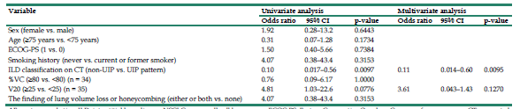
Akut alevlenme
Risk faktörleri
Kobayashi ve ark. Impact of interstitial lung disease classification
on the development of acute exacerbation of interstitial
lung disease and prognosis in patients with stage III nonsmall-
cell lung cancer and interstitial lung disease treated
with chemoradiotherapy. J Cancer 2018;9(11):2054e2060.
Evre III – KRT
37 olgu
RT sonrası 1 yıl içinde
≥ G3 % 46
G4 % 2.7
G5 % 2.7
Notes:
KRT (günlük low dosr Carbo).
KRT ile tedavi edilen olgularda 1 y içinde akut alevlenme oranı oldukça yükse, %46
ILD paterninin UIP olması bağımsız risk f. Olarak bulunmuş.
NON UIP paternin ise hem AE riskinin düşük olduğunu, hem de PFS ve GS’ın UIP ye göre daha iyi olduğunu görmekteyiz. Belki bu grup uygun olabilri RT için ancak ek prospektif dataya ihtiyaç olduğu aşikar.
Ek bilgi olarak da PFS ve GS’ın UP patern ile ne kadar kötüleştiğini grmekteyiz
However, exploration of the risk factor for AE of ILD in patients with NSCLC and ILD treated with chemoradiotherapy remains limited. Thus, identifying patients at a low risk of the AE of ILD and long-term survival treated with radiotherapy among patients with NSCLC and ILD is imperative.-KOBAYASHI
Of 37 patients, 17 (46%) developed AE of ILD worse than grade 3 within 1 year after the last irradiation. In univariate analysis, the incidence rate of AE of ILD was lower in patients with a non-usual interstitial pneumonia (UIP) pattern than in those with a UIP pattern. Multivariate analysis showed that ILD classification was significantly associated with the incidence of AE of ILD. The median overall survival (OS) durations in patients with a non-UIP pattern and a UIP pattern were 16.5 and 9.3 months, respectively. In univariate analysis, patients with a non-UIP pattern showed better survival. Multivariate analysis showed that ILD classification was a significant independent prognostic factor.-KOBAYASHI
However, in this study, patients with a UIP pattern had a significantly shorter PFS duration compared to that in patients with a non-UIP pattern. The possible reason for this is that patients with a UIP pattern tended to be unable to complete curative-intent radiotherapy because of the occurrence of AE of ILD.-KOBAYSHI
In conclusion, this study showed that the incidence of AE of ILD was high in patients with stage III NSCLC and ILD treated with chemoradiotherapy as the first-line treatment. However, a non-UIP pattern, which does not exhibit lung volume loss on thoracic radiography and honeycombing on thoracic CT, significantly reduced the risk of ILD-AE,
including radiation pneumonitis, and resulted in longer PFS and OS durations as well as a higher 2-year survival rate in this study. Therefore, radiotherapy might be effective in patients with NSCLC and milder ILD with a diagnosis of non-UIP pattern, which does not exhibit lung volume loss on thoracic radiography and honeycombing on thoracic CT, although there still remains a high risk for AE of ILD triggered by radiotherapy in this population. In the future, we need to analyze the risk and efficacy of chemoradiotherapy in patients with stage III NSCLC and a non-UIP pattern using multi-institutional data.-KOBAYASHI
The presence of IPF has been independently associated with time to treatment failure and overall survival [25]. Kobayashi et al. [28] have shown that when stage III NSCLC patients were treated with radical radiotherapy, the non-
UIP pattern had better progression-free survival (PFS) (median PFS 16.5 versus 9.3 months, P ¼ 0.0032) and overall survival (median overall survival 43 versus 12.2 months, P < 0.0001, 2-year overall survival 72% versus 0%) compared with the UIP pattern.-SAHA- KOBAYASHİ İÇİN DİYOR
Although chemoradiotherapy is the highest risk treatment for patients with ILD, it may be feasible in some patients. These patients should be identified because chemoradiotherapy can cure lung cancer. However, which patients with ILD are candidates for chemoradiotherapy is unclear.-HIGO

Slide 18
IPF ve non-IPF olgularında akc ca
IPF | Non-IPF
Alt lob (% 75) | Üst lob (% 68)
Skuamöz (% 63) | Adeno (% 55)
IPF’de akc ca gelişim bölgesi
Fibrotik alan %50
Marginal-fibrotik alan %30
Extra-fibrotik %13
Kawasaki H, Nagai K, Yokose T, et al. Clinicopathological characteristics of surgically resected lung cancer associated with idiopathic pulmonary fibrosis. J Surg Oncol 2001; 76: 53–57.
Watanabe Y, Kawabata Y, Koyama N, et al. A clinicopathological study of surgically resected lung cancer in patients with usual interstitial pneumonia. Respir Med 2017; 129: 158–163.
Notes:
Lung cancer in IPF patients (LC-IPF) occurs more frequently in the lower lobes (p<0.001), whereas non-IPF ILD patients do not differ in localisation of lung cancer to the general population [16]. A clinicopathological study in Japan divided subjects into histological subgroups: UIP (clinically IPF group), non-UIP (clinically non-IPF ILD) and a normal group (without ILD), and showed that patients with lung cancer and UIP on histology had a subpleural lung cancer predilection in the lower lobes (75.5%), matching the typical distribution of UIP [19]. The most frequent cancer type was squamous cell cancer (62.8%) [19]. In comparison, in the non-UIP group, lung cancer occurred most frequently in the upper lobes (68.1%), with adenocarcinoma the commonest cancer type (55.2%)-KEWALRAMANI
The occurrence of cancer within the fibrotic regions was confirmed by another study, in which lung cancer localisation within fibrotic areas was seen in 50%, followed by marginal-fibrotic areas (29%) andextrafibrotic areas (13%) [29]. Radiologically, lung cancer is most often found on CT in areas withinfibrosis (44.4%) followed by adjacent areas abutting fibrosis (29.6%)-KEWALRAMANI
usually located in the peripheral lung zones where fibrotic changes are predominant. They may, therefore, be difficult to detect, particularly if evolving slowly – YIOE

Slide 19
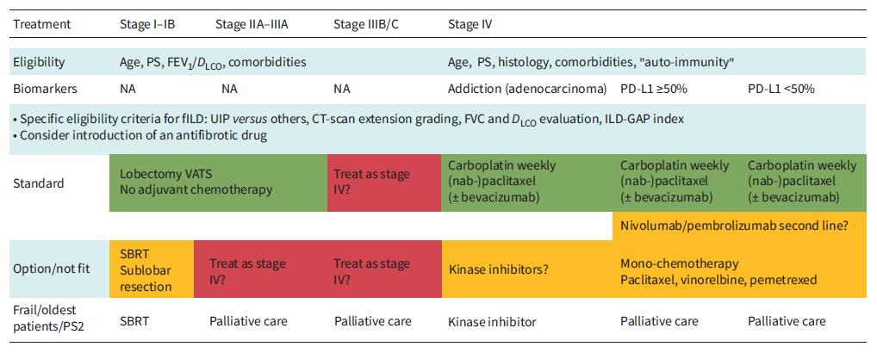
KHDAK + f-IAH- ERS rehberi
Kewalramani et al. Lung cancer in patients with fibrosinginterstitial lung diseases: an overview of current knowledge and challenges. ERJ Open Res 2022; 8: 00115-
Notes:
Bu ERSrehberinde fibrozing-IAH durumda RT’nin sadece SBRT’nin erken evrede olabilrlğini görüyoruz. Lİ-KHDAK’nde ise onkolojik TEDAVİ GEREKLİLİĞi KESİN AMA TEDAVİ İLİŞKİLİ RİSK YÜKSEK.daha ileri evrelerde sistemik tedavi önerilmekte.
ESTRO-ACROP rehberinde; 1 y dan uzun yaşam beklentisi ve ECOG<=3 halinde SBRT için kesin CI (genel olarak-IAH için değil bu cümle aslında) olmadığını belirtiyorlar. IPF’nin ciddi RP için risk f. Olarak tanımlanmış olmasına rağmen, birçok enstitü tarafından rölatif CI kabul edilmediğini, ancak deneyimli merkezlerde yapılması gerektiğini vurgulanmakta.
Eş zamanlı yapılmamal, palyasyon gerekliliği veya hasta isteği durumunda ALARA. Ancak antifibrotiklerin kullanımı ve sağladığı fayda ile KHDAK tedavisindeki fayda/zarar dengesini değiştirebilir önümüzdeki yıllarda
European radiotherapy guidelines recommend performing SABR in patients with early-stage NSCLC if the estimated life expectancy is at least 1 year [21], and the present analysis reveals that approximately 30% of our patients survived for a shorter period. We suggest that use of the ILD-GAP index [16], or modifications thereof [22], may aid in identifying patients with poor prognosis, who may not benefit from active cancer treatment. For patients who elect to undergo SABR, limiting the irradiated lung volumes may reduce the risk of ILD exacerbation and severe RP [2], a finding which has led us to the use of MR-guided-BREATH HOLD sabr-FINAZZI
Institutions agreed (62.5%–100%) that there are no absolute contraindications for lung SBRT in terms of age, Charlson Comorbidity score, chronic obstructive pulmonary disease (COPD) GOLD classification and pre-treatment pulmonary function. However, the majority of the institutions agree on a minimum ECOG performance status of 3 (agreement 75%) and a minimum life expectancy of 1 year (agreement 75%)-GUCKENBERG-ESTRO-ACROP
In the pre-SBRT era, a relevant proportion of patients at advanced age or suffering from severe comorbidities were not offered a curative treatment approach but were managed with best supportive care, only [30,31<1 year were identified as contraindications for SBRT. Other factors like old patient age [32–34], severe comorbidities and poor pulmonary function should not prevent recommendation of SBRT as a curative and well tolerated option [35–37]. Clinical situations, which are potentially associated with an increased risk for toxicity, do not preclude use of SBRT, for example following a contralateral pneumonectomy [38–40], treatment of two simultaneous primaries [41,42] and treatment of centrally located NSCLC [43,44].
Recently, idiopathic pulmonary fibrosis (IPF) has been identified as a risk factor for severe radiation induced pneumonitis but was not a relative contraindication for SBRT in the majority of the institutions [45–47]. However, all institutions agree that more extensive SBRT experience is required in these situations and institutions starting their SBRT program should refer such patients to more experienced colleagues –GUCKENBERG-ESTRO-ACROP
SBRT is recommended as curative and well tolerated treatment to this high risk population; only ECOG performance status >3 and estimated life expectancy of 1 YEAR
GAPI’de aktif tedavi düşünülebilir-HAN
A proposal for adapted modern therapeutic strategies for lung cancer fibrosing interstitial lung disease (fILD) other than small cell lung carcinoma.-kewalramanı
Next to surgical treatments for selected candidates, stereotactic body radiation therapy (SBRT) can be chosen for frail patients with early-stage cancer. Combination treatments or only chemotherapy/targeted anticancer drugs might be chosen for more advanced stages, depending on overall individual frailty and age.-KEWALRAMANI
A retrospective study by ONISHI et al. [62] in 242 patients with ILD and early-stage lung cancer receiving SBRT found the rate of severe radiation pneumonitis to be 12.4%. The mortality rate was 6.9%. Some of the risk factors for poor outcome include FVC <70%, >10% of normal lung receiving radiation, performance status 2–4, presence of squamous cell carcinoma and clinical stage T2, as well as regular use of steroid before SBRT-KEWALRAMANI
Patients with LA-NSCLC are at high risk of death from untreated NSCLC in the near term, and overall survival in this population is limited, even with radical treatment. 34,44 On balance, the risk of death from LA-NSCLC likely outweighs the risk of death from ILD but treatment paradigms are generally more intensive and morbid than for ES-NSCLC, risking severe toxicity in patients with ILD. Any treatment decision should be individualized for a patient’s overall clinical situation and goals of care.-GOODMANN
The risk of severe side effects with CCRT is the highest in patients with a diagnosis of IPF, and extreme caution should be utilized when planning treatment in this population. Definitive CCRT in patients with IPF should be reserved for very select cases, and a thorough understanding of the risk of treatment-related mortality should be included in a shared decision-making process. A dosimetric constraint of V20 smaller than or equal to 25% should be adhered to wherever possible for all patients undergoing TRT for LA-NSCLC.6,7-GOODMANN
Studies examining the administration of definitive CCRT in this population are sparse but suggest that treatment can be safely delivered. Appropriate radiotherapy
schedules for this population include single fraction, high-dose palliative, or radical fractionations, including chemotherapy. When considering chemotherapy, it may be reasonable to avoid taxane-containing regimens. Evidence suggests that patients with preexisting ILD are at an increased risk of pneumonitis when treated with paclitaxel or docetaxel-GOODMANN
The increasing use of antifibroticagents or other therapies may shift the risk-to-benefit ratio of treatment for NSCLC in this patient population-GOODMANN

Slide 20
EORTC
Konvansiyonel fr. RT IPF olguları ciddi/ölümcül RP geliştirme riski taşırlar
RT mümkünse önerilmemelidir (Kanıt düzeyi derece III-Öneri düzeyi A)
De Ruysscher ve ark. European Organization for Research and Treatment of Cancer (EORTC) recommendations for planning and delivery of high-dose, high precision radiotherapy for lung cancer. Radiother Oncol. 2017 Jul;124(1):1-10.
Notes:
Very few data evaluate the efficacy and toxicity of conventional radiation therapy in ILD patients with lung cancer (LC-ILD). Radiotherapy-induced pneumonitis can add to mortality in LC-IPF and contributes to the overall poor outcome in these patients [63]. The European Organisation for Research and Treatment of Cancer recommends that conventional radiotherapy should be avoided for patients with LC-IPF [KEWALRAMANI
Kanıt düzeyi III Prospective cohort studies
Öneri düzeyi A Strong evidence for efficacy with a substantial clinical benefit, strongly recommended
because of poor survival is likely to be more affected by the progression and severity of IPF itself than by LC severity.-han

Slide 21
TRT+ IAH Literatür
Tamamen retrospektif data
  Semptomatik IAH Ø
  Asemptomatik IAH
  Subklinik IAH
  Radyolojik IAH
Notes:
Most studies reported the outcome of thoracic radiotherapy in patients with subclinical, asymptomatic or radiologically diagnosed ILDs [17,21,31]. There were no data on thoracic radiotherapy in patients with lung cancer who were overtly symptomatic for ILDs.-SAHA
most prospective clinical trials exclude patients with comorbid IP and there are no randomized controlled trials to provide evidence, it is difficult to propose a standard of care as a “guideline”-ıkeda
patients with NSCLC and ILD are often excluded from clinical trials and even clinical settings concerned with radiotherapy for the treatment of lung cancer because they are considered to be at high risk for AE of ILD triggered by radiotherapy-KOBAYASHI
However, it should be noted that there are differences in defining ILD among studies. Kim et al. [28] only included idiopathic pulmonary fibrosis, which is a subtype of ILD. Yamaguchi et al. [29] included subclinical/ asymptomatic ILD while Glick et al. [30] and Ueki et al. [31] reviewed all CT scans to retrospectively diagnose ILD. These discrepancies could lead to over or under diagnosis of ILD or an inaccurate assessment of ILD severity. In our study, all ILD patients needed to have an established ILD diagnosis before the diagnosis of NSCLC-TANG

Slide 22
Pre-RT yaklaşım
Kullanılan ajan
HRCT
SFT
DLCO
Göğüs kons
  PFT optimizasyonu (mümkünse)
  IAH tedavisinin düzenlenmesi (gereklilik varsa)
  RT sırasında antifibrotik/steroid kullanımı devamı önerilir
  IAH’nın subtipinin belirlenmesi-GAP indexi
    IPF +/-
    UIP +/-
Notes:
Olgu bize kons. a geldiğinde; tedavi öncesi risk değerlendirmesi çok önemli
Antifibrotik tedavinin RT sırasında devamı önemli, AE yi RT’nin tetiklemesinin öüne geçebilmek macıylaHistory/physical examination within 4 weeks prior to registration, including documentation of current medications and home oxygen use.
HRCT scan of the thorax (with contrast unless medically contraindicated) within 12 weeks of registration. Slice thickness must be 1.5mm or less with continuous (i.e. non-gapped) images. Each centre must communicate with their radiologists to ensure that CT scans are done using protocols adequate for ILD. The primary tumor dimensions will be measured on CT.
Positron emission tomography (PET) scan of the entire body within 8 weeks of registration, using FDG.
Pre-bronchodilator spirometry, lung volumes and diffusion capacity within 8 weeks prior to treatment.
Assessment by a respirologist/pulmonologist within 4 weeks of enrollment, for the following purposes:
To optimize pulmonary function and treatment of ILD, if possible.
To document subtype of ILD, and whether possible, probable or definite IPF exists.
To document key clinical features related to ILD (per a questionnaire), required for central review. –PALMA
Antifibrotic drugs have been approved for IPF and,recently, for other progressive fILDs that decelerate disease progression and thus increase survival-KEWALRAMANI
antifibrotic therapy may improve life expectancy with the added possibility that acute exacerbation triggered by resection surgery, chemotherapy or radiotherapy may be reduced in prevalence, as discussed earlier. When an alternative diagnosis to IPF is made, and ILD is overtly progressive, the documented benefits of antifibrotic therapy in progressively fibrotic ILD justify its Use. There are no data to suggest that antifibrotic therapy in patients with pre-existing ILD should be discontinued when lung cancer is diagnosed. However, non-IPF patients managed with immunosuppressive therapy should ideally be discussed, case by case, with an oncologist, in view of the possible deleterious effects of these treatments in promulgating cancer progression.-KEWALRAMANI
When employing TRT in a patient with ILD, a comprehensive pretreatment risk assessment, informed consent discussion, and strict planning criteria are imperative. At the time of consultation, patients should be reviewed for prior diagnoses, symptoms, or signs suggestive of ILD. CT images should be carefully inspected to screen for subclinical ILAs. Patients with ILA should be referred to a pulmonologist for a comprehensive assessment to identify a potential cause and for optimization and comanagement. Determining a specific ILD subtype may allow for risk mitigation strategies such as avoidance of ongoing exposure in patients with hypersensitivity pneumonitis-GOODMAN

Slide 23

RO Kliniklerinde IAH? - Endişeler
Tedavi ilişkili mortalite ↑?
  IAH akut alevlenme?
  ≥ G3 RP?
Klinik belirteçler?
Doz- volüm sınırlamaları ne olmalı?
Güvenli TRT yapılabilecek alt grup var mı?
BSC?
Notes:
Terazinin bir tarafına IAH’nı prx ve onkolojik tedavinin toksisitesini koyarken, karşı kola tedavi edilmeyeyen akc ca outcome’ını koymak durumundayız. Tedavisiz evre I olgularda bile 1 yıllık mortalitenin %.... Olduğu bilinmekte, bu durumda çoğu vaka aslında aktif onkolojik tedaviye ihtiyaç duyduğu aşikar.
Ancak RT ile en büyük endişemiz AE’yi tetiklemek, ve ciddi ve G5 RP. Bu olgular zaten ileri yaş, ağır sigara içici ve kısıtlı pulm fizyolojiye sahip olgular. Standart doz-volum sınırlandırmaları bu hastalar için uygun olmayabilir. Farklı RT modalitelerinin yan etki ve mortaliteye etkileri nasıl olur, …
Ancak onkolojik tedaviniz ne kadar mükemmel olursa olsun eğer AE’yi tetiklerseniz mortaliteyle sonuçlanma ihtimali çok yüksek bu yüzden altta yatan IAHnda AE yaratmyacak en uygun tedaviyi seçmek zorundayız.
When employing TRT in a patient with ILD, a comprehensive pretreatment risk assessment, informed consent discussion, and strict planning criteria are imperative
Patients with early-stage NSCLC and co-existing ILD pose a particular challenge for clinicians, who need to weigh the prognosis of underlying ILD and risks of toxicity of curative
treatments, against the poor outcome of untreated lung cancer. For patients who are operable or inoperable, the median survival after presenting with an untreated stage I NSCLC is
in the range of 16.6 and 7.6 months, respectively [19]. Consequently, pursuing an active treatment strategy would appear warranted in many cases, and a study using the
Surveillance, Epidemiology and End Results (SEER)-Medicare linked database has suggested that most IPF patients with early-stage NSCLC do receive stage-appropriate therapy-FINAZZI
Among patients with NSCLC and ILD, the most serious issue is acute exacerbation (AE) of ILD caused by anticancer treatment-KOBAYHI
Patients with IPF are typically of older age, often smokers and highly comorbid. The underlying ILD leads to reduced lung functional performance and respiratory capacity (i.e. reduced FVC and DLCO). Mortality is increased with increasingly severe lung function impairment, as judged by FVC, DLCO, the Composite Physiologic Index or the ILD–Gender Age Physiology (GAP) index. In addition, underlying ILD predisposes to a risk of acute exacerbation and, thus, increased mortality [33]. Therapeutic strategies for lung cancer in patients with fILD need to be adapted according to the individual treatment risk and the prognosis of both lung cancer and underlying ILD-KEWALRAMANI
Early and late lung cancer mortality in patients with ILD is increased after adjustment for confounding factors. Some of the reasons for early mortality are acute exacerbation of the fILD related to surgery, irradiation or anticancer drugs [49]. Late mortality may be due to lung cancer progression or relapse, and also to ILD natural history [50]. Treatment options for NSCLC have improved dramatically over the past decade. An individual and personalised treatment approach to lung cancer in patients with fILD is desirable-KEWALRAMANI
Clinicians may be reluctant to offer radiotherapy to lung cancer patients with coexistent ILD because of concerns about severe or even fatal radiation pneumonitis [16e18]. Even when radiotherapy is delivered, standard selection criteria or radiation dose-volume constraints may not be suitable for this group of lung cancer patients with ILD. The aim of this systematic review was to report the incidence of radiation pneumonitis, including treatment-related mortality, associated with different forms of thoracic radiotherapy, and to investigate clinical and dosimetric predictors of radiation pneumonitis in these patients. Furthermore, we wanted to explore whether there is any subgroup who could safely be treated with thoracic radiotherapy even in the presence of ILD.-SAHA
patients with IPF have less functional reserve to tolerate pulmonary resection compared with patients without IPF.-KAWASAKİ
The pros and cons of undergoing potential toxic treatment versus best supportive care must be carefully considered by both clinicians and patients-KEWALRAMANI
However, most lung cancer patients with ILD cannot undergo chemoradiotherapy because it is considered to be the highest-risk therapy in terms of inducing an
acute exacerbation of ILD or severe radiation pneumonitis. Compared with radiotherapy alone, the addition of chemotherapy increases the incidence of severe radiation pneumonitis-HIGO
No matter how effective the treatment for lung cancer is, once an acute exacerbation of pre-existing IP occurs, it will be fatal to the patient at a high rate. Therefore, it is of utmost importance to choose a therapy that is unlikely to induce acute exacerbation of pre-existing IP
Any treatment decision should be individualized for a patient’s overall clinical situation and goals of care. Careful and robust discussions surrounding expected risks and benefits are necessary when obtaining informed consent. Patients with incidentally detected lung cancers (e.g., lung cancers found during routine imaging done for ILD) or cancers arising
from ground-glass opacities and adenocarcinoma in situ may have a more indolent course, altering the risk-tobenefit ratio.-GOODMAN

Slide 24
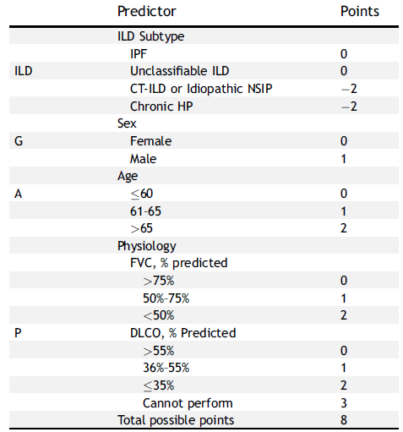
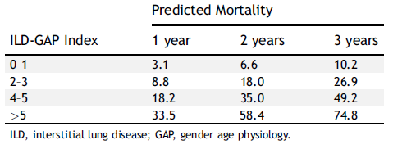
GAP Gender-Age-Physıology index
Ley, B. et al. A multidimensional index and staging system for idiopathic pulmonary fibrosis. Annals of Internal Medicine 2012 156, 684–691,
GAP I
GAP II
GAP III
Han, et al. Prognosis of non-small-cell lung cancer in patients with idiopathicpulmonary fibrosis. Sci Rep 2019;9(1):12561.
Notes:
Onun için bize prognozu gösterebilecek bir index GAP indeksinden bahsetmek istiyorum. Çünkü bazı olgular yavaş bazıarı çok hızlı seyirli olabiliyor ve RT’ye kons. Edilen bir olgunun IAH na bağlı px bilmek en önemli nokta aslında.
Aslında akc. Tx zamanlaması ve hasta seçimi için geliştirilmiş bir prognostik index ve evreleme sisitemi
Cinsiyet, yaş, fulmoner fizyoloji IAH subtipi 0-8 arası skorlamak için kullanılıyor. Mortalite risk tahminleme sonuçlarına göre örn skor0-1 is 3 y mortalite % 10 iken >5 ise oran %75’e çıkıyor.
Şekilde GAP indeksine göre tedavi modalitesine bağlı sağkalım eğrileri görülmekte; Evre I’de en iyi S cerrahiyle elde edilirken, GAP II ve III’te hiçbir tedavi modalitesi AKC ca erken evre/geç evre de olsa değiştirmiyor VE otörler evreI ’DE AKTİF TEDAVİ UYGUN GÖRÜNÜRKEN, ıı VE ıı’TE risk-yarar dengesinin hastayla tartışıldığı ortak karar mekanizmasına ihtiyaç duyulduğu görülmekte. Öte yandan tedavisiz evereI olgunun 1 yıllık mortalitesinin %60 larda olduğunu biliyoruz evre 3 IAH olsa bile bu akc. Cadan ve tedaviye bağlı toksisteden ölüm riskinden çok daha fazla. Yani tedavisiz bırakırsak akc. Kanserinden ölme riski çok daha yüksek. SBRT mortalitesinin ise % ıpf yoksa %15 varsa %33 olduğunu biliyoruz.
Therefore, it is of utmost importance to choose a therapy that is unlikely to induce acute exacerbation of pre-existing IP.
In 2012, Ley et al.16 reported the GAP index and staging system, which can be easily used to predict the mortality and the timing of lung transplantation in IPF patients.-HAN
The GAP and ILD-GAP models could help clinicians more accurately counsel patients with IPF and non-IPF ILDs. This population of patients is substantial, and until now there have been few data to help inform their prognosis. In particular, the ILD-GAP model could help determine the appropriate timing for lung transplantation evaluation in the non-IPF population. For example, patients with an ILD-GAP Index of 0 to 3 have a low expected 1-year mortality and can likely defer referral for lung transplantation evaluation and undergo careful clinical monitoring. Those with an ILD-GAP Index 4, on the other hand, have a substantially higher mortality risk and should be considered for lung transplantation, if appropriate. Additional research is required to determine whether the ILD-GAP model could help direct the use of other therapies, current and future, that may be more appropriate in patients with better or worse prognoses-RYERS
The ILD-GAP model integrates sex, age, pulmonary physiology (forced vital capacity and DLCO), and ILD subtype to provide a score ranging from 0 to 8. In patients
with ILD-GAP score of 0 to 1, three-year mortality is estimated at 10%, whereas scores greater than five are associated with a predicted 3-year mortality of 75%-GOOLDMAN
the higher the modified GAP index, a scoring system for the severity of IPF, the higher the incidence of acute exacerbation of IPF by cytotoxic drugs and the lower the 1-year survival rate-IKEDA
. In GAP stage I, the most significant increase in survival probability was in the surgery group (Fig. 1a; hazard ratio [HR] = 0.233; 95% confidence interval [CI]: 0.094–0.574; p = 0.005). However, unlike GAP stage I, no survival benefit was found in the surgery group as in the GAP stages II and III (Fig. 1b;-han
Evre I KHDAK – tedavisiz .S: 6-8 ay 1y mortalite %60-70 -GOODMAN
Patients with ILD have a variable prognosis, with some individuals surviving years after diagnosis with only a modest decline in lung function, whereas others
experience rapid respiratory decline and death within months. Accurate prognostication is critical to allow patients and physicians to weigh trade-offs between
treatment options and observation. The ILD gender age physiology (ILD-GAP) index is a model for mortality risk prediction in patients with ILD. It was originally derived
and validated as the “GAP risk prediction model” for patients with IPF alone but subsequently extended to other types of ILD (Table 2). This modified ILD-GAP index
was clinically validated in a study of approximately1200 patients with ILD-GOOLDMAN
Before recommending treatment, a radiation oncologist may wish to consider the patient’s ILD-related survival on the basis of their ILD-GAP score. Patients with
lung cancer and lower ILD-GAP scores may be better candidates for curative therapy, given their improved ILD-specific survival, whereas patients with higher ILDGAP
scores may benefit from attenuated-intensity treatments or only observation. As discussed subsequently, it is hypothesized that patients with higher ILDGAP
scores have a higher risk of radiation toxicity.-GOOLDMANN
Even in the absence of lung cancer, the natural history of ILD is variable. Some patients survive many years with only a modest decline in lung function, whereas
other patients experience rapid respiratory decline and death within a few short months-PALMA
the majority of points assigned based on current pulmonary function. Notably, all patients with IPF or unclassifiable ILD have a minimum index of 2 in the ILD-GAP model, reflecting their inferior prognosis. We hypothesize that ILD subtype and severity of pulmonary impairment both influence the risk of radiation toxicity.-PALMA
For patients with ILD and concurrent early-stage lung cancer who are not candidates for surgery, these data showing high rates of toxicity have led to a difficult clinical
dilemma, since there are few alternate treatment options. The option of delivering no treatment whatsoever, which avoids any risk of treatment-related toxicity, is associated
with a high risk of death due to the lung cancer itself. The median survival for untreated stage I NSCLC is only 6–8 months, with 1-year mortality of 60–70% [12], much higher than the risks associated with SABR treatment. For example, in one study of untreated patients with NSCLC in the U.S. National Cancer Database, the median survival for patients with stage I NSCLC who were unfit for an operation was 7.6 months [13]. This suggests that even in patients with an ILDGAP score > 5, the risk of death due to lung cancer within 1 year exceeds the risk of death due to ILD or complications of SABR.-PALMA
As a result, patients with ILD and early-stage NSCLC are often advised, after discussion of their case at a multidisciplinary conference, that treatment with SABR provides the best chance of local control and cure, but that SABR is associated with an appreciable risk of treatment-related toxicity. For patients undergoing SABR under this scenario, the optimal dose and fractionation is unknown.-PALMA
Han et al. [54], in their retrospective review, tried to evaluate the efficacy of lung cancer treatments and the prognosis in lung cancer patients with IPF according to
the lung cancer stage and GAP (gender [G], age [A] and two physiology variables [P]) stage [54]. They showed that in GAP stage I, surgery was significantly associated with
favourable survival outcomes in lung cancer. On the contrary, no treatment modality resulted in significant clinical improvement in GAP stage II/III. The incidences of
adverse events in IPF and its mortality during treatment were 13.8% and 6.3%, respectively. Adverse events occurred commonly in advanced GAP stage. They
concluded that active treatment should be considered in GAP stage I but treatment in GAP stage II/III needs shared decision making weighing up the risks and benefits of the
Treatment-SAHA
Our study provides preliminary evidence supporting the clinical utility of the GAP index, which was prognostic in our ILD patients. The Assessment of Precision Irradiation in Early NSCLC
and Interstitial Lung Disease (ASPIRE-ILD) is a phase II trial (NCT03485378) investigating the benefit of SABR in stage I NSCLC vs a historical untreated control based on the ILD GAP index-TANG
Use of the ILD-GAP index may allow for an informed discussion about the risk of death from NSCLC versus the competing ILD-related mortality calculated for that individual
patient

Slide 25
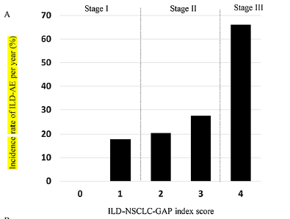
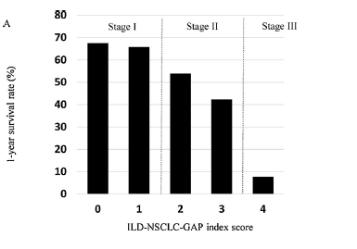
GAP-IAH-KHDAK index
Kobayashi et al. ILD-NSCLC-GAP index scoring and staging system for patients with non-small cell lung cancer and interstitial lung disease. Lung Cancer. 2018 Jul;121:48-53.
ILD subtip
  IPF : 0
  non-IPF : −2
Sex
  Kadın : 0
  Erkek : 1
yaş
  ≤60 : 0
  61–65 : 1
  >65 : 2
%FVC
  > 75% : 0
  50%–75% : 1
  <50% : 2
+
stages I: 0–1
II: 2–3
III: 4–5
Notes:
CO her hastada bakılmadığı için Daha basit modifiye formu KHDAK için geliştirilmiş. (RT dışlanmış) Gruplara göre 1 yılda AE ve 1 yıllık sağkalımlara baktığımızda GAP grubu 1 y AE insidası ve px ile ile yakın ilişkili. Skor arttıkça AE risk artıyor, S azalıyor. Bu indeksi AE ve px u ön görmede kullanabiliriz.
The medical records of 78 patients with NSCLC and ILD who underwent a pulmonary function test before initiation of platinum-based chemotherapy as first-line treatment at the Shizuoka ancer enter between September 2002 and December 2014 were reviewed retrospectively.-Because radiotherapy was considered to be a risk factor for ILDAE
[24,25], patients who underwent chest radiotherapy as first-line treatment were excluded from this study. The ILD-NSCLC-GAP index used in our study was derived from the
original ILD-GAP index [18], with the exclusion of%DLCO reported in our previous study [17],because DLCO is not routinely performed in patients with advanced NSCLC and ILD in clinical settings. Briefly, the ILD-NSCLC-GAP index was used to obtain a total score ranging between 0 and 5: ILD subtype (IPF and unclassifiable ILD, 0; non-IPF, −2), sex(female, 0; male, 1), age (years; ≤60, 0; 61–65, 1; >65, 2), and%FVC ( > 75%, 0; 50%–75%, 1; <50%, 2). Similarly to the original ILDGAP index, patients were categorized into three groups based on the ILD-NSCLC-GAP index score: stages I (0–1), II (2–3), and III (4–5). In addition, we compared the incidence of ILD-AE, one-year survival rate,
and overall survival (OS) among the three ILD-NSCLC-GAP index stages.KOBAYASHI
Fig1. Incidence rate of ILD-AE per year according to the ILD-NSCLC-GAP index scoring and staging system (score 0, n=5; score 1, n=19; score 2, n=13; score 3, n=31; score 4, n=10). (B) The incidence rate of ILD-AE among patients with ILD-NSCLC-GAP stages I (n=24), II (n=44), and III (n=10). ILD-This result suggested that the ILD-NSCLC-GAP index stage was significantly associated with the incidence rate of ILD-AE (P=0.0022).KOBAYASHI
Fig 2. One-year survival rate according to the ILD-NSCLC-GAP index scoring and staging system (score 0, n=5; score 1, n=19; score 2, n=13; score 3, n=31; score 4, n=10). (B) OS curve for patients with the ILD-NSCLCGAP stages I (n=24), II (n=44), and III (n=10). This result showed that the ILD-NSCLC-GAP index stage was significantly associated with prognosis (P=0.0073-KOBAYASHI
The incidence of ILD-AE increased gradually and the one-year survival and median OS rates decreased gradually with increasing ILD-NSCLC-GAP index scores and stages.
Conclusion: The ILD-NSCLC-GAP index scoring and staging system may be a useful tool to calculate a prediction of the incidence of ILD-AE and its prognosis for patients with NSCLC and ILD-The patients with ILD-NSCLC-GAP index stage I may be at low risk for incidence of ILD-AE triggered by chemotherapy and have prolonged survival owing to chemotherapy. On the other hand, the patients with ILD-NSCLC-GAP index stage III could be at high risk for ILD-AE and have difficulty achieving long-term survival. Therefore, the ILD-NSCLC-GAP index
scoring and staging system could be a useful tool to predict the incidence of ILD-AE and its prognosis for patients with NSCLC and ILDKOBAYASHI
ALT BÖLÜM SİLİNİP HAN’IN GAP I ŞEKLİ BURAYA ALINABİLİR

Slide 26
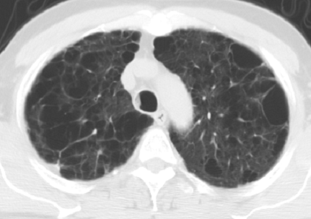
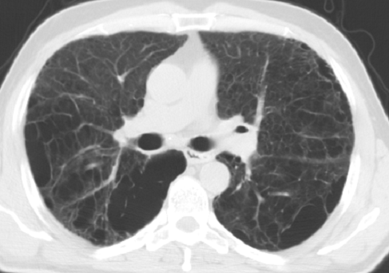
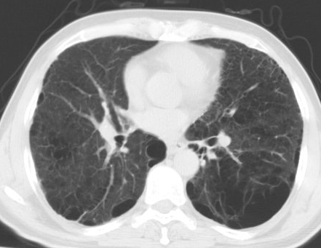
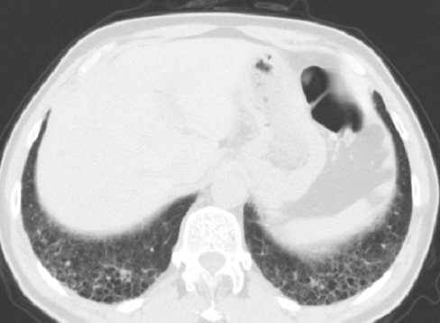
Olgu-1
Tanı Anı (Aralık 2013)
70 y
50p/y - Haziran 2020 stop
IAH tanısı (RA): Aralık 2013
  FEV1 %79
  FVC % 94
  FEV1/FVC: %87
Notes:
Tanı anı bt: Sağ akciğer üst lob apeks ve posteriorunda sekel bant tarzında atelektaziler mevcuttur. Posteriorda subplevral atelektazi ve plevral çekinti gelişmiştir.
Her iki akciğerde yaygın sentrilobüler paraseptal amfizematöz havalanma artışları izlenmektedir. Her iki akciğerde paraseptal düzeyde geniş hava bülleri mevcuttur.
16.11.16BT: Önceki BT tetkikinde tanımlanan sağ akciğer üst lob apikal segmentte posterior subplevral alanda plevral kalınlaşmanın eşlik ettiği, öncelikle sekel lehine değerlendirilen nodüler opasite takipte stabildir.
Her iki akciğer parankimindeki amfizematöz değişiklikler, yer yer izlenen lineer atelektatik bantlar, sağ akciğer orta lob lateral segmentte subplevral parankim alanındaki non-spesifik nodüler opasite artımları, her iki akciğer parankimindeki fibrotik değişiklikler ve diğer parankim bulguları takipte stabildi

Slide 27
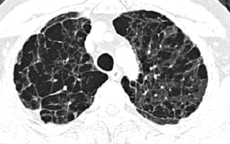
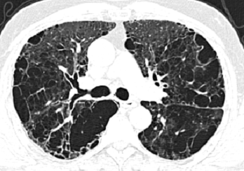
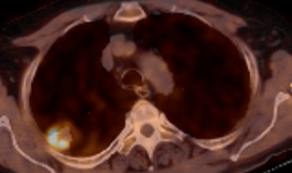
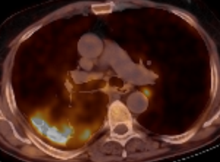
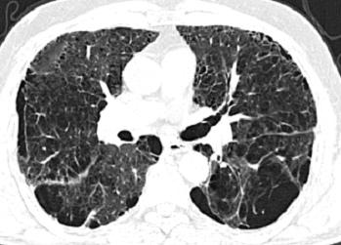
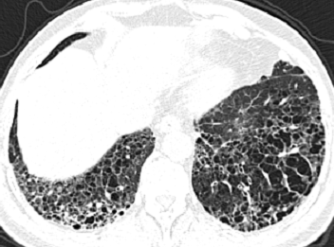
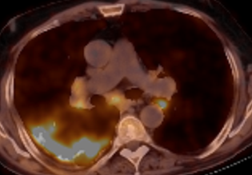
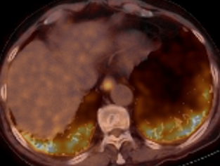
Fibrotik IAH Akc Ca
Skuamöz h.
T1cN3M0 – IIIB
Aralık 2017
Haziran 2022
Skuamöz h. Karsinom T1cN3M0
Fibrozis: UIP paterni (+)
Skuamöz h.
T1cN3M0 – IIIB
Notes:
FDG-PET imaging could be an alternative to assess inflammation and fibrosis, since a recent study has shown that FDG lung uptake may be used to assess IPF severity and to predict
progression-free survival in these patients [33]. The increased uptake found in IPF patients might be related to a metabolic shift towards increased glycolysis, particularly in fibroblasts-DE RUSCHER-NİNTEDANİB
usually located in the peripheral lung zones where fibrotic changes are predominant. They may, therefore, be difficult to detect, particularly if evolving slowly – YIOE
Sadece 1 sene BT çekilmeden pass geçilmiş, sonraki sene ca
Aralık 17 BT: Her iki akciğerde ve orta zonlarda daha belirgin olmak üzere difüz dağılım gösteren destrüktif amfizem bulguları subplevral büller dikkati çekmektedir. Bazal kesimlerde tipik bal peteği görümündk kistik yapılar mevcuttur. Tüm akciğerde intersitisiyel fibrozis ve amfizemin birlikte görülmesine bağlı kalın duvarlı kistik yapılar eski tetkike göre daha belirgindir. Amfizem zemininde UIP paterninde interstisyel fibrozisi düşündüren görünüm mevcuttur. PET: Eş zamanlı BT' de her iki akciğer amfizematö görünümde olup sağ akciğer üst lob posterior segmentte izlenen, posterolateral kostal plevral yüze oturan, yaklaşık 2.4cm uzun akslı lezyonda (SUVmax:7.9), her iki akciğer üst loblarda izlenen yer yer nodüler konsolide alanlarda (SUVmax:4.0) ve sağda belirgin her iki akciğer alt lobunda izlenen yaygın buzlu cam dansitesi ve bal peteği görünümdeki alanlarda (SUVmaks:9.0) artmış 18FDG tutulumu dikkati çekmiştir
Eş zamanlı BT' de her iki alt paratrakeal, subkarinal-paraözefageal (SUVmaks:4.4) ve her iki hiler-interlober bölgede izlenen lenf nodlarında artmış 18FDG tutulumu izlenmiştir.

Slide 28
GAP-IAH-KHDAK index
Kobayashi et al. ILD-NSCLC-GAP index scoring and staging system for patients with non-small cell lung cancer and interstitial lung disease. Lung Cancer. 2018 Jul;121:48-53.
ILD subtip
  IPF : 0
  non-IPF : −2
Sex
  Kadın : 0
  Erkek : 1
yaş
  ≤60 : 0
  61–65 : 1
  >65 : 2
%FVC
  > 75% : 0
  50%–75% : 1
  <50% : 2
+
Notes:
The medical records of 78 patients with NSCLC and ILD who underwent a pulmonary function test before initiation of platinum-based chemotherapy as first-line treatment at the Shizuoka ancer enter between September 2002 and December 2014 were reviewed retrospectively.-Because radiotherapy was considered to be a risk factor for ILDAE
[24,25], patients who underwent chest radiotherapy as first-line treatment were excluded from this study. The ILD-NSCLC-GAP index used in our study was derived from the
original ILD-GAP index [18], with the exclusion of%DLCO reported in our previous study [17],because DLCO is not routinely performed in patients with advanced NSCLC and ILD in clinical settings. Briefly, the ILD-NSCLC-GAP index was used to obtain a total score ranging between 0 and 5: ILD subtype (IPF and unclassifiable ILD, 0; non-IPF, −2), sex(female, 0; male, 1), age (years; ≤60, 0; 61–65, 1; >65, 2), and%FVC ( > 75%, 0; 50%–75%, 1; <50%, 2). Similarly to the original ILDGAP index, patients were categorized into three groups based on the ILD-NSCLC-GAP index score: stages I (0–1), II (2–3), and III (4–5). In addition, we compared the incidence of ILD-AE, one-year survival rate,
and overall survival (OS) among the three ILD-NSCLC-GAP index stages.KOBAYASHI
Fig1. Incidence rate of ILD-AE per year according to the ILD-NSCLC-GAP index scoring and staging system (score 0, n=5; score 1, n=19; score 2, n=13; score 3, n=31; score 4, n=10). (B) The incidence rate of ILD-AE among patients with ILD-NSCLC-GAP stages I (n=24), II (n=44), and III (n=10). ILD-This result suggested that the ILD-NSCLC-GAP index stage was significantly associated with the incidence rate of ILD-AE (P=0.0022).KOBAYASHI
Fig 2. One-year survival rate according to the ILD-NSCLC-GAP index scoring and staging system (score 0, n=5; score 1, n=19; score 2, n=13; score 3, n=31; score 4, n=10). (B) OS curve for patients with the ILD-NSCLCGAP stages I (n=24), II (n=44), and III (n=10). This result showed that the ILD-NSCLC-GAP index stage was significantly associated with prognosis (P=0.0073-KOBAYASHI
The incidence of ILD-AE increased gradually and the one-year survival and median OS rates decreased gradually with increasing ILD-NSCLC-GAP index scores and stages.
Conclusion: The ILD-NSCLC-GAP index scoring and staging system may be a useful tool to calculate a prediction of the incidence of ILD-AE and its prognosis for patients with NSCLC and ILD-The patients with ILD-NSCLC-GAP index stage I may be at low risk for incidence of ILD-AE triggered by chemotherapy and have prolonged survival owing to chemotherapy. On the other hand, the patients with ILD-NSCLC-GAP index stage III could be at high risk for ILD-AE and have difficulty achieving long-term survival. Therefore, the ILD-NSCLC-GAP index
scoring and staging system could be a useful tool to predict the incidence of ILD-AE and its prognosis for patients with NSCLC and ILDKOBAYASHI
ALT BÖLÜM SİLİNİP HAN’IN GAP I ŞEKLİ BURAYA ALINABİLİR

Slide 29
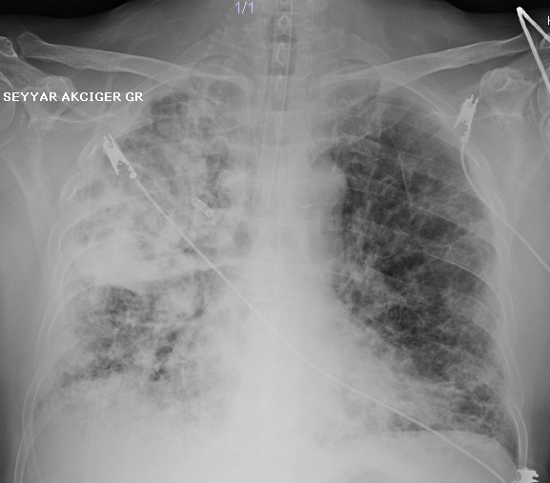
GAP-IAH-KHDAK index
Kobayashi et al. ILD-NSCLC-GAP index scoring and staging system for patients with non-small cell lung cancer and interstitial lung disease. Lung Cancer. 2018 Jul;121:48-53.
ILD subtip
  IPF : 0
  non-IPF : −2
Sex
  Kadın : 0
  Erkek : 1
yaş
  ≤60 : 0
  61–65 : 1
  >65 : 2
%FVC
  > 75% : 0
  50%–75% : 1
  <50% : 2
+
RT önerilmedi – 3 ay sonra solunum yetmezliği ex
stages III: 4
Notes:
The medical records of 78 patients with NSCLC and ILD who underwent a pulmonary function test before initiation of platinum-based chemotherapy as first-line treatment at the Shizuoka ancer enter between September 2002 and December 2014 were reviewed retrospectively.-Because radiotherapy was considered to be a risk factor for ILDAE
[24,25], patients who underwent chest radiotherapy as first-line treatment were excluded from this study. The ILD-NSCLC-GAP index used in our study was derived from the
original ILD-GAP index [18], with the exclusion of%DLCO reported in our previous study [17],because DLCO is not routinely performed in patients with advanced NSCLC and ILD in clinical settings. Briefly, the ILD-NSCLC-GAP index was used to obtain a total score ranging between 0 and 5: ILD subtype (IPF and unclassifiable ILD, 0; non-IPF, −2), sex(female, 0; male, 1), age (years; ≤60, 0; 61–65, 1; >65, 2), and%FVC ( > 75%, 0; 50%–75%, 1; <50%, 2). Similarly to the original ILDGAP index, patients were categorized into three groups based on the ILD-NSCLC-GAP index score: stages I (0–1), II (2–3), and III (4–5). In addition, we compared the incidence of ILD-AE, one-year survival rate,
and overall survival (OS) among the three ILD-NSCLC-GAP index stages.KOBAYASHI
Fig1. Incidence rate of ILD-AE per year according to the ILD-NSCLC-GAP index scoring and staging system (score 0, n=5; score 1, n=19; score 2, n=13; score 3, n=31; score 4, n=10). (B) The incidence rate of ILD-AE among patients with ILD-NSCLC-GAP stages I (n=24), II (n=44), and III (n=10). ILD-This result suggested that the ILD-NSCLC-GAP index stage was significantly associated with the incidence rate of ILD-AE (P=0.0022).KOBAYASHI
Fig 2. One-year survival rate according to the ILD-NSCLC-GAP index scoring and staging system (score 0, n=5; score 1, n=19; score 2, n=13; score 3, n=31; score 4, n=10). (B) OS curve for patients with the ILD-NSCLCGAP stages I (n=24), II (n=44), and III (n=10). This result showed that the ILD-NSCLC-GAP index stage was significantly associated with prognosis (P=0.0073-KOBAYASHI
The incidence of ILD-AE increased gradually and the one-year survival and median OS rates decreased gradually with increasing ILD-NSCLC-GAP index scores and stages.
Conclusion: The ILD-NSCLC-GAP index scoring and staging system may be a useful tool to calculate a prediction of the incidence of ILD-AE and its prognosis for patients with NSCLC and ILD-The patients with ILD-NSCLC-GAP index stage I may be at low risk for incidence of ILD-AE triggered by chemotherapy and have prolonged survival owing to chemotherapy. On the other hand, the patients with ILD-NSCLC-GAP index stage III could be at high risk for ILD-AE and have difficulty achieving long-term survival. Therefore, the ILD-NSCLC-GAP index
scoring and staging system could be a useful tool to predict the incidence of ILD-AE and its prognosis for patients with NSCLC and ILDKOBAYASHI
ALT BÖLÜM SİLİNİP HAN’IN GAP I ŞEKLİ BURAYA ALINABİLİR

Slide 30
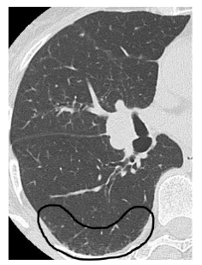
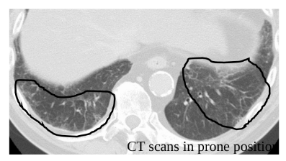
Subklinik IAH
Asemptomatik olgularda insidental radyolojik bulgu
  Tarama programlarında %10-20
  TRT olgularında %18-38
Retiküler anomaliler
Traksiyon bronşiektazi
Bilateral buzlu cam
Bal peteği
Non-amfizematöz kistler
Goodman ve ark JTO-2020
Kobayashi ve ark. Radiat. Oncol. 2021
Notes:
pretreatment HRCT images with an axial slice thickness of 0.1 cm in a lung window.-LI
Bu radyolojik bulgular Subklinik IAH’nın göstergeleri
TRT olgularında %18 dolaylarında-NISKA
TRT olgularında %18-38 gerçek bilinmiyor, tahmin edilen
IAH’NIN PFS ve GS’düşürdüğünü bliyoruz ama subklinik ILA durumunda nasıl bilgimiz net değil.şöyle ki;RP riskini arttığını bildiren yayınlar gelmeye başladı
Typical computed tomography images of interstitial lung abnormalities (ILAs). (a) ILAs accounting for 5% of the area of a lung zone; (b) ILAs accounting for 10% of the area of a lung zone.-KOBAYASHI-2021 SUPP
The increased risk of treatment-related toxicity in patients with NSCLC and ILD is well established, with some suggestion in the literature of increased risk of toxicity even in the setting of subclinical ILD-GOODMANN NISKA İÇİN DİYOR
Recently, Washko et al. proposed the concept of interstitial lung abnormalities (ILA) to evaluate interstitial change on HRCT (15,16). ILA was defined as particular patterns of increased lung density affecting >5% of any lung zone, including ground-glass or reticular abnormalities, diffuse centrilobular nodularity, nonemphysematous cysts, honeycombing, or traction bronchiectasis. The clinical characteristics of patients with ILA have been reported for several cohorts
Nishino et al. reported that ILA was identified in 14% of treatment-naïve advanced non-small-cell lung cancer patients and was associated with shorter survival (17). However, the clinical impact of ILA in patients with locally advanced lung cancer is unknown. In particular, the risk of chemoradiotherapy for patients with ILA is an issue to be investigate-HIGO
İnterstitial changes on CT, such as subpleural reticular opacities, honeycombing and traction bronchiectasis, were risk factors of severe radiation pneumonitis (31). We need careful observation when undergo chemoradiotherapy for the patients with ILA.-HIGO SANUKI YAYINI İÇİN DİYOR AMA BENDE YOK
In addition, the survival rate of the ILA group was not significantly lower than that of the no-ILA group. In contrast, previous study of Stage IV non-small-cell lung cancer
patients with ILA showed the shorter survival time (17). A possible cause of the conflicting results is difference of patient selection. Our study excludes the patients who do not receive chemoradiotherapy and it may result in selecting patients with ILA who have good condition, whereas the previous study includes patients with or without
chemotherapy (17). Another possible cause is small sample size. Although the difference was not significant, the survival rate of the ILA group was lower than that of the no-ILA group and the relationship between ILA and shorter survival may be significant in a large-scale study. Therefore, we cannot completely ignore the risk of
chemoradiotherapy in this patient population. Patients with locally advanced disease have decisive difference from those with Stage IV disease. They have a chance of cure at certain rate. Whether patients receive the treatment even if they take a certain risk is a choice that takes their view of life. Therefore, large-scale studies investigating
the survival of patients with locally advanced lung cancer and ILA treated with chemoradiotherapy are needed to find a safer patient population.-HIGO
However, up to 10% of smokers7 and up to 18% of patients who have undergone TRT5 have asymptomatic subclinical ILD as an incidental finding on CT. The risk of RP among these patients has been poorly characterized. Yamaguchi et al5,6 suggest that patients with extensive subclinical ILD should be treated with caution owing
to potential increased risk for fatal RP. However, limited subclinical ILD has not yet been associated with fatal RP. We present 2 cases of fatal RP in patients with limited subclinical IPF found incidentally on pretreatment CT.-NISKA
Tarama BT’lerinde %10-20 dolaylarında, kanser olgularında daha yüksek olabilir-Kobayashi SCLC de %38 oranında-KOBAYASHI 2021

Slide 31
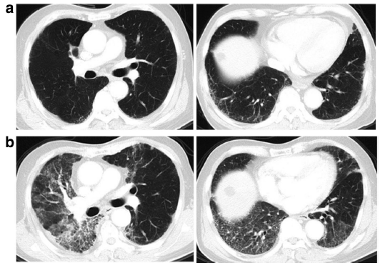
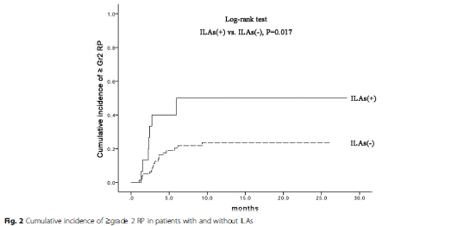
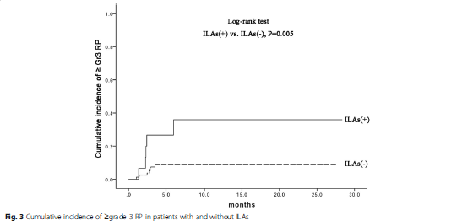
Subklinik IAH - RP
Li ve ark. Preexisting radiological interstitial lung abnormalities are a risk factor for severe radiation pneumonitis in patients with small-cell lung cancer after thoracic radiation therapy. Radiat Oncol 2018;13(1):82.
Pre-RT : bilateral subplevral retiküler anomaliler
≥Derece 2 %50 vs %23 p=0.017
RP
Post-RT : bilateral diffüz interstisyei infiltrasyon-konsolidasyon
≥Derece 3 %36 vs % 9 p=0.005
RP
Notes:
The total dose was ≥60 Gy in limited-stage SCLC and ≥ 50 Gy in extensivestage SCLC, generally delivered at 2.0 Gy/(fraction ⋅ day, five fractions per week.Radyolojik akc abnormalitesi + olan 15 olgu ve olmayan 80 olgu-retrospektif IMRT
G2: 27 (31.0%), G3:10 (11.5%), G4: three (3.4%), and G5: five (5.7%)
SUBKLİNİK hastalık: SX YOK-TEDAVİ YOK da öte, radyolojik anomaliler de risk f.
The widespread use of high-resolution computed tomography (HRCT) in clinical applications has facilitated the detection
of ILAs in asymptomatic and undiagnosed individuals-Lİ
Interstitial lung abnormalities (ILAs) have a higher incidence in patients with lung cancer compared with the general population [13–15]. Radiographic ILAs were present in 14% of treatment-naïve patients with advanced non-small-cell lung carcinoma
HRCT’de interstisyel değişiklikler:honeycombing, subpleural reticular opacities, ground-glass opacity, and traction bronchiectasis, nonemphysematous cysts: IAH bulguları
Fig.A 75-year-old male with small-cell lung cancer having preexisting radiological ILAs who developed RP beyond radiation field after TRT. a
Prior to RT, initial HRCT exhibited subpleural reticular opacities at levels of bilateral lower lobes. b 60 Gy in 30 fractions was delivered to a
pulmonary tumor in the right upper lobe with mediastinum and right hilar lymphadenopathy. Three weeks after completing RT, the patient
developed diffuse interstitial infiltration and consolidation extending beyond radiation field

Slide 32
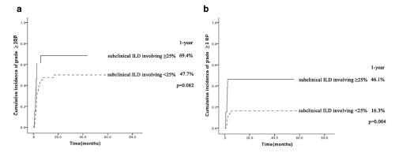
Subklinik IAH tutulu akciğer vol - RP
Li et al. Risk factors for radiation pneumonitis in lung cancer patients with subclinical interstitial lung disease after thoracic radiation therapy.
Radiat Oncol 16, 70 (2021).
≥ G2 RP
≥ G3 RP
Subklinik İAH ≥%25 akc vol
Subklinik İAH < %25 akc vol
Subklinik İAH ≥%25 akc vol
Subklinik İAH < %25 akc vol
Notes:
IMRT-retrospective intensity-modulated radiation therapy with a prescribed dose of ≥ 50 Gy-87 pt
(G2: 13.7%), G3:12 (12.6%), G4-5 yok
Although the percentage of lung volume affected in subclinical ILD did not significantly increase the cumulative incidence of grade ≥ 2 RP (69.4%vs.47.7%, p = 0.082, Fig. 1a), the cumulative incidence of grade ≥ 3 RP was significantly higher in patients with subclinical ILD involving ≥ 25% of lung volume than those with < 25% involvement of lung volume (46.1% vs. 16.3%, p = 0.004, Fig. 1b).-Lİ
Previous studies found that patients withsubclinical ILD were more susceptible to developing RP after thoracic radiation therapy-Lİ
It was difficult to accurately distinguish RP from other types of pneumonitis, because RP is a clinical diagnosis, and can be confounded by preexisting or comorbid disease, including subclinical ILD exacerbations, tumor progression, or infection.-Lİ

Slide 33
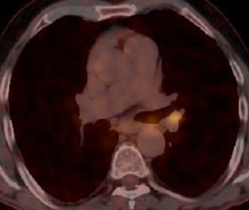
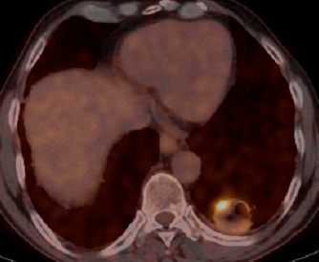
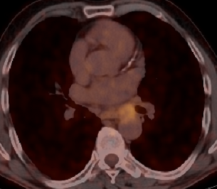
Olgu-2
62 y
40p/y
Ek hastalık: Ø
Skuamöz h - T2aN2M0 - IIIA
Eş zamanlı KRT (63 Gy-2 kür CE) Şubat 2016’da tamamlanıyor
MLD: 14.2 Gy V20: %28 V5: %56
Notes:
Pet: Eş zamanlı BT'de her iki akciğerde bazal kesimde belirgin milimetrik fibronodüler dansite artımları ve üst zonda bal peteği ile buzlucam görünümü dikkati çekmiş olup sol akciğer alt lobda yerleşimli yaklaşık 3.6x3.3cm boyutlu kaviter parankim lezyonu ile uyumlu alanda çevresel artmış (SUVmax:11.6) 18FDG tutulumu izlenmiştir. Yine eş zamanlı BT'de sol inferior pulmoner ven ile torasik aorta arasında izlenen yaklaşık 1.6cm kısa akslı lenf nodu (SUVmax:7.4), sol hiler bölgede izlenen yaklaşık 1.1cm kısa akslı lenf nodu (SUVmax:8.4) ile uyumlu alanda artmış 18FDG tutulumu izlenmiştir. Ayrıca eş zamanlı BT'de sol atrium ile torasik aorta arasında izlenen yaklaşık 1cm (SUVmax:3.0), subkarinal (SUVmax:2.9), bilateral alt paratrakeal (SUVmax:3.2), aortikopulmoner ve paraaortik (SUVmax:2.5) bölgede izlenen subsantimetrik-milimetrik boyutlu lenf nodları ile uyumlu alanda mediastinal vasküler yapılardan hafif yüksek düzeyde, sol sürrenal bezde izlenen yaklaşık 0.8cm çaplı nodüler kalınlaşma ile uyumlu alanda çevre doku ile eş düzeyde 18FDG tutulumu izlenmiştir.
RT sırasında adaptif için11.1.16: Önceki PET BT tetkikinde mediastende sol inferior ven ile torasik aorta arasında tariflenen lenf bezinin kısa aksının 16mm den 12mm ye , sağ alt paratrakeal bölgede izlenen lenf bezinin kısa aksının 12mm den 9mm ye regresyonu görülmeketdir, sol hiler bölgede kısa aksı 14mm boyutunda ölçülen lenf bezinde anlamlı boyutsal farklılık saptanmamıştır.
Mediastende mevcut diğer lenf bezleri takipte stabildir.,
Sol akciğer alt lobda postero bazal segmentte yerleşimli kaviter kitlesel oluşum güncel tetkikte 3,5x2,8cm boyutunda ölçülmüştür ve kısmi volümetrik regresyon izlenmektedir.
Her iki akciğer parankimindeki pulmoner fibrozis lehine intersisyel opasite artımları , nonspesifik milimetrik nodüler oluşumlar , amfizematöz değişiklikler ve diğer parankim bulguları takipte stabildir.Güncel tetkikte yeni gelişen metastatik natürde nodüler oluşum veya aktif infiltrasyon bulgusu ayırt edilmemişti
PET: 21.1.16. Önceki çalışmaya göre boyutunda küçülme ve tama yakın anlamlı metabolik yanıt izlenen sol akciğer alt lobda yerleşimli yaklaşık 2.8x2.4 cm (önceki 3.6x3.3cm) boyutlu kaviter parankim lezyonu ile uyumlu alanda hafif düzeyde artmış 18FDG tutulumu izlenmiştir.
- Önceki çalışmaya göre bazıları izlenmeyen, diğerlerinde küçülme ve aktivitesinde azalmanın dikkati çektiği sol inferior pulmoner ven ile torasik aorta arasında, subkarinal, sağ alt paratrakeal, aortikopulmoner pencere, sol hiler bölgede subsantimetrik-milimetrik boyutlu lenf nodları ile uyumlu alanda mediastinal vasküler yapılarla eş veya hafif yüksek düzeyde 18FDG tutulumu izlenmiştir.

Slide 34
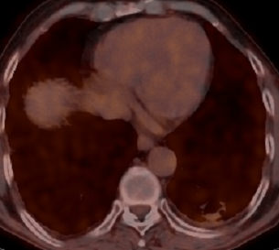
Olgu-2
62 y
40p/y
Ek hastalık: Ø
Skuamöz h - T2aN2M0 - IIIA
Eş zamanlı KRT (63 Gy-2 kür CE) Şubat 2016’da tamamlanıyor
MLD: 14.2 Gy V20: %28 V5: %56
Notes:
Pet: Eş zamanlı BT'de her iki akciğerde bazal kesimde belirgin milimetrik fibronodüler dansite artımları ve üst zonda bal peteği ile buzlucam görünümü dikkati çekmiş olup sol akciğer alt lobda yerleşimli yaklaşık 3.6x3.3cm boyutlu kaviter parankim lezyonu ile uyumlu alanda çevresel artmış (SUVmax:11.6) 18FDG tutulumu izlenmiştir. Yine eş zamanlı BT'de sol inferior pulmoner ven ile torasik aorta arasında izlenen yaklaşık 1.6cm kısa akslı lenf nodu (SUVmax:7.4), sol hiler bölgede izlenen yaklaşık 1.1cm kısa akslı lenf nodu (SUVmax:8.4) ile uyumlu alanda artmış 18FDG tutulumu izlenmiştir. Ayrıca eş zamanlı BT'de sol atrium ile torasik aorta arasında izlenen yaklaşık 1cm (SUVmax:3.0), subkarinal (SUVmax:2.9), bilateral alt paratrakeal (SUVmax:3.2), aortikopulmoner ve paraaortik (SUVmax:2.5) bölgede izlenen subsantimetrik-milimetrik boyutlu lenf nodları ile uyumlu alanda mediastinal vasküler yapılardan hafif yüksek düzeyde, sol sürrenal bezde izlenen yaklaşık 0.8cm çaplı nodüler kalınlaşma ile uyumlu alanda çevre doku ile eş düzeyde 18FDG tutulumu izlenmiştir.
RT sırasında adaptif için11.1.16: Önceki PET BT tetkikinde mediastende sol inferior ven ile torasik aorta arasında tariflenen lenf bezinin kısa aksının 16mm den 12mm ye , sağ alt paratrakeal bölgede izlenen lenf bezinin kısa aksının 12mm den 9mm ye regresyonu görülmeketdir, sol hiler bölgede kısa aksı 14mm boyutunda ölçülen lenf bezinde anlamlı boyutsal farklılık saptanmamıştır.
Mediastende mevcut diğer lenf bezleri takipte stabildir.,
Sol akciğer alt lobda postero bazal segmentte yerleşimli kaviter kitlesel oluşum güncel tetkikte 3,5x2,8cm boyutunda ölçülmüştür ve kısmi volümetrik regresyon izlenmektedir.
Her iki akciğer parankimindeki pulmoner fibrozis lehine intersisyel opasite artımları , nonspesifik milimetrik nodüler oluşumlar , amfizematöz değişiklikler ve diğer parankim bulguları takipte stabildir.Güncel tetkikte yeni gelişen metastatik natürde nodüler oluşum veya aktif infiltrasyon bulgusu ayırt edilmemişti
PET: 21.1.16. Önceki çalışmaya göre boyutunda küçülme ve tama yakın anlamlı metabolik yanıt izlenen sol akciğer alt lobda yerleşimli yaklaşık 2.8x2.4 cm (önceki 3.6x3.3cm) boyutlu kaviter parankim lezyonu ile uyumlu alanda hafif düzeyde artmış 18FDG tutulumu izlenmiştir.
- Önceki çalışmaya göre bazıları izlenmeyen, diğerlerinde küçülme ve aktivitesinde azalmanın dikkati çektiği sol inferior pulmoner ven ile torasik aorta arasında, subkarinal, sağ alt paratrakeal, aortikopulmoner pencere, sol hiler bölgede subsantimetrik-milimetrik boyutlu lenf nodları ile uyumlu alanda mediastinal vasküler yapılarla eş veya hafif yüksek düzeyde 18FDG tutulumu izlenmiştir.

Slide 35
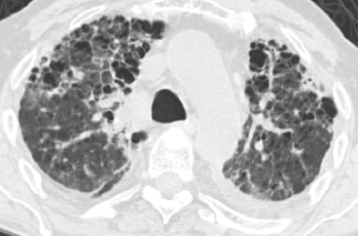
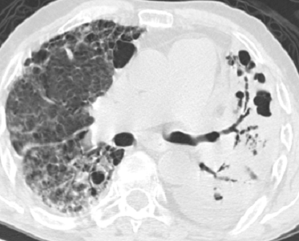
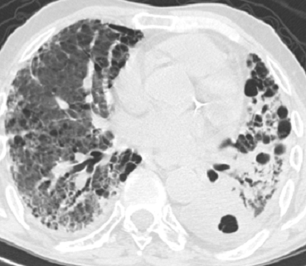
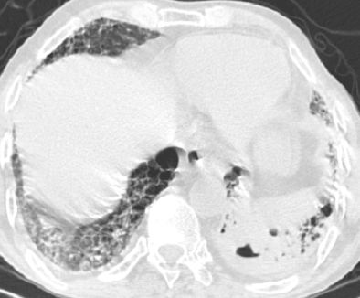
Pre-RT – GAP: 0 Post-RT 12. ay – IPF (UIP)
KRT sonrası 12. ay
öksürük-balgam
IAH tanısı Şubat 2017
Antifibrotik (+)
Notes:
Mart 2016 fibroziste artış başlıyor: Önceki BT tetkikinde izlenen sol hiler bölgede yerleşimli lenf bezinin kısa aksında 14mm'den 6mm'ye boyutsal regresyon izlenmiştir. Mediastende mevcut diğer lenf bezleri takipte stabil boyut ve özelliktedir. Yeni gelişen LAP saptanmamıştır.
Kesitler akciğer parankim penceresinde değerlendirildiğinde, sol akciğer alt lob posterobazal segmentte yerleşimli kaviter kitlesel oluşum güncel tetkikte 3.1x2.4cm boyutunda ölçülmüştür ve kısmi volümetrik regresyon izlenmiştir. Ayrıca kitlenin kaviter komponentinde artış, solid komponentinde ise azalma dikkati çekmektedir.
Her iki akciğer parankimindeki pulmoner fibrozis lehine interstisyel opasite artımları güncel tetkikte de mevcut olup, sol akciğer alt lob parankimindeki buzlu cam dansitelerinde artış izlenmektedir (fibrozisin progresyonu?, aktif alveolit fazı-enfeksiyöz süreç?). Hastanın kliniği ile birlikte değerlendirme uygun olacaktır.
Her iki akciğer parankimindeki nonspesifik milimetrik nodüler oluşumlar, amfizematöz değişiklikler ve diğer parankim bulguları takipte stabil olarak izlenmektedir.
Haziran 2016: Olguda sol akciğer alt lob posterior bazal segment düzeyinde subplevral alanda posteriorda tanımlanan içerisinde intrakaviter yumuşak doku komponentleri de içeren 24x31mm ebatlardaki kalın duvarlı kavitenin belirgin regresyon göstererek yeni BT tetkikinde en geniş aksta 1.5cm çapta izlendiği izlenmektedir. Kavite içerisinde izlenen solid komponetlerin tam regresyon gösterdiği ve kavite duvarının inceldiği görülmektedir. Bulgular anlamlı regresyon lehine değerlendirilmiştir. Ancak önceki BT tetkikinden farklı olarak sol hemitoraksta apeksten bazale dek uzanan ve kalınlığı 2.5cm'ye ulaşan ve majör fissür içerisine de ilerleyen efüzyonun oluştuğu saptanmıştır.
Sol akciğer alt lob parankiminde olasılıkla RT süreçlerine sekonder gelişen buzlu cam görünümleri ve fibrozis bulgularının belirginleştiği dikkati çekmektedir.
Diğer parankimal bulgular stabildir.
Mediastende patolojik boyutta lenf bezi saptanmadı.
Sol hiler lenf nodundaki regresyon düzeyinin stabil olarak devam ettiği görülmektedir.
Temmuz 2016: kciğer Ca tanısı ile takip edilen olguda , o dönemde izlenen sol akciğerde alt lob majör fissür düzeyinde izlenen düşük dansiteli loküle plevral sıvı (fantom tm ?) yönünden anlamlı olabilecek nodüler lezyonda regresyon saptanmıştır . Yine sol hemitoraksta yer yer loküle çekintiler oluşturan plevral efüzyonda da regresyon mevcuttur .
Sağ akciğerde üst lob apikal -posterior segmentte yeni gelişen retiküler buzlu cam dansitesinde fokal opasite artımları mevcuttur .
Bunun dışında o dönemde izlenen her iki akciğer alt loblar düzeyinde subplevral alanda belirginlik gösteren yer yer bal peteği tutulum paterni oluşturan İPF ile uyumlu bulgular , yine her iki akciğerde bazıları pseudokavitasyon gösteren 4-5mm yi geçmeyen nodüler lezyonlar , sol akciğer alt lob düzeyinde subplevral alanda tanımlanan regrese nodüler lezyon , mediastinal kısa aksları 5-6mm yi geçmeyen lenf bezleri , sekel amfizematöz değişiklikler ve diğer bulgularda belirgin farklılık saptanmamıştır ,
stabildir .
Kasım 2016: Her iki akciğerde yaygın , yer yer belirginleşen parankimal ve subplevral hava kistleri ile birlikte izlenen amfizem görünümü , bazal kesimlerde belirginleşen inhomojen dağılım gösteren yaygın buzlucam dansitesi ile septal ve peribronşial kalınlaşmalar tarzında interstisyel infiltratif lezyonlar vardır . Sol üst lob lingüler ve solalt lob anterobazal segmentte bu infiltrasyonlar yer yer hava bronkogramları içeren konsolidatif görünüm kazanmaktadır . Sol hemitoraks orta ve alt posteriorda milimetrik serbest plevral sıvı vardır . Kronik zeminde akut enfeksiyöz infiltrasyon düşünülmüştür .
Şubat 2017: Hastanın bir önceki incelemesinde de izlenen her iki akciğerde yaygın İPF ile uyumlu bal peteği akciğer görünümleri izlenmektedir. Sol hemitoraksta izlenen konsoldasyon alanlarında belirgin progresyon mevcuttur.Bir önceki incelemede izlenmeyen sağ akciğer alt lob superior segment ve posterior bazal segmentler düzeyinde 5cm boyutlara ulaşan kaviter kitlesel lezyonlar izlenmektedir. Malignite ? enfeksiyöz ? Hastanın kliniği ile birlikte değerlendirilmesi gereklilik halinde PET BT ile incelenmesi önerilir. ağ akciğerde izlenen üst ve alt loblar düzeyindeki buzlu cam dansitesinde sentriasiner opasite artımları benzer görünümdedir.

Slide 36
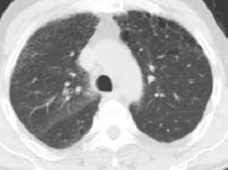
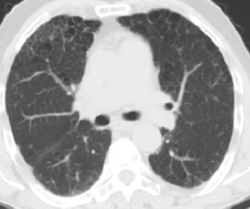
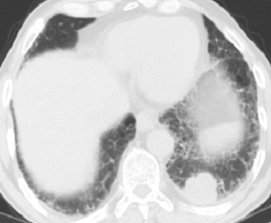
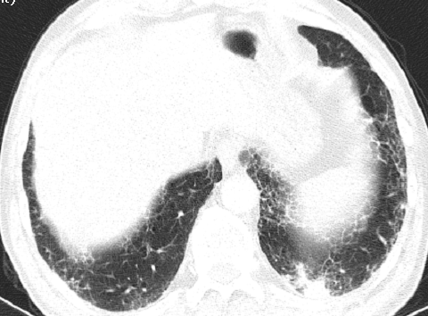
Pre-RT – GAP: 2 Post-RT 12. ay – IPF (UIP)
Notes:
Mart 2016 fibroziste artış başlıyor: Önceki BT tetkikinde izlenen sol hiler bölgede yerleşimli lenf bezinin kısa aksında 14mm'den 6mm'ye boyutsal regresyon izlenmiştir. Mediastende mevcut diğer lenf bezleri takipte stabil boyut ve özelliktedir. Yeni gelişen LAP saptanmamıştır.
Kesitler akciğer parankim penceresinde değerlendirildiğinde, sol akciğer alt lob posterobazal segmentte yerleşimli kaviter kitlesel oluşum güncel tetkikte 3.1x2.4cm boyutunda ölçülmüştür ve kısmi volümetrik regresyon izlenmiştir. Ayrıca kitlenin kaviter komponentinde artış, solid komponentinde ise azalma dikkati çekmektedir.
Her iki akciğer parankimindeki pulmoner fibrozis lehine interstisyel opasite artımları güncel tetkikte de mevcut olup, sol akciğer alt lob parankimindeki buzlu cam dansitelerinde artış izlenmektedir (fibrozisin progresyonu?, aktif alveolit fazı-enfeksiyöz süreç?). Hastanın kliniği ile birlikte değerlendirme uygun olacaktır.
Her iki akciğer parankimindeki nonspesifik milimetrik nodüler oluşumlar, amfizematöz değişiklikler ve diğer parankim bulguları takipte stabil olarak izlenmektedir.
Haziran 2016: Olguda sol akciğer alt lob posterior bazal segment düzeyinde subplevral alanda posteriorda tanımlanan içerisinde intrakaviter yumuşak doku komponentleri de içeren 24x31mm ebatlardaki kalın duvarlı kavitenin belirgin regresyon göstererek yeni BT tetkikinde en geniş aksta 1.5cm çapta izlendiği izlenmektedir. Kavite içerisinde izlenen solid komponetlerin tam regresyon gösterdiği ve kavite duvarının inceldiği görülmektedir. Bulgular anlamlı regresyon lehine değerlendirilmiştir. Ancak önceki BT tetkikinden farklı olarak sol hemitoraksta apeksten bazale dek uzanan ve kalınlığı 2.5cm'ye ulaşan ve majör fissür içerisine de ilerleyen efüzyonun oluştuğu saptanmıştır.
Sol akciğer alt lob parankiminde olasılıkla RT süreçlerine sekonder gelişen buzlu cam görünümleri ve fibrozis bulgularının belirginleştiği dikkati çekmektedir.
Diğer parankimal bulgular stabildir.
Mediastende patolojik boyutta lenf bezi saptanmadı.
Sol hiler lenf nodundaki regresyon düzeyinin stabil olarak devam ettiği görülmektedir.
Temmuz 2016: kciğer Ca tanısı ile takip edilen olguda , o dönemde izlenen sol akciğerde alt lob majör fissür düzeyinde izlenen düşük dansiteli loküle plevral sıvı (fantom tm ?) yönünden anlamlı olabilecek nodüler lezyonda regresyon saptanmıştır . Yine sol hemitoraksta yer yer loküle çekintiler oluşturan plevral efüzyonda da regresyon mevcuttur .
Sağ akciğerde üst lob apikal -posterior segmentte yeni gelişen retiküler buzlu cam dansitesinde fokal opasite artımları mevcuttur .
Bunun dışında o dönemde izlenen her iki akciğer alt loblar düzeyinde subplevral alanda belirginlik gösteren yer yer bal peteği tutulum paterni oluşturan İPF ile uyumlu bulgular , yine her iki akciğerde bazıları pseudokavitasyon gösteren 4-5mm yi geçmeyen nodüler lezyonlar , sol akciğer alt lob düzeyinde subplevral alanda tanımlanan regrese nodüler lezyon , mediastinal kısa aksları 5-6mm yi geçmeyen lenf bezleri , sekel amfizematöz değişiklikler ve diğer bulgularda belirgin farklılık saptanmamıştır ,
stabildir .
Kasım 2016: Her iki akciğerde yaygın , yer yer belirginleşen parankimal ve subplevral hava kistleri ile birlikte izlenen amfizem görünümü , bazal kesimlerde belirginleşen inhomojen dağılım gösteren yaygın buzlucam dansitesi ile septal ve peribronşial kalınlaşmalar tarzında interstisyel infiltratif lezyonlar vardır . Sol üst lob lingüler ve solalt lob anterobazal segmentte bu infiltrasyonlar yer yer hava bronkogramları içeren konsolidatif görünüm kazanmaktadır . Sol hemitoraks orta ve alt posteriorda milimetrik serbest plevral sıvı vardır . Kronik zeminde akut enfeksiyöz infiltrasyon düşünülmüştür .
Şubat 2017: Hastanın bir önceki incelemesinde de izlenen her iki akciğerde yaygın İPF ile uyumlu bal peteği akciğer görünümleri izlenmektedir. Sol hemitoraksta izlenen konsoldasyon alanlarında belirgin progresyon mevcuttur.Bir önceki incelemede izlenmeyen sağ akciğer alt lob superior segment ve posterior bazal segmentler düzeyinde 5cm boyutlara ulaşan kaviter kitlesel lezyonlar izlenmektedir. Malignite ? enfeksiyöz ? Hastanın kliniği ile birlikte değerlendirilmesi gereklilik halinde PET BT ile incelenmesi önerilir. ağ akciğerde izlenen üst ve alt loblar düzeyindeki buzlu cam dansitesinde sentriasiner opasite artımları benzer görünümdedir.

Slide 37


Post-RT 6. ay Post-RT 12. ay – IPF (UIP)
Notes:
Mart 2016 fibroziste artış başlıyor: Önceki BT tetkikinde izlenen sol hiler bölgede yerleşimli lenf bezinin kısa aksında 14mm'den 6mm'ye boyutsal regresyon izlenmiştir. Mediastende mevcut diğer lenf bezleri takipte stabil boyut ve özelliktedir. Yeni gelişen LAP saptanmamıştır.
Kesitler akciğer parankim penceresinde değerlendirildiğinde, sol akciğer alt lob posterobazal segmentte yerleşimli kaviter kitlesel oluşum güncel tetkikte 3.1x2.4cm boyutunda ölçülmüştür ve kısmi volümetrik regresyon izlenmiştir. Ayrıca kitlenin kaviter komponentinde artış, solid komponentinde ise azalma dikkati çekmektedir.
Her iki akciğer parankimindeki pulmoner fibrozis lehine interstisyel opasite artımları güncel tetkikte de mevcut olup, sol akciğer alt lob parankimindeki buzlu cam dansitelerinde artış izlenmektedir (fibrozisin progresyonu?, aktif alveolit fazı-enfeksiyöz süreç?). Hastanın kliniği ile birlikte değerlendirme uygun olacaktır.
Her iki akciğer parankimindeki nonspesifik milimetrik nodüler oluşumlar, amfizematöz değişiklikler ve diğer parankim bulguları takipte stabil olarak izlenmektedir.
Haziran 2016: Olguda sol akciğer alt lob posterior bazal segment düzeyinde subplevral alanda posteriorda tanımlanan içerisinde intrakaviter yumuşak doku komponentleri de içeren 24x31mm ebatlardaki kalın duvarlı kavitenin belirgin regresyon göstererek yeni BT tetkikinde en geniş aksta 1.5cm çapta izlendiği izlenmektedir. Kavite içerisinde izlenen solid komponetlerin tam regresyon gösterdiği ve kavite duvarının inceldiği görülmektedir. Bulgular anlamlı regresyon lehine değerlendirilmiştir. Ancak önceki BT tetkikinden farklı olarak sol hemitoraksta apeksten bazale dek uzanan ve kalınlığı 2.5cm'ye ulaşan ve majör fissür içerisine de ilerleyen efüzyonun oluştuğu saptanmıştır.
Sol akciğer alt lob parankiminde olasılıkla RT süreçlerine sekonder gelişen buzlu cam görünümleri ve fibrozis bulgularının belirginleştiği dikkati çekmektedir.
Diğer parankimal bulgular stabildir.
Mediastende patolojik boyutta lenf bezi saptanmadı.
Sol hiler lenf nodundaki regresyon düzeyinin stabil olarak devam ettiği görülmektedir.
Temmuz 2016: kciğer Ca tanısı ile takip edilen olguda , o dönemde izlenen sol akciğerde alt lob majör fissür düzeyinde izlenen düşük dansiteli loküle plevral sıvı (fantom tm ?) yönünden anlamlı olabilecek nodüler lezyonda regresyon saptanmıştır . Yine sol hemitoraksta yer yer loküle çekintiler oluşturan plevral efüzyonda da regresyon mevcuttur .
Sağ akciğerde üst lob apikal -posterior segmentte yeni gelişen retiküler buzlu cam dansitesinde fokal opasite artımları mevcuttur .
Bunun dışında o dönemde izlenen her iki akciğer alt loblar düzeyinde subplevral alanda belirginlik gösteren yer yer bal peteği tutulum paterni oluşturan İPF ile uyumlu bulgular , yine her iki akciğerde bazıları pseudokavitasyon gösteren 4-5mm yi geçmeyen nodüler lezyonlar , sol akciğer alt lob düzeyinde subplevral alanda tanımlanan regrese nodüler lezyon , mediastinal kısa aksları 5-6mm yi geçmeyen lenf bezleri , sekel amfizematöz değişiklikler ve diğer bulgularda belirgin farklılık saptanmamıştır ,
stabildir .
Kasım 2016: Her iki akciğerde yaygın , yer yer belirginleşen parankimal ve subplevral hava kistleri ile birlikte izlenen amfizem görünümü , bazal kesimlerde belirginleşen inhomojen dağılım gösteren yaygın buzlucam dansitesi ile septal ve peribronşial kalınlaşmalar tarzında interstisyel infiltratif lezyonlar vardır . Sol üst lob lingüler ve solalt lob anterobazal segmentte bu infiltrasyonlar yer yer hava bronkogramları içeren konsolidatif görünüm kazanmaktadır . Sol hemitoraks orta ve alt posteriorda milimetrik serbest plevral sıvı vardır . Kronik zeminde akut enfeksiyöz infiltrasyon düşünülmüştür .
Şubat 2017: Hastanın bir önceki incelemesinde de izlenen her iki akciğerde yaygın İPF ile uyumlu bal peteği akciğer görünümleri izlenmektedir. Sol hemitoraksta izlenen konsoldasyon alanlarında belirgin progresyon mevcuttur.Bir önceki incelemede izlenmeyen sağ akciğer alt lob superior segment ve posterior bazal segmentler düzeyinde 5cm boyutlara ulaşan kaviter kitlesel lezyonlar izlenmektedir. Malignite ? enfeksiyöz ? Hastanın kliniği ile birlikte değerlendirilmesi gereklilik halinde PET BT ile incelenmesi önerilir. ağ akciğerde izlenen üst ve alt loblar düzeyindeki buzlu cam dansitesinde sentriasiner opasite artımları benzer görünümdedir.

Slide 38

Post-RT 6. ay Post-RT 12. ay – IPF (UIP)
Notes:
Temmuz 2017 ex
Mart 2016 fibroziste artış başlıyor: Önceki BT tetkikinde izlenen sol hiler bölgede yerleşimli lenf bezinin kısa aksında 14mm'den 6mm'ye boyutsal regresyon izlenmiştir. Mediastende mevcut diğer lenf bezleri takipte stabil boyut ve özelliktedir. Yeni gelişen LAP saptanmamıştır.
Kesitler akciğer parankim penceresinde değerlendirildiğinde, sol akciğer alt lob posterobazal segmentte yerleşimli kaviter kitlesel oluşum güncel tetkikte 3.1x2.4cm boyutunda ölçülmüştür ve kısmi volümetrik regresyon izlenmiştir. Ayrıca kitlenin kaviter komponentinde artış, solid komponentinde ise azalma dikkati çekmektedir.
Her iki akciğer parankimindeki pulmoner fibrozis lehine interstisyel opasite artımları güncel tetkikte de mevcut olup, sol akciğer alt lob parankimindeki buzlu cam dansitelerinde artış izlenmektedir (fibrozisin progresyonu?, aktif alveolit fazı-enfeksiyöz süreç?). Hastanın kliniği ile birlikte değerlendirme uygun olacaktır.
Her iki akciğer parankimindeki nonspesifik milimetrik nodüler oluşumlar, amfizematöz değişiklikler ve diğer parankim bulguları takipte stabil olarak izlenmektedir.
Haziran 2016: Olguda sol akciğer alt lob posterior bazal segment düzeyinde subplevral alanda posteriorda tanımlanan içerisinde intrakaviter yumuşak doku komponentleri de içeren 24x31mm ebatlardaki kalın duvarlı kavitenin belirgin regresyon göstererek yeni BT tetkikinde en geniş aksta 1.5cm çapta izlendiği izlenmektedir. Kavite içerisinde izlenen solid komponetlerin tam regresyon gösterdiği ve kavite duvarının inceldiği görülmektedir. Bulgular anlamlı regresyon lehine değerlendirilmiştir. Ancak önceki BT tetkikinden farklı olarak sol hemitoraksta apeksten bazale dek uzanan ve kalınlığı 2.5cm'ye ulaşan ve majör fissür içerisine de ilerleyen efüzyonun oluştuğu saptanmıştır.
Sol akciğer alt lob parankiminde olasılıkla RT süreçlerine sekonder gelişen buzlu cam görünümleri ve fibrozis bulgularının belirginleştiği dikkati çekmektedir.
Diğer parankimal bulgular stabildir.
Mediastende patolojik boyutta lenf bezi saptanmadı.
Sol hiler lenf nodundaki regresyon düzeyinin stabil olarak devam ettiği görülmektedir.
Temmuz 2016: kciğer Ca tanısı ile takip edilen olguda , o dönemde izlenen sol akciğerde alt lob majör fissür düzeyinde izlenen düşük dansiteli loküle plevral sıvı (fantom tm ?) yönünden anlamlı olabilecek nodüler lezyonda regresyon saptanmıştır . Yine sol hemitoraksta yer yer loküle çekintiler oluşturan plevral efüzyonda da regresyon mevcuttur .
Sağ akciğerde üst lob apikal -posterior segmentte yeni gelişen retiküler buzlu cam dansitesinde fokal opasite artımları mevcuttur .
Bunun dışında o dönemde izlenen her iki akciğer alt loblar düzeyinde subplevral alanda belirginlik gösteren yer yer bal peteği tutulum paterni oluşturan İPF ile uyumlu bulgular , yine her iki akciğerde bazıları pseudokavitasyon gösteren 4-5mm yi geçmeyen nodüler lezyonlar , sol akciğer alt lob düzeyinde subplevral alanda tanımlanan regrese nodüler lezyon , mediastinal kısa aksları 5-6mm yi geçmeyen lenf bezleri , sekel amfizematöz değişiklikler ve diğer bulgularda belirgin farklılık saptanmamıştır ,
stabildir .
Kasım 2016: Her iki akciğerde yaygın , yer yer belirginleşen parankimal ve subplevral hava kistleri ile birlikte izlenen amfizem görünümü , bazal kesimlerde belirginleşen inhomojen dağılım gösteren yaygın buzlucam dansitesi ile septal ve peribronşial kalınlaşmalar tarzında interstisyel infiltratif lezyonlar vardır . Sol üst lob lingüler ve solalt lob anterobazal segmentte bu infiltrasyonlar yer yer hava bronkogramları içeren konsolidatif görünüm kazanmaktadır . Sol hemitoraks orta ve alt posteriorda milimetrik serbest plevral sıvı vardır . Kronik zeminde akut enfeksiyöz infiltrasyon düşünülmüştür .
Şubat 2017: Hastanın bir önceki incelemesinde de izlenen her iki akciğerde yaygın İPF ile uyumlu bal peteği akciğer görünümleri izlenmektedir. Sol hemitoraksta izlenen konsoldasyon alanlarında belirgin progresyon mevcuttur.Bir önceki incelemede izlenmeyen sağ akciğer alt lob superior segment ve posterior bazal segmentler düzeyinde 5cm boyutlara ulaşan kaviter kitlesel lezyonlar izlenmektedir. Malignite ? enfeksiyöz ? Hastanın kliniği ile birlikte değerlendirilmesi gereklilik halinde PET BT ile incelenmesi önerilir. ağ akciğerde izlenen üst ve alt loblar düzeyindeki buzlu cam dansitesinde sentriasiner opasite artımları benzer görünümdedir.

Slide 39


Subklinik IAH - SBRT
G2-5 RILI
Subklinik IAH (+) % 45
RP için risk f + p<0.001
G5
2/4 olguda balpeteği (+)
G2-5 RILI
Subklinik IAH (+) % 47
RP için risk f Ø p=0.608
Yaygın RILI
3/3 olguda subklinik IAH –skor1 (+)
Bal peteği
Buzlu cam
Okubo. Predicting risk factors for radiation pneumonitis after
stereotactic body radiation therapy for primary or metastatic lung tumours. Br J Radiol. 2017 May;90(1073)
Liu et al. Stereotactic body radiotherapy for early stage non-small cell
Lung cancer in patients with subclinical interstitial lung disease.
Transl Lung Cancer Res 2020;9(6):2328e2336
Notes:
48 (44.0%) of 109 patients were recognized with grade 2–5 RILI after SBRT, and 18 (47.4%) of 38 patients with subclinical ILD were observed with grade 2–5 RILI. Subclinical ILD was not a significant factor of grade 2–5 RILI (P=0.608); however, 3 patients had extensive RILI, and they all suffered from subclinical ILD
The CT appearance of extensive pneumonitis.RT sonrası 3 ayda (A) Dose distribution on computed tomography (CT). Red and yellow lines are 40 and 2 Gy, respectively. (B) CT image before stereotactic body radiotherapy. CT at the level of bilateral lower lobes shows focal subpleural ground-glass abnormalities. In this case, the abnormality was less than 5% of the lung (interstitial lung disease score 1); (C,D) 3 months after stereotactic body radiotherapy. CT at the level of the upper lobes (C) and lower lobes (D) showing extensive ground-glass abnormalities and pulmonary fibrosis. –lIU
Conclusion: Subclinical ILD was not a significant factor for RILI or PFS in early stage NSCLC patients receiving SBRT; however, patients with subclinical ILD skoru çok düşük olmasına rağmen receiving SBRT may experience uncommon extensive RILI
2. sekil Okuba nın 5x10 Gy-G5 RP-A case with Grade 5 radiation-induced pneumonitis after stereotactic body radiotherapy (SBRT): (a, b) CT images prior to SBRT for the lung. CT finding of honeycombing was recognized in both inferior lobes of the lung. (c) CT with dose distribution. Prescription dose was 56Gy per 7 fractions. Lung V5, V10, V20, V30 and mean lung dose were 21.4%, 13.4%, 3.3%, 1.7% and 3.7%, respectively. (d) A CT image taken 7 months after SBRT showed expanding honeycombing.-OKUBO
Grade 2–5 RP was noted in 6 (8.4%) of the 71 cases. For clinical risk factors of RP, subclinical ILD was the only factor significantly associated with the occurrence of Grade 2–5 RP (p,0.001). Among the 11 cases with ILD prior to SBRT, Grade 2–5 RP was observed in 5 (45%) cases and 2 of the 4 patients with honeycombing died of RP. The region, in-field or out-of-field, of ILD was not a significant
factor for Grade 2–5 RP.-OKUBO
Okubo et al. found subclinical ILD to be the only significant factor for grade 2–5 RILI, and patients with ILD should be monitored carefully for severe RILI after SBRT treatment (17). In our study, there was no significant relationship between Grade 2–5 RILI and subclinical ILD. However, the patients with subclinical ILD were more likely to appear extensive RILI, even if the subclinical ILD on CT imaging was slight –LI
Belki de eskiden lenfositik hipersensitivite rxn olarak tanımladığımız doz konstraintleri çok düşük olgularda beklenmedik yaygın RILI altta yatan subklinik IAH’na bağlı olabilir. BENİM YORUMUM
Compared with classical RILI, extensive RILI seems to be a completely different disease process, involving genetic factors and immune regulation, while classical RILI is characterized by the inflammatory consequences of direct irradiation injury to lung tissue (18). Roberts et al. showed that lymphocytic alveolitis appeared in both lung fields after strict unilateral thoracic radiotherapy, especially in patients with clinical pneumonia. They drew the conclusion that radiotherapy might cause generalized lymphocyte-mediated hypersensitivity reactions (19). In the current study, though the mean lung dose of the contralateral lung were 0.3–7.1 Gy, however, in the three patients with extensive RILI , they were low (0.5, 0.6 and 0.9 Gy, respectively), which could be explained by the above non-classical disease process LIU
According to previous reports, radiation pneumonitis grade 3 and above were observed in 10–40% of patients who had PIC, and grade 5 was observed in more than 5% of these
patients. Our study showed a similar incidence of severe toxicity in patients with PIC as previous retrospective reports have suggested [3–5], and the true rates may be higher in a prospective setting-IAH değil pulmonary ınterstisyel chage diyor-radyolojik yani-versus <70%). Grade 3–5 and grade 5 RP occurred in 12.4% and 6.9%
of patients, respectively. The incidence rates of severe RP according to the patient backgrounds are shown in Table 3. It has been found that V20 ≥ 10% was a major risk factor of severeONISHI

Slide 40

SBRT
Chen et al. Treatment-relatedNtoxicity in patients with early-stage non-small cell lung cancer and coexisting interstitial lung disease: a systematic review. Int J Radiat Oncol Biol Phys. 2017;98:622–631.
V20: % 6.5
MLD: 4.5 Gy
Notes:
Peki erken evrede durum nasıl? 13 çalışma 122 olgu SABR kolunda
STARS and ROSEL trials reported 10% grade 3 treatmentrelated adverse events (three [10%] chest wall pain, two [6%] dyspnoea or cough and one [3%] fatigue and rib fracture)
in stage I NSCLC patients treated with SABR with no grade 4 events or treatment-related death-SAHA
A recent meta-analysis showed that in early stage lung cancer patients with co-existing ILD treated with SBRT, V20 <6.5% and MLD <4.5 Gy were found to be metrics associated with reduced mortality and treatment-related ILD-specific toxicity -LIU
Kombinasyon tedavisi alan yok Although informative, direct comparison of untreated data with the prognosis of ES-NSCLC patients with coexisting ILD is challenging, given the latter’s unique competing risk and treatment-related toxicity profiles. Insomuch as a randomized study between no treatment versus radical treatment is unlikely to be feasible, a modeling study through a decision analysis may be informative, Indeed, some investigators consider ILD as a contraindication to SBRT. KONG meta analizi
Patients with ILD are frequently deemed to be medically inoperable owing to comorbidities and poor baseline pulmonary function. If operation is not an option, trea ment with SABR is generally considered to provide the best chance of local control and ure33; however, individuals with pre-existing ILD are at higher risk of SABR-related pulmonary toxicity. Chen et al.32 performed a systematic review of studies reporting outcomes for patients with ILD treated with SABR for ES-NSCLC. Most studies included patients on the basis of radiographic patterns consistent with ILD. Rates of treatment-related mortality and ILD-specific toxicity
(defined as grade 3 radiation pneumonitis or acute exacerbation of ILD) were 15.6% and 25%, respectively. Patients with a diagnosis of IPF appeared to be at increased risk. SABR-related mortality and toxicity rates in the IPF population were 33% and 71%, respectively, compared with 14% and 22% for studies including other types of ILD (p ¼ 0.092; p ¼ 0.01).-GOODMAN CHEN METAANALIZ İÇİN SÖYLÜYOR
13 çalışma
Relationship between stereotactic ablative radiation therapy parameters and treatment-related mortality and
interstitial lung diseaseespecific toxicity. Size of individual points reflect the number of patients in each individual study. Color coding differentiates studies that reported values only for patients who experienced treatment-related mortality versus studies that reported values for all patients. Red Z a study (18) that included dosimetric parameters only for patients who experienced grade 5 toxicity. Yellow Z 2 studies (21, 23) that included dosimetric parameters only for patients who experienced grade 3 toxicity. White Z all remaining studies. Weighted linear regression was performed based on sample size, and regression lines are shown on individual graphs. Dashed lines on the V20 and MLD graphs represent proposed dosimetric thresholds to limit treatment-related toxicity.-CHEN
In a systematic review of patients with ILD treated with SABR for Extensive stage (ES)-NSCLC by Chen et al. [45], the reported rates of treatment-related mortality and
ILD-specific toxicity (defined as grade 3 radiation pneumonitis or acute exacerbation of ILD) were 15.6% and 25%, respectively. Patients with a diagnosis of IPF were at
increased risk of SABR-related mortality and toxicity (33% and 71% versus 14% and 22%, respectively) compared with patients with other types of ILD-saha

Slide 41
 | V20 |  |  | MLD
 | <% 6.5 | ≥% 6.5 |  | <4.5 Gy | ≥4.5 Gy
Rx ilişkili mortalite | % 11 | % 32 | p=0.024 | % 11 | % 33 | p=0.015
≥ G3 RP/ IAH akut alevlenme | % 20 | % 38 | p=0.085 | % 19 | % 42 | p=0.029
Chen et al. Treatment-relatedNtoxicity in patients with early-stage non-small cell lung cancer and coexisting interstitial lung disease: a systematic review. Int J Radiat Oncol Biol Phys. 2017;98:622–631.
Notes:
Rates of treatment-related mortality and ILD-specific toxicity (defined as grade 3 radiation pneumonitis or acute exacerbation of ILD) were 15.6% and 25%, respectively. Patients with a diagnosis of IPF appeared to be at increased risk. SABR-related mortality and toxicity rates in the IPF population were 33% and 71%, respectively, compared with 14% and 22% for studies including other types of ILD (p ¼ 0.092; p ¼ 0.01).-GOODMAN CHEN METAANALIZ İÇİN SÖYLÜYOR
Radiation dosimetric parameters were examined for possible relationships with toxicity. On subgroup analysis, in studies in which the lung volume receiving 20 Gy or more (V20) was below 6.5%, treatment-related mortality and ILD-specific toxicity were 11% and 20%, compared with 32% and 38%, respectively, in studies with V20 greater than or equal to 6.5%. Similarly, treatment-related mortality and ILD-specific toxicity were 11% and 19%, respectively, for studies reporting mean lung doses (MLD) less than 4.5 Gy, compared with 33% and 42%, respectively, when MLD was greater than or equal to 4.5 Gy. Nevertheless, there are recognized limitations in this meta-analysis, including the possibility of publication bias. For example, an unexpected toxicity may be an impetus for reporting results that may otherwise not have been published. In addition, the authors note a wide range of reported toxicity rates suggesting that treatment planning or delivery may influence observed adverse events.5-Goodman
In contrast, among the 23 patients with ILD treated with particle beam therapy (eg, proton beam therapy), pulmonary toxicity and treatment-related mortality occurred less often, in 18.2% and 4.3%, respectively.-NISKA CHEN İÇİN DİYOR

Slide 42
 | IAH (non-IPF) | IPF
Rx ilişkili mortalite | % 15.6 | % 33 | p=0.092
≥ G3 RP/ IAH akut alevlenme | % 25 | %71 | p=0.01
Chen et al. Treatment-relatedNtoxicity in patients with early-stage non-small cell lung cancer and coexisting interstitial lung disease: a systematic review. Int J Radiat Oncol Biol Phys. 2017;98:622–631.
Notes:
Within the meta-analysis, 13 published studies (Additional file 1) assessed outcomes after SABR. Overall, the use of SABR in patients with earlystage
NSCLC and pre-existing ILD was associated with a 25% risk of radiation pneumonitis (grade 3 or higher) and a 15% risk of treatment-related death. The risk may
be highest in the subset of patients with IPF: SABRrelated mortality was 33% in studies limited to IPF patients, and 14% in other studies that included only non-
IPF fibrotic ILD, or a combination of IPF and non-IPF fibrotic ILD patients (p = 0.092).-PALMA
However, the true rates of toxicity likely differ from the results of this meta-analysis, as nearly all the included studies were retrospective, a wide range of doses
were used, and there was substantial variability in outcomes (e.g., treatment-related death ranged from 0 to 60% across studies). There is also risk of publication bias
favoring the publication studies that show remarkable results (i.e. high rates of toxicity). Compounding these limitations, attribution of toxicity to radiation is difficult,
since ILD exacerbations and radiation pneumonitis may result in similar clinical presentations.-PALMA
Pulmonary toxicity was not chosen as a primary endpoint because it is very difficult to distinguish between radiation pneumonitis and ILD exacerbations.
The patients included herein are expected to develop ILD exacerbations as part of the natural history of their ILD, and they are at risk of ILDrelated
death, which is difficult to distinguish from pneumonitis-related death. Erroneous attribution of ILD exacerbations to radiation could lead to the incorrect
conclusion that the radiation dose should be lowered. In essence, the subjectivity of assigning the cause of toxicity should not be part of the primary
outcome due to the risk of misattribution.-ASLINDA PALMA KENDİ ÇALIŞMASI İÇİN SÖYLÜYOR AMA BURADA DA KULLANILABİLİR

Slide 43

The Assessment of Precision Irradiation in Early NSCLC and Interstitial Lung Disease ASPIRE-ILD
Palma et al. BMC Cancer (2019) 19:1206
Notes:
Faz II-tek kol
2026 da tamamlanması bekleniyor
There is an unmet need for properly designed prospective studies. Although the ASPIRE ILD study is looking into the safety and feasibility of SABR in early-stage lung cancer patients with ILD, there are no prospective studies for locally advanced lung cancer patients receiving conventional radiotherapy [53]. Prospective studies need to be developed particularly incorporating particle beam therapy or modern radiotherapy, including respiratory gating, breath hold techniques, adaptive radiotherapy and use of magnetic resonance linear accelerator-based radiotherapy, which promises to produce less toxicity. The other potential area of research is the concurrent use of antifibrotic agents (together with modern radiotherapy), which is often used for the treatment of ILD-SAHA
This is a prospective phase II study of SABR in patients with co-existent interstitial lung disease, to determine oncologic and toxicity outcomes. Patients will be divided
into 3 separate cohorts based on the ILD-GAP index-PALMA ve SABR uygulanmayan historik grup kontrol grubunu oluturuyor.
The Assessment of Precision Irradiation in Early NSCLC
and Interstitial Lung Disease (ASPIRE-ILD) is a phase II trial (NCT03485378) investigating the benefit of SABR in stage I NSCLC vs a historical untreated control based on the ILD GAP index-TANG
SABR will be considered worthwhile if median OS is > 1 year with an acceptable risk of toxicity, defined as a grade 3 or 4 pulmonary toxicity rate of less than 35%
and a risk of treatment-related death of less than 15%.-PALMA
owever, the true rates of toxicity likely differ from the results of this meta-analysis, as nearly all the included studies were retrospective, a wide range of doses were used, and there was substantial variability in outcomes (e.g., treatment-related death ranged from 0 to 60% across studies). There is also risk of publication bias favoring the publication studies that show remarkable results (i.e. high rates of toxicity). Compounding these limitations, attribution of toxicity to radiation is difficult, since ILD exacerbations and radiation pneumonitis may
result in similar clinical presentations. Therefore, the true rates of toxicity of SABR in fibrotic ILD patients are likely higher than in the general population, but the precise extent of toxicity remains unknown.PALMA
The option of delivering no treatment whatsoever, which avoids any risk of treatment-related toxicity, is associated with a high risk of death due to the lung cancer itself. The median survival for untreated stage I NSCLC is only 6–8 months, with 1-year mortality of 60–70% [12], much higher than the risks associated with SABR treatment. For example, in one study of untreated patients with NSCLC in the U.S. National Cancer Database, the median survival for patients with stage I NSCLC who were unfit for an operation was 7.6 months
[13]. This suggests that even in patients with an ILDGAP score > 5, the risk of death due to lung cancer within 1 year exceeds the risk of death due to ILD or complications of SABR.-PALMA
There remains a lack of high-quality evidence to guide the treatment of NSCLC in patients with ILD. A prospective phase II study of patients with coexisting
ILD and early stage NSCLC (ASPIRE-ILD, NCT03485378) is investigating the safety and efficacy of SABR in this population. Patients enrolled in the trial are stratified by
ILD-GAP score, which is hypothesized to predict toxicity risk, and therefore, the trial will allow for assessment of the ILD-GAP score as a predictor of toxicity. ASPIRE-ILD
assigns all patients to a dose of 50 Gy in five fractions, and the primary end point is overall survival compared with historical controls. If high toxicity rates are
encountered, ASPIRE-ILD includes prespecified deescalation measures where the dose can be reduced, although de-escalation is likely to reduce local control-GOODMAN
Patients should be appropriately counseled on an approximately 20% risk of ILD-related toxicity and a 10% risk of treatmentrelated mortality.-GOODMAN ASPIRE İÇİN DİYOR
Overall survival (OS) was chosen as the primary outcome as it objectively reflects the potential benefits of treatment (i.e. extended survival), the harms of treatment
(grade 5 toxicity), and the natural history of the ILD disease process itself. Since the median survival of untreated Stage I NSCLC in inoperable patients is consistently
reported as < 1 year (as noted above), we hypothesize that the use of SABR can achieve a median OS of > 1 year in patients with ILD. Though pulmonary toxicity is not to be the primary outcome in this trial, it will nevertheless be closely monitored to determine whether subsequently-enrolled patients will receive a deescalated radiation regimen.-PALMA
SABR will be considered worthwhile if median OS is > 1 year with an acceptable risk of toxicity, defined as a grade 3 or 4 pulmonary toxicity rate of less than 35%
and a risk of treatment-related death of less than 15%. –PALMA
Patients who consent to this substudy will undergo 129-Xe MRI at Robarts Research Institute at 2 time-points: pre-SABR, 6-months post-SABR.
Objectives
To assess changes in pulmonary ventilation in patients with ILD who have undergone SABR using 129-Xe MRI.-PALMA
Limitations of this study include potentially shorter available follow-up times due to the usually limited prognosis from comorbid ILD diagnoses, potential difficulties
in assessing local control outcomes due to the CT appearance of ILD exacerbations and late radiationrelated lung fibrosis, as well as potentially slow accrual-PALMA

Slide 44



Olgu -3
66 y, E
Adenokarsinom
T1cN0M0
FEV1 : %90
FVC : %71
FEV1/FVC: %83
DLCO : %35
6dk yürüme testinde desatüre
  %95 → %75
Med İnop.
IAH?
Notes:
BT 29.8.22: Bilateral subplevral retiküler, kistik parenkimal değişiklik, sağ üst lob ant 16 mm
PET: 12.8.22: 13x11 mm SUV: 5.3
HRCT (MUĞLA: BALPETEĞİ)

Slide 45
Olgu -3
66 y, E
Adenokarsinom
T1cN0M0
FEV1 : %90
FVC : %71
FEV1/FVC: %83
DLCO : %35
6dk yürüme testi desatüre
  %95 → %75
Med İnop.
IAH?
Retikülasyon : +
Buzlu cam : +
Traksiyon broşiektazi : Ø
Bal peteği : Ø
Amfizem zemininde gelişmiş NSIP
Notes:
BT 29.8.22: Bilateral subplevral retiküler, kistik parenkimal değişiklik, sağ üst lob ant 16 mm
PET: 12.8.22: 13x11 mm SUV: 5.3
HRCT (MUĞLA: BALPETEĞİ)

Slide 46


Olgu -3
ILD subtip
  IPF : 0
  non-IPF : −2
Sex
  Kadın : 0
  Erkek : 1
yaş
  ≤60 : 0
  61–65 : 1
  >65 : 2
%FVC
  > 75% : 0
  50%–75% : 1
  <50% : 2
+
stages II: 2
Notes:
BT 29.8.22: Bilateral subplevral retiküler, kistik parenkimal değişiklik, sağ üst lob ant 16 mm
PET: 12.8.22: 13x11 mm SUV: 5.3
HRCT (MUĞLA: BALPETEĞİ)

Slide 47
IAH TRT için kontrendike midir?
24 çalışma
Retrospektif
Subklinik/asx/radyolojik IAH
Semptomatik olgu Ø
Saha et al.Is Thoracic Radiotherapy an Absolute Contraindication for Treatment of Lung Cancer Patients With Interstitial Lung Disease? A Systematic Review. Clin Oncol (R Coll Radiol). 2022 Dec;34(12):e493-e504.
Notes:
There were no published or completed prospective clinical trials that had looked into the feasibility and safety of thoracic radiotherapy for lung cancer patients -in the presence of ILD.-SAHA
Most studies reported the outcome of thoracic radiotherapy in patients with subclinical, asymptomatic or radiologically diagnosed ILDs [17,21,31]. There were no data on thoracic radiotherapy in patients with lung cancer who were overtly symptomatic for ILDs.-SAHA
Symptomatic (grade 2 radiation pneumonitis) was reported in 16 studies (Tables 1 and 2). The median overall incidence of grade 2 radiation pneumonitis was 48.65% (range 12e69%). The median incidence of grade 2 radiation pneumonitis in the curative-intent fractionated radiotherapy (non-SABR) group was 50% (range 12e64%). The median incidence of grade 2 radiation pneumonitis in patients treated with SABR was 32% (range 19e55%). The median incidence of grade 2 radiation pneumonitis in particle beam-treated patients was 43.87% (range 18.75e69%)-SAHA
Grade 3 radiation pneumonitis was reported in 16 studies (Tables 1 and 2). The median overall incidence of grade 3 radiation pneumonitis was 19.7% (range 8e46%). The median incidence of grade 3 radiation pneumonitis in the curative-intent fractionated radiotherapy (non- SABR) group was 31.8% (range 8e46%). The median incidence of grade 3 radiation pneumonitis in SABR-treated patients was 11.9% (range 8e38.9%). The median incidence of grade 3 radiation pneumonitis in particle beamtreated patients was 20.25% (range 12.5e28%). –SAHA
Eighteen studies (five of radical radiotherapy and 13 of SABR/particle beam therapy) reported grade 5 radiation pneumonitis. The median incidence of grade 5 radiation pneumonitis was 6% (range 0e60%). The median incidence of grade 5 radiation pneumonitis in the radical radiotherapy (non-SABR) group was 2.7% (range 0e6.6%). The median incidence of grade 5 radiation pneumonitis in SABR-treated patients was 6.25% (range 0e60%). The median incidence of grade 5 radiation pneumonitis in particle beam-treated patients was 6.25% (range 0e6.9%). -SAHA
Two studies did not specify the grade of radiation pneumonitis but reported acute exacerbations of ILD [23,25]. Taya et al. [23] reported acute exacerbations in 7.7%
of 27 patients in their series who received thoracic radiotherapy. In the series by Koyama et al. [25], five of six patients developed exacerbation of existing ILD.-SAHA

Slide 48
RP
 | genel | Konv fr | SBRT
≥ G2 | % 48.6 (12-69) | % 50 (12-64) | % 32 (19-55)
≥ G3 | % 20 (8-46) | % 32 (8-46) | % 12 (8-39)
G5 | %6 (0-60) | % 2.7 (0-7) | % 6 (0-60)
Akut alevlenme | %7.7 (vertebraya palyatif RT alan 2 olgu) ve TRT alan 5/6 pt
Saha et al.Is Thoracic Radiotherapy an Absolute Contraindication for Treatment of Lung Cancer Patients With Interstitial Lung Disease? A Systematic Review. Clin Oncol (R Coll Radiol). 2022 Dec;34(12):e493-e504.
Notes:
G2 ve üstü RP oranın yüksek olduğunu görüyoruz %50 lerde.
The median overall incidence of grade 2 radiation pneumonitis was 48.65% (range 12e69%). The median incidence of grade 2 radiation pneumonitis in the curative-intent fractionated radiotherapy (non-SABR) group was 50% (range 12e64%)Normale göre bira yüksek %30-40 aralığı aslında. The median incidence of grade 2 radiation pneumonitis in patients treated with SABR was 32% (range 19e55%). The median incidence of grade 2 radiation pneumonitis in particle beam-treated patients was 43.87% (range 18.75e69%)
Grade 3 radiation pneumonitis was reported in 16 studies (Tables 1 and 2). The median overall incidence of grade 3 radiation pneumonitis was 19.7% (range 8e46%).
The median incidence of grade 3 radiation pneumonitis n the curative-intent fractionated radiotherapy (non-SABR) group was 31.8% (range 8e46%). The median incidence
of grade 3 radiation pneumonitis in SABR-treated patients was 11.9% (range 8e38.9%). The median incidence of grade 3 radiation pneumonitis in particle beamtreated
patients was 20.25% (range 12.5e28%).
Eighteen studies (five of radical radiotherapy and 13 of SABR/particle beam therapy) reported grade 5 radiation
pneumonitis. The median incidence of grade 5 radiation pneumonitis was 6% (range 0e60%). The median incidence of grade 5 radiation pneumonitis in the radical radiotherapy (non-SABR) group was 2.7% (range 0e6.6%). The median incidence of grade 5 radiation pneumonitis in SABR-treated patients was 6.25% (range 0e60%). The median incidence of grade 5 radiation pneumonitis in particle beam-treated patients was 6.25% (range 0e6.9%).
Two studies did not specify the grade of radiation pneumonitis but reported acute exacerbations of ILD [23,25]. Taya et al. [23] reported acute exacerbations in 7.7% of 27 patients in their series who received thoracic radiotherapy. In the series by Koyama et al. [25], five of six patients developed exacerbation of existing ILD.-SAHATRT dozu??? Belirtilmemiş.
Grade 3 or higher radiation pneumonitis occurred in 10-20%, and grade 5 (fatal) disease occurred in 5-6% of patients with lung cancer and comorbid IP after stereotactic radiotherapy. should be remembered that rigorous prospective research will likely result in a still-higher incidence of stereotactic radiation-induced exacerbation of comorbid IP. ▪ Stereotactic radiotherapy for lung cancer with comorbid IP is not necessarily contraindicated, but it is important to reduce the exposure of normal lung tissue to irradiation, and to take precautions following treatment.-Japon rehberOGURA

Slide 49
≥G3 RP
Saha et al.Is Thoracic Radiotherapy an Absolute Contraindication for Treatment of Lung Cancer Patients With Interstitial Lung Disease? A Systematic Review. Clin Oncol (R Coll Radiol). 2022 Dec;34(12):e493-e504.
Klinik belirteçler
Dozimetrik belirteçler???
Klinik/subklinik IAH (+)
>%25 akciğer volümü(+)
IPF ve UIP pattern (+)
Washko skoru ↑
KL-6>500/600 U/ml
SP-D ↑
FVC ↓
Sigara>40p/y
ECOG ↓
Pre-RT Gemcitabine (+)
Eşzamanlı KRT (özellikle taksan)
ALARA
Konv fr
  MLD < 12 Gy
  V20 < % 25
  V5 < % 50
SBRT
  Yoshitake ve ark.
    MLD < 4 Gy
    V10 < % 12
    V5 < %18
  Chen MTA
    MLD < 4.5 Gy
    V20 < 6.5 Gy
Notes:
The presence of subclinical or radiological ILD has consistently been shown to be an independent predictor of grade 2 or grade 3 radiation pneumonitis [17,21,22, 29,34e36]. A recent study by Li et al. [21] reported that ILD affecting more than 25% of the lung volume is associated with grade 3 radiation pneumonitis. Among different subtypes of ILD, IPF and UIP pattern fibrosis has been shown to be associated with a greater risk of severe radiation pneumonitis than non-IPF or non-UIP pattern fibrosis [23,28]. Washko et al. [9] published a scoring system for reporting the severity of interstitial changes on computed tomography scan in the COPD Gene Study. According to this scoring system, score 1 ¼ focal or unilateral ground glass opacity (GGO)/reticulation or <5% patchy GGO; score 2 ¼ non-dependent GGO affecting >5% of any lung zone, nondependent reticular abnormality, honeycombing, traction bronchiectasis, non-emphysematous cyst and architectural distortion; score 3 ¼ bilateral sub-pleural fibrosis in multiple lobes associated with honeycombing and traction
bronchiectasis. The Washko score has been correlated with severe radiation pneumonitis [34]. KL-6 is a serological biomarker in ILD and higher levels of KL-6 are associated
with severe radiation pneumonitis or acute exacerbation of IIPs [16,23,26,38]. Cut-off values of more than 500U/ml and 600 U/ml have been suggested to predict severe radiation
pneumonitis. SP-D is a useful biomarker of severity on ILD. Yamashita et al. [16] showed that patients with a high level of SP-D had a higher cumulative incidence of grade 4e5
radiation pneumonitis at 1 year (29% versus 3%, P ¼ 0.0001). Nakajima et al. [41], in their cohort of patients treated with carbon ion radiotherapy, reported that pre-treatment SP-D
level was significantly lower in the radiation pneumonitis grade-progressing patient population (P ¼ 0.036). Several patient-related factors have also been reported. Low forced vital capacity (FVC) and low forced expiratory volume 1 (FEV1), in pre-treatment pulmonary function tests, have been shown to be associated with severe radiation pneumonitis in ILD patients with lung cancer [23,35]. A smoking history of more than 40 pack years seems to be associated with an increased risk of grade 3 pneumonitis [29]. Two studies reported Eastern Cooperative Oncology Group performance status to be associated with severity of radiation pneumonitis [34,36]. Among the tumour factors, lower lobe tumour location
has been reported to be associated with a higher risk of severe radiation pneumonitis compared with tumours located in other lobes [36]. Among the treatment-related factors, previous use of gemcitabine chemotherapy is also associated with a higher risk of grade 3 radiation pneumonitis [21] in patients with ILD.-SAHA
Atientrelated factors, including poor lung function and poor Eastern Cooperative Oncology Group performance status, are associated with the severity of radiation pneumonitis in
lung cancer patients with or without ILD receiving radiotherapy as tumour-related factors such as lower lobe tumour location. Concurrent use of chemotherapy, particularly
taxanes (paclitaxel or docetaxel), increases the risk of radiation pneumonitis [52]. In our review, one recently published study by Li et al. [21] showed that previous use of
gemcitabine chemotherapy has been associated with a higher risk of severe radiation pneumonitis.-saha
ILD spedifik serolojik belirteçler: kl sp-d ILD-specific serological biomarkers, such as KL-6 and SP-D, need further research to validate their role in predicting the severity of radiation pneumonitis.
Dozimetrik belirteçler: SORGULANABİLİR DEĞERLER OLDUĞU UNUTULMAMALIDIRMean lung dose (MLD), V5 and V20 are commonly reported dosimetric predictors of radiation pneumonitis in non-SABR radical radiotherapy patients. Li et al. [21] reported MLD >12 Gy to be predictive of grade 2 radiation pneumonitis and V5 50% to be predictive of grade 3 radiation pneumonitis. V20 > 25% has been associated with a higher
risk of severe radiation pneumonitis or acute exacerbation of ILD in non-SABR radical radiotherapy patients [26,28]. Several dosimteric parameters, including MLD, V5, V10,
V15, V20 and V25, have been reported in the literature predicting symptomatic and severe radiation pneumonitis in SABR-treated patients, but there is limited evidence on
the agreed cut-off [17,31,35,36,38]. Yoshitake et al. [38] reported that V5 >18% was a significant predictor of grade 2 radiation pneumonitis in their cohort of lung SABR patients
(66.7% versus 0%). They also reported that MLD >4 Gy (70% versus 12.5%) and V10 >12% (70% versus 12.5%) to be predictors of symptomatic radiation pneumonitis.
There is limited evidence about the dosimetric predictors of radiation pneumonitis in particle beam-treated patients. Nakajima et al. [41], in their cohort of stage IeII lung cancer
patients treated with carbon ion radiotherapy, reported high V5 and V10 to predictors of symptomatic radiation pneumonitis.-SAHA
In the multivariate analysis, MLD ≥ 12.0 Gy was a significant risk factor for grade ≥ 2 RP (p = 0.049). Having received chemotherapy with gemcitabine in he past, having a V5 ≥ 50%, and having subclinical ILD involving ≥ 25% of the lung volume were significantly associated with grade ≥ 3 RP (p = 0.046, p = 0.040, and p = 0.024, respectively). –Lİ
early-stage lung cancer patients with SABR in the setting of
ILD, we would suggestMLD <4 Gy, V10 <12% and V5 <18% based on the limited evidence [38] we have in our review. These dose-volume constraints can be used until we have
new evidence.

Slide 50

Öneriler
Parenkim, subklinik IAH bulguları açısından gözden geçirilmeli
UIP patern !!!!
GAP-IAH-KHDAK indeksi AE ve prognoz için kullanılmalı
Olgular bilgilendirilmeli
  Mortalite ve yan etki oranları
Eşzamanlı KT Ø
PORT endikasyonu Ø
En modern RT teknikleri ile minimal toksisite hedeflenmeli
Antifibrotik tedavi kesilmemeli
Notes:
MRC dyspnoea score worsened significantly after radiotherapy inILD (3.38 vs 4.10; p = 0.02) patients. ILD patients were on oxygen therapy before radiotherapy, increasing to 28 (20%) and 10 (29%)after radiotherapy-tang
The key findings from this systematic review support the following suggestions. First, patients with ILD are reported to be at higher risk of severe or fatal radiation pneumonitis
and exacerbation of ILD. Second, various clinical predictors have been suggested in multiple retrospective literature with questionable values. Third, V5, V10, V20 and MLD are
the most commonly reported dosimetric predictors of severe radiation pneumonitis in this group of patients and radiation pneumonitis is seen at lower thresholds than is
seen in usual radiotherapy practice. Finally, the overall prognosis of lung cancer patients with ILD is poor comparedwith those without ILD.-SAHA
Belki de eskiden lenfositik hipersensitivite rxn olarak tanımladığımız doz konstraintleri çok düşük olgularda beklenmedik yaygın RILI altta yatan subklinik IAH’na bağlı olabilir. BENİM YORUMUM
There are almost no reports on chemoradiotherapy for lung cancer patients with comorbid IP. At present, indication of chemoradiotherapy for lung cancer with comorbid IP in routine clinical practice must be considered carefully-OGURA(EXCEPT SCLC)
Compared with classical RILI, extensive RILI seems to be a completely different disease process, involving genetic factors and immune regulation, while classical RILI is characterized by the inflammatory consequences of direct irradiation injury to lung tissue (18). Roberts et al. showed that lymphocytic alveolitis appeared in both lung fields after strict unilateral thoracic radiotherapy, especially in patients with clinical pneumonia. They drew the conclusion that radiotherapy might cause generalized lymphocyte-mediated hypersensitivity reactions (19). In the current study, though the mean lung dose of the contralateral lung were 0.3–7.1 Gy, however, in the three patients with extensive RILI , they were low (0.5, 0.6 and 0.9 Gy, respectively), which could be explained by the above non-classical disease process LIU
Therefore, the ILD-NSCLC-GAP index scoring and staging system could be a useful tool to predict the incidence of ILD-AE and its prognosis for patients with NSCLC and ILD-KOBAYASHI
it is difficult to accurately quantify the risk of RP for patients with subclinical ILD as an incidental finding on CT. We report 2 cases of fatal RP in patients with radiographically diagnosed asymptomatic limited subclinical ILD.
Despite V20 and MLD values within generally acceptable ranges, our 2 patients with subclinical ILD developed fatal RP. More research is needed to better define the role of subclinical ILD in the development of RP. Until additional data become available, providers may consider subclinical ILD as having the potential for
greater risk of RP. Before treatment, diagnostic chest CT may be examined for evidence of subclinical ILD. When designing the radiotherapy plan, V20 should be kept as low as reasonably achievable, and attention should be paid to the conformality of the high and intermediate dose regions. Particle beam therapy (eg, proton radiotherapy) may improve these dosimetric parameters and reduce ILD-specific toxicity and treatment-related mortality, but more data are needed to clarify.-NISKA
Kim et al. [24] reported a borderline favourable 1-year overall survival when early-stage lung cancer in patients with IPF was treated with proton versus photon therapy, but thiswas not statistically significant (1-year overall survival 66.7% versus 46.4%, P ¼ 0.081).-SAHA
we suggest that safer values of dosimetric factors should be used in patients with subclinical ILD treated with SBRT to prevent these patients from developing extensive RILI. –LIU
Patients with a poor underlying prognosis, as predicted by ILD-GAP scores, could be counseled to refrain from therapy. In patients eligible for treatment, careful attention must be given to limiting lung doses during SABR. Future collaborative studies are needed to differentiate outcomes in ILD subtypes, to evaluate the efficacy of combined approaches, as well as to identify patients who may not benefit from curative cancer treatment.-FINAZZI
Stereotactic radiotherapy for lung cancer with comorbid IP is not necessarily contraindicated, but it is important to reduce the exposure of normal lung tissue to irradiation, and to take precautions following treatment.-Japon rehberOGURA
Chemoradiation therapy is not recommended for limiteddisease (LD)-SCLC with comorbid IP at present, because thoracic radiotherapy carries a high risk of AE of IP [16,17]. It is unknown whether radiotherapy could be possible if patients are selected appropriately.-OGURA4
Japon rehberi not recommend preventive drug administration for lung cancer patients with IPF or other forms of UIP to avoid postoperative AE, aside from
antifibrotic drugs such as pirfenidone and so on.-tang

Slide 51
KOAH
Notes:
COPD is a chronic inflammatory lung disease that causes airflow obstruction and it is the most frequent concomitant disease in early-stage NSCLC patient.6,7 In
lung cancer patients with radiotherapy, there are conflicting data regarding the effect of COPD on the risk of radiation pneumonitis (RP) development.8–10 Some studies
showed that the presence of COPD or emphysema is associated with a higher risk of RP,8,10 while a retrospective study reported that RP was relatively mild in patients
with severe COPD.9 However, the impact of coexisting COPD on overall survival beyond RP after definitive radiotherapy has not been fully investigated.-KIM
In patients who were not feasible for surgical resection thus underwent definitive radiotherapy for early-stage SCLC, we observed that patients with COPD showed
similar OS to the control patients without underlying pulmonary disease such as COPD, CPFE, and IPF. The development of Grade ≥ 3 RP was also similar between COPD
patients and control patients with lung cancer. Given that control patients did not have underlying pulmonary diseases but were unable to undergo surgical resection for
multiple reasons such as old age, poor performance status, or co-morbidities,1 our study showed that the presence of COPD itself did not increase the risk of overall mortality, contrary to the presence of CPFE or IPF.-KIM
the presence of COPD is associated with better survival outcomes in patients with advanced NSCLC treated with ICIs.-KIM
usually patients with predicted postoperative forced expiratory volume in 1 second and predicted postoperative DLCO less than 30% are considered inoperable.29 Stereotactic
ablative radiotherapy (SABR) is an effective and safe alternative to resection in medically inoperable patients. RTOG 0236 revealed a good safety profile for
SABR in this population with a reported risk of grade 3-4 toxicities of 13% and 4%, respectively, and no grade 5 toxicities-GOODMAN
Amfizemde daha da rahatız, amfizemli alanda parenkim yok.hatta RT’nin volüm reduction etkisiyle kalan akciğer daha iyi ekspanse olabilir yorumu var.
Ancak eşlik eden ILD yi mutlaka dışlamamız gerekiyor.

Slide 52

KOAH
KOAH : Akciğer kanser riski 6x↑
Akciğer kanseri: % 40-70 KOAH (+)
Notes:
KOAH’ta akciğer kanseri prevalansı %9 olarak bulunmuştur-TTD
Tütün maruziyetinin yanında genetik yatkınlık, DNA metilasyonundaki epigenetik değişiklikler, lokal pulmoner kronik enflamasyon ve KOAH’ta bulunan anormal akciğer onarım mekanizmalarının da akciğer kanseri gelişimine en önemli potansiyel katkılar olduğu düşünülmektedir-TTD
Overlapping pathways of pathogenesis for COPD and lung canc COPD is a heterogeneous disease, with multiple aetiological factors, clinical phenotypes and multimorbidities. The response of the lungs to long-term exposure to noxious particles causes an abnormal chronic inflammatory response that leads to destruction of the lung parenchyma, narrowing of the small airways and mucociliary dysfunction. These changes lead to hyperinflation of the lungs, gas trapping, airflow limitation, chronic sputum production and exacerbations, plus extrapulmonary effects such as sarcopeniaer.-ERS
People with COPD are six times more likely to develop lung cancer than people without COPD-ERS
COPD and lung cancer share many pathogenic pathways (figure 1, table 2) [2, 24–26]. Upon contact with airborne particulate matter, ozone or tobacco smoke, an inflammatory response in COPD is triggered in the lungs, whereby macrophages and neutrophils release reactive nitrogen species and ROS, leading to DNA damage, which can predispose to cancer-ERS
EMT is characterised by the loss of epithelial polarity in basal cells leading to differentiation into (myo)fibroblast-type mesenchymal cells [35]. In COPD, EMT is an active process implicated in small-airway fibrosis and obliteration [36], potentially attributed to dysfunctional pithelium and fibroblast intercellular communication [37]. EMT is known to promote tumour
development and invasive progression in lung cancer-ERS
Genomic and epigenetic aberrations are cancer hallmarks and are also implicated in COPD [2, 39]. Telomere shortening associated with the natural ageing process and tobacco smoke
exposure are well documented in both COPD and lung cancer [25]. Dysfunctional telomeres cause sustained inflammation in COPD [40], whereas in lung cancer, inactivation of the
retinoblastoma (Rb) and p53 pathway results in critically short telomeres and genetic instability (end-to-end chromosomal fusions, anaphase bridges, widespread cell death and cell
immortalisation driven by dysregulation in telomere maintenance)-ERS
Bacteria are commonly identified in the lungs of patients with COPD and patients with lung cancer [24]. Alterations and imbalances in commensal lung microbiota associated with exposure to noxious particles and gases impair host immune defence and worsen inflammation during COPD exacerbations [43]. Dampened immunity, chronic inflammation and the presence of certain bacterial strains have been shown to facilitate colonisation of cancer cells and progression of lung cancer metastasis-ERS
Helping patients quit smoking is an important consideration for every patient with COPD and lung cancer. Smoking cessation reduces morbidity and mortality, even in patients with severe COPD [51], and improves lung cancer outcomes at every stage-ERS

Slide 53


TTD-GOLD RAPORU-2021
Notes:
Korkumuz şu: in patients with very severe COPD because of little reserve pulmonary function where even minor trauma may cause fatal damage yaratır mı?.-TAKEDA-2012
Bronkodilatatör (BD) sonrası FEV₁/FVC < 0.70 ise, persistan hava akımı kısıtlılığı var demektir, bu da KOAH tanısı koydurur. GOLD evre 1 hastalarda prognostik klinik değere sahip olduğunu gösteren çalışma sonuçlarının^{​4​} gelmesi nedeniyle) DLCO ölçümü (Karbonmonoksit Difüzyon Kapasitesi Ölçümü) yapılması öneriliyor. <%60 DLCO değerleri; azalmış egzersiz kapasitesi, artan semptomlar, daha kötü sağlık durumu ile diğer klinik değişkenlerden ve hava akımı kısıtlılığının derecesinden bağımsız olarak artan ölüm riski ile ilişkili bulunmuş.-GOLD
Because COPD increases the risk of postoperative complications, careful preoperative assessment is warranted [58]. Predicted postoperative FEV1 (ppo-FEV1) is used to risk stratify patients for in-hospital mortality, respiratory failure, quality of life, long-term dyspnoea and the Need for ongoing oxygen therapy. Perioperative risks increase substantially when ppo-FEV1 is <40% predicted, but the threshold for surgery has progressively lowered in line withimprovements in operative techniques such as video-assisted thoracoscopic surgery and limited/ sublobar resection, perioperative care and more global physiological assessment such ascardiopulmonary exercise tests. On average, in people with COPD, lobectomy leads to a decrease in FEV1 of 0.11 L after 3–6 months, and 0.15 L within 1–2 years [59]. However, loss of lung function is not inevitable after surgery; even without formal lung volume reduction surgery, lobectomy may result in a “lung volume reduction effect” in some people with COPD, which can minimise pulmonary function loss or sometimes even improve it [60]. Management of COPD should be optimised perioperatively. A retrospective study of 268 patients with COPD undergoing surgery for NSCLC in Korea found that perioperative long-acting bronchodilators improved postoperative lung function at 12 months (mean difference in FEV1 129 mL) [61]. A systematic review of nine studies (651 patients) found that perioperative pulmonary rehabilitation reduced the risk of postoperative pulmonary complications, the risk of pneumonia and the length of hospital stay-ERS
A systematic review found that lung function declined after radiotherapy, and DLCO appeared to be more affected than FEV1 [64]. Whether COPD is an independent risk factor for RP is uncertain [65], although one prospective study found that emphysema increased the risk of RP [66-RAHİ]. Oral steroid therapy is the main treatment for RP; however, evidence from a small case series suggests that inhaled corticosteroids could be used to treat mild cases and may protect against RP [65].-ERS

Slide 54
Pulmoner
rehabilitasyon
TTD-GOLD RAPORU-2021
Notes:
Korkumuz şu: in patients with very severe COPD because of little reserve pulmonary function where even minor trauma may cause fatal damage yaratır mı?.-TAKEDA-2012
Bronkodilatatör (BD) sonrası FEV₁/FVC < 0.70 ise, persistan hava akımı kısıtlılığı var demektir, bu da KOAH tanısı koydurur. GOLD evre 1 hastalarda prognostik klinik değere sahip olduğunu gösteren çalışma sonuçlarının^{​4​} gelmesi nedeniyle) DLCO ölçümü (Karbonmonoksit Difüzyon Kapasitesi Ölçümü) yapılması öneriliyor. <%60 DLCO değerleri; azalmış egzersiz kapasitesi, artan semptomlar, daha kötü sağlık durumu ile diğer klinik değişkenlerden ve hava akımı kısıtlılığının derecesinden bağımsız olarak artan ölüm riski ile ilişkili bulunmuş.-GOLD
Because COPD increases the risk of postoperative complications, careful preoperative assessment is warranted [58]. Predicted postoperative FEV1 (ppo-FEV1) is used to risk stratify patients for in-hospital mortality, respiratory failure, quality of life, long-term dyspnoea and the Need for ongoing oxygen therapy. Perioperative risks increase substantially when ppo-FEV1 is <40% predicted, but the threshold for surgery has progressively lowered in line withimprovements in operative techniques such as video-assisted thoracoscopic surgery and limited/ sublobar resection, perioperative care and more global physiological assessment such ascardiopulmonary exercise tests. On average, in people with COPD, lobectomy leads to a decrease in FEV1 of 0.11 L after 3–6 months, and 0.15 L within 1–2 years [59]. However, loss of lung function is not inevitable after surgery; even without formal lung volume reduction surgery, lobectomy may result in a “lung volume reduction effect” in some people with COPD, which can minimise pulmonary function loss or sometimes even improve it [60]. Management of COPD should be optimised perioperatively. A retrospective study of 268 patients with COPD undergoing surgery for NSCLC in Korea found that perioperative long-acting bronchodilators improved postoperative lung function at 12 months (mean difference in FEV1 129 mL) [61]. A systematic review of nine studies (651 patients) found that perioperative pulmonary rehabilitation reduced the risk of postoperative pulmonary complications, the risk of pneumonia and the length of hospital stay-ERS
A systematic review found that lung function declined after radiotherapy, and DLCO appeared to be more affected than FEV1 [64]. Whether COPD is an independent risk factor for RP is uncertain [65], although one prospective study found that emphysema increased the risk of RP [66-RAHİ]. Oral steroid therapy is the main treatment for RP; however, evidence from a small case series suggests that inhaled corticosteroids could be used to treat mild cases and may protect against RP [65].-ERS

Slide 55
ERS/ESTS rehberi - PFT
Pulmoner fizyolojinin TRT’nin akut ve geç etkilerini tahmin gücü ↓ (kanıt düzeyi 2+)
FEV1 ve DLCO için güvenilir / tehlikeli tanımlama Ø (kanıt düzeyi 2++)
Literatür sonuçları çelişkili
  Düşük FEV1 RP ile ilişkili (+)
  Düşük FEV1 RP ile ilişkili Ø
  FEV1< %50 olgularda RT ile düzelme
Brunelli A, European Respiratory Society and European Society of Thoracic Surgeons joint task force on fitness for radical therapy. ERS/ESTS clinical guidelines on fitness for radical therapy in lung cancer patients (surgery and chemo-radiotherapy). Eur Respir J. 2009 Jul;34(1):17-41. doi: 10.1183/09031936.00184308. Erratum in: Eur Respir J. 2009 Sep;34(3):782.
Notes:
concerns about the safety of SBRT in this vulnerable patient population. This is especially true because patients with extremely poor pulmonary function (PF) are treated with SBRT: even a small loss of PF could have deleterious effects in such a fragile patient population. So far, however, no lower limit of PF required for safe and effective SBRT has been reported.
Yine elimizde tek güvenilir araç DVH ler ERS bunu söyleyeli 10 yıl geçmiş henüz değişiklik yok.-GUCKENBERG
1) Pulmonary physiology cannot accurately determine the acute and long-term risks related to thoracic radiotherapy. Level of evidence 2+.
2) Safe lower limits of respiratory function (FEV1 or DL,CO) for radical radiotherapy have not been defined as they have been for surgery. The current evidence base does not permit any statements about what is safe or unsafe. Level of evidence 2++.
3) To date, radiotherapy dosimetric parameters are the most effective tools for predicting radiation-related lung damage [285–287]. Models based on combination of radiotherapy planning parameters, lung function tests, and lung perfusion imaging may have a higher predictive value and should be addressed in further research. Biological markers predicting the risk of radiation-related lung damage should be explored further [288]. In addition, comprehensive lung function testing before and after radiotherapy, as well as the long-term effects of chemo-radiotherapy, including QoL, should be evaluated in each prospective chemo-radiotherapy trial
From a physiological perspective, the DLCO reflects the available alveolar surface area, the volume of blood present in the pulmonary capillaries, and the thickness of the alveolar
capillary membrane. This parameter is helpful in the evaluation of patients with dyspnea, obstructive lung diseases, and restrictive lung diseases, with or without pulmonary
parenchymal involvement; it is also useful for assessing patients with pulmonary vascular diseases. Impaired DLCO% is indicative of hypoxia [40]. Strong evidence
from the experimental data indicate that hypoxia may be one of the most important driving forces that initialize and perpetuate radiation-induced pulmonary injury. –ZHOU
Pft İÇİNDE EN ÇOK dlco İLİŞKİLİ GİBİ

Slide 56

↓PFT - RP
Wang et al (2013) Poor baseline pulmonary function
may not increase the risk of radiation-induced lung toxicity.
Int J Radiat Oncol Biol Phys 85:798–804.
260 3B-KRT
≥G2 RP KOAH(+) %14
KOAH (-) %25 p=0.04
Yaş ve MLD bağımsız faktörler
Tek başına ↓PFT RP riskini arttırmıyor
FEV1+MLD+Yaş =G2 RP prediksiyonu marjinal↑
↓ PFT RT için kontrendikasyon olarak kullanılmamalı
Notes:
Bazal PFT leri için hem fikir olunan tek konu RT sonrası düşüş göstermeleri ve hiçbir zaman eskiye dönmemeleri. Ancak bu RP ile ilşkilendirilememiş. En yakın ilşki bazal DLCO ile kurulabiliyor.
Oldukça geniş bir kohort ve inanılanın aksine düşük PFT RILT’yi predikte etmiyor. Hatta KOAH + olgularda RP daha az. Tek başına ↓PFT RP riskini arttırmıyor.hatta düşük RP ile ilişkili olabilir. FEV1 yaş ve MLD kombinasyonu prediktabiliteyi arttırabilir.
Mesala bu çalışmada KOAH olgularında RP daha az. Zaten kötü olan akc fxn. Daha fazla bozamazsınız görüşünün temsilcisi bu sonuç.Baseline lung function is often considered to be a risk factor for RILT after conventional fractionated radiation therapy (albeit based on relatively limited data), but this has not been seen for RILT after SBRT,65-67 likely because of the limited lung volume receiving high dose with SBRT.
Conversely, interstitial lung disease (ILD), a group of lung diseases that share a pathogenic pathway leading to irreversible fibrosis, has been associated with an elevated risk
of RILT after SBRT (Table 4). Indeed, some investigators consider ILD as a contraindication to SBRT. KONG meta analiz
UPTO date
Wang et al. indicated that poor baseline PF did not increase the risk of radiation-induced lung toxicity (RILT) [7]; on multivariate analysis, the MLD and age (≥65 years) were significantly correlated with the development of symptomatic RILT-ZHOUE
WANG: This study aimed to investigate (1) whether baseline PF was correlated with SRILT in patients with NSCLC treated with 3DCRT, and (2) whether PF could provide additional information to the conventional model in the prediction of SRILT.
In this combined analysis, we investigated the effects of patien tand treatment-related factors on the development of SRILT in NSCLC patients treated with CRT. As expected, age and MLD served as robust predictors for SRILT. In contrast to traditional belief, poor PF did not increase the risk of SRILT in this large cohort Based on 247 patients with complete data, ROC curves in Figure 2 showed that the addition of age to MLD-based model did not enhance the predictability for SRILT (AUC 0.63 vs 0.64, PZ.65). However, the combination of age and the dichotomized MLD (17.4 Gy split) and FEV1 (65% split) marginally improved the predictive efficacy of SRITL than that of ML Kendi srimizde de
HERNANDEZ:After RT, a mild decrease in the forced expiratory volume in 1 s ( FEV1) may indicate minor development of bronchial obstruction due to tissue swelling. Declines in forced vital capacity (FVC) and total lung capacity (TLC) indicate a degree of lung stiffening since both are indicators of lung compliance. As larger volumes are irradiated, a more significant
decrease in lung compliance seems to appear, affecting FVC, TLC, and, subsequently, FEV1.
A reduction of DLCO after RT refers to an interstitial lung tissue damage that compromi es the gas transfer through the alveolocapillary membrane. The six-minute walking test (6-MWT) is a useful predictor tool for RP in patients undergoing thoracic irradiation for lung carcinoma. A 6-MWT/FVC ratio below 4 ft/l predicts chronic RP [69]. A prospective study in NSCLC patients evaluating lung function with a broad range of lung function tests showed that a reduction in baseline FEV1 (p = 0.02)
and DLCO (p = 0.02), together with an increase in the fractional exhaled nitric oxide (FeNO) test (p = 0.04), correlate with the development of RP [70]. Likewise, a reduction in lung function observed before symptoms appear in patients with radiation-induced lung injury. Pulmonary function tests have proven to be useful tools for the early detection of lung tissue changes secondary to radiation
This phenomenon may be explained by the following hypotheses. First, better PF is subject to higher level of cellular oxygenation, which might result in greater radiation sensitivity of alveolar cells and more significant lung injury. Our functional imaging study observed a similar phenomenon that single photon emission computed tomography (SPECT) based ventilation and perfusion function decreased remarkably after 45Gy of RT in initially functional regions whereas improved in previously defective regions (15). Second, patients with poor baseline PF are more likely to experience significant pulmonary symptoms prior to treatment. For those whose symptoms have already reached or approached a nadir, the post-RT score would be less likely to decrease by one grade, therefore SRILT could not be diagnosed on our criteria. Third, bronchial obstruction or compression by tumor is a common cause of low FEV1 level. Tumor shrinkage after treatment could alleviate airway occlusion and improve ventilation function, which may translate into symptom lessening (16). Forth, most of the patients in this cohort with low FEV1 were probably emphysema patients, though we did not grade the emphysema score for every single patient. Since emphysema is anatomically equivalent to the lack of lung tissue, one would expect less risk of lung toxicity if there is less lung tissue to injure-wang

Slide 57

KOAH – ağır/Çok ağır
Hafif-GOLD I : 194
Orta-GOLD II : 255
Ağır-GOLD III : 118
Çok ağır-GOLD IV: 20
Fr RT : 55 Gy/20 fr (48.8–68.3 Gy/15–33 fr)
SABR : 60 Gy/5 fr (54–60 Gy/3–8 fr)
GOLD III/IV RT öncesi ve sonrası:
MRC dispne skoru: 3.47 vs 3.94; p < 0.001
02 ihtiyacı : % 9 vs % 20
SFT
FEV1 (HR = 1.00, 95%CI 1.00–1.00; p = 0.37)
DLCO (HR = 1.00, 95% CI 0.99–1.00; p = 0.24)
Tang C, Mistry H, Bayman N, et al. Outcomes of curative-intent radiotherapy in non-small cell lung cancer (NSCLC) patients with chronic obstructive pulmonary disease (COPD) and interstitial lung disease (ILD). Radiother Oncol 2021; 160: 78–81.
Notes:
Sınıflar arası S farkı olmadığını görmekteyiz. Şimdiye kadar olam küratif RT uygulanan grupta sağkalım ve akc fxn nı değerlendiren en geniş seri
A retrospective study of 587 patients with NSCLC and COPD in the UK found that, while curative-intent radiotherapy increased breathlessness and the need for supplemental oxygen in
some patients, OS was similar among COPD severities [67], indicating that more severe COPD should not be considered an absolute contraindication to radiotherapy.-ERS
We investigated the outcomes of NSCLC patients with COPD and ILD treated with curative-intent radiotherapy in a retrospective study. We report on the association of baseline clinical, physiological, radiotherapy and dosimetric lung parameters with survival. We present the impact of radiotherapy on respiratory functional outcomes (breathlessness and oxygen requirements) in patients with severe/very severe COPD and ILD.-TANG
COPD severity was retrospectively stratified based on preradiotherapy forced expiratory volume in 1-second (FEV1), according to Global Initiative for Chronic Obstructive Lung Disease
(GOLD) criteria [18]. ILD patients needed to have an established diagnosis of ILD before NSCLC diagnosis (i.e. not simply based on radiological findings of lung fibrosis at the time of diagnosis). ILD patients were retrospectively staged using the GAP index, which is a widely accepted risk assessment tool to provide prognostication in ILD [19]. Medical Research Council (MRC) dyspnoea score [20] was used to stratify breathlessness severity. MRC dyspnoea score and oxygen requirements before and after radiotherapy were extracted from the electronic records of patients with severe/very severe COPD and ILD (this analysis was restricted to this group whom we hypothesized are more likely to experience significant post-radiotherapy morbidity).-TANG
92 severe/very severe COPD and 21 ILD patients had MRC dyspnoea scores documented before and after radiotherapy. The mean MRC dyspnoea score worsened significantly after radiotherapy in severe/very severe COPD (3.47 vs 3.94; p < 0.001) and ILD (3.38 vs 4.10; p = 0.02) patients. We extracted data on oxygen requirements
in all severe/very severe COPD and ILD patients. 12 (9%) severe/ very severe COPD and 4 (12%) ILD patients were on oxygen therapy before radiotherapy, increasing to 28 (20%) and 10 (29%) after radiotherapy, respectively.-tang
We showed that low FEV1 was not associated with reduced survival in COPD patients. The survival of patients with severe/very severe COPD after radiotherapy was not significantly different from patients with mild/moderate COPD. These findings are important and provide indirect evidence supporting the benefit of curativeintent radiotherapy in NSCLC patients with severe/very severe COPD, irrespective of baseline FEV1 value. Patients with ILD had a significantly shorter survival and higher 90-day mortality after radiotherapy, compared to non-ILD patients. These findings highlight the importance of careful risk/benefit assessment for curative-intent radiotherapy and informed patient decisions in NSCLC patients with ILD-TANG
Our findings of a lack of association between decreasing FEV1 and poor outcomes post-radiotherapy in NSCLC patients are in agreement with some [21–23] but not all [24,25] of the smaller published studies. A previous study reported that SABR for stage I NSCLC should not be withheld in patients with severe/very severe COPD [23]. To date, there is no recommended FEV1 cut-off for safe radiotherapy delivery due to lack of robust data-TANG
However, it should be noted that there are differences in defining ILD among studies. Kim et al. [28] only included idiopathic pulmonary fibrosis, which is a subtype of ILD. Yamaguchi et al. [29] included subclinical/ asymptomatic ILD while Glick et al. [30] and Ueki et al. [31] reviewed all CT scans to retrospectively diagnose ILD. These discrepancies could lead to over or under diagnosis of ILD or an inaccurate assessment of ILD severity. In our study, all ILD patients needed to have an established ILD diagnosis before the diagnosis of NSCLC. Our study provides preliminary evidence supporting the clinical utility of the GAP index, which was prognostic in our ILD patients. The Assessment of Precision Irradiation in Early NSCLC
and Interstitial Lung Disease (ASPIRE-ILD) is a phase II trial (NCT03485378) investigating the benefit of SABR in stage I NSCLC vs a historical untreated control based on the ILD GAP index-TANG
We found that NSCLC patients with underlying severe/very severe COPD and ILD became more breathless after radiotherapy. Similar results were reported previously, but using different
breathlessness scales [3,35–38]. Nugent et al. [3] showed that the
decline in quality-of-life after radiotherapy was not permanent. It
should be noted that our respiratory outcomes after radiotherapy
were not time-specific. Additionally, we reported an increase in
oxygen use among severe/very severe COPD and ILD patients after
radiotherapy. Previous studies [38–40] reported an increase in
oxygen requirements after radiotherapy, but not exclusively in
COPD or ILD patients. Our findings could guide informed patient
decisions on expected functional outcomes post-radiotherapy in
NSCLC with coexistent underlying severe respiratory comorbidities.-tang

Slide 58
ESTRO-ACROP rehberi
SBRT için kesin kontrendikasyon Ø
  KOAH
  GOLD sınıfı
  PFT
Ancak minimum
  ECOG 3
  yaşam beklentisi 1 yıl olmalı
Guckenberger et al. ESTRO ACROP consensus guideline on implementation and practice of stereotactic body radiotherapy for peripherally located early stage non-small cell lung cancer. Radiother Oncol. 2017 Jul;124(1):11-17.
Notes:
that there are no absolute
contraindications for lung SBRT in terms of age, Charlson Comorbidity
score, chronic obstructive pulmonary disease (COPD)
GOLD classification and pre-treatment pulmonary function. However,
the majority of the institutions agree on a minimum ECOG
performance status of 3 (agreement 75%) and a minimum life
expectancy of 1 year (agreement 75%). SBRT after pneumonectomy
(agreement 100%),

Slide 59

Ağır KOAH - SBRT
Uzun dönem PFT’de sınırlı ↓ (+); ağır-çok ağır KOAH’da ns
Takeda et al. Reassessment of declines in pulmonary function ≥1 year after stereotactic body radiotherapy. Chest 2013;143:130–7.
Notes:
Santral ve periferal tm
Hatta guckenberg, daha iyi SFTnin daha çok etkilendiğini göstermiş. Kayıp yaklaşık %3 dolaylarında genel olarak.
Furthermore, it has been previously reported that SBRT has a limited effect on long-term pulmonary function decline, especially in patients with severe COPD-HARA
Furthermore, in previously reported data of patients with severe COPD, only small and nonsignificant declines in FEV1.0 and forced VC were seen 1 year after
SBRT –HARA
However, clinicians may hesitate to use SBRT in patients with both NSCLC and severe COPD because they have little reserve pulmonary function and even minor radiation damage may prove to be fatal-TAKEDA
In this study, we included patients with central tumors 6 as well as patients with peripheral tumors . Pulmonary function was classifi ed using GOLD staging. Long-term pulmonary function declines fo
In a retrospective study in Japan, mean declines in FEV1 and FVC ⩾1 year after SABR were 7.4% and 3.6%, respectively [68]. –ERS
minimal reduction in pulmonary function after SBRT has been described, although a report by Guckenberger et al. did find that the decline of pulmonary function after SBRT was significantly correlated with pre-SBRT pulmonary function [44]. Takeda et al. investigated the relationship between pneumonitis and COPD severity [37]. In their reports, the global initiative for chronic obstructive lung disease (GOLD) stage was negatively correlated with decreased respiratory function. The authors concluded that patients with COPD had a lower risk of radiation pneumonitis. The same group has also reported that lower forced expiratory volume % in 1 s (FEV1) and forced vital capacity (FVC) were significant in patients with normal function or mild to moderate COPD, but not significant in patients with severe COPD (GOLD stage III–IV). SBRT had a limited effect on decreased longterm pulmonary function ≥ 1 year after SBRT [45]. Wang et al. also assessed whether poor pulmonary function was associated with pneumonitis and concluded that poor pulmonary function did not increase the risk of radiation pneumonitis [46]. Stephans et al. reported that there was no significant decline observed in pulmonary functional tests after-doı
llowing SBRT were quantitatively assessed by comparing results from pulmonary function tests (PFTs) performed pretreatment to those performed 1 year after SBRT-TAEDA
Considered together, these fi ndings suggest that the declines in PFT parameters in the current study were primarily physiologic aging declines, and that SBRT had a limited infl uence on
decline in pulmonary function-TAKEDA
In conclusion, declines in FEV 1 and FVC after
SBRT were small after a median posttreatment duration
of 21 months (range, 12.0-74.8 months). Declines
were statistically signifi cant in patients with normal
lung function or mild-to-moderate pretreatment COPD,
but not signifi cant in patients with severe COPD. The
declines were primarily due to physiologic aging and
SBRT had limited infl uence on long-term pulmonary
function decline. Low BMI was the predictor for
decline in FEV 1 and FVC . 10% following SBRT.-TAKEDA

Slide 60

Ağır KOAH - SBRT
Takeda et al. Severe COPD is correlated with mild radiation pneumonitis following stereotactic body radiotherapy. Chest. 2012 Apr;141(4):858-866.
Notes:
N=256
retrospektif
RP in patients with severe COPD was relatively
mild compared with that in patients with normal
pulmonary function or with mild COPD. H

Slide 61

0₂ Bağımlı olgularda SBRT?
n: 24
KOAH : 18
KOAH + IAH: 6
Sonuç:
G2 : 3 olgu
G3-4: Ø
G5 : 1 olgu (IPF+)
SBRT ile pre-post SFT’de ↓Ø
Hara et al.Stereotactic body radiotherapy for chronic obstructive pulmonary disease patients undergoing or eligible for long-term domiciliary oxygen therapy, Journal of Radiation Research, Volume 57, Issue 1, January 2016, Pages 62–67
Notes:
G5 RP sadece 1 olguda o da IPF li
SBRT öncesi ve sonrası hem hafif hem ağır KOAH olgularında PFT’de düşüşş olmadığını görmekteyiz.(1 yıllık) BİR ÖNCEKİ ÇALIŞMADA DA =02 İHTİYACINDA ARTIŞ OMLADIĞI BİLGİLERİNİ BİRLEŞTİRİRSEK UYGUN GÖRÜNMEKTE
Sağkalım değerleri de med inop evre ISBRT olgularıyla benzer. Patients with COPD who underwent LTOT historically had a poor prognosis. The 3- and 5-year OS rates of these patients were 51% and 22%, respectively, and the median survival was 3.0 years [1]. Patients with untreated clinical Stage I NSCLC also had a poor prognosis. The 5-year OS rate of these patients was 14–24%, and the median survival time was 17–27 months [16]. Therefore, both patients with early lung cancer and those undergoing LTOT seemed to have poor prognosis. However, compared with these studies, we obtained good outcomes of SBRT for these patients. The 1-, 3- and 5-year OS were 87%, 49% and 36%, respectively, and the median survival time was 30 months. These results indicate that SBRT may be more beneficial for patients with lung cancer undergoing LTOT than those undergoing no specific treatment (natural course-HARA

Slide 62

Teşekkürler…

Slide 63
RTOG 0236
T1-2N0M0 periferal KHDAK
18X3 Gy
2 y izlemde PFT’de ns ↓, 02 sat→
Bazal PFT post-SBRT ↑pulmoner toksisite ve S için prediktif Ø
↓ bazal PFT, SBRT endikasyonu dışlamak için kullanılmamalı
Stanic et al.No Clinically Significant Changes in Pulmonary Function Following Stereotactic Body Radiation Therapy for Early- Stage Peripheral Non-Small Cell Lung Cancer: An Analysis of RTOG 0236, International Journal of Radiation ncology*Biology*Physics,88, I5,2014, 1092-1099.
Notes:
This finding of minimal influence of SBRT on PF is supported by data in the literature. An overview is given in Table 6. Three studies reported no significant PFT changes after SBRT,14,25,26 and small changes of 3% are described by Bral et al.3Faz II Kuzey Amerika n=55-GUCKENBERG
None of the baseline PFT parameters correlated with any pulmonary toxicity including pleural effusion and pneumonitis-stanıc
First, following SBRT in this population of medically inoperable patients, non-significant declines in PFT were seen with no significant change of oxygen saturation at the 2-yearfollow-up. Second, baseline PF was not predictive of radiation pneumonitis or any pulmonary toxicity following SBRT. Third, there was no relationship between the occurrence of radiation pneumonitis and the common normal lung tissue dose parameters used for predicting radiation pneumonitis after conventional radiation. Fourth, poor baseline PF did not predict decreased survival following SBRT, and higher median and overall survivals were seen in medically inoperable patients without cardiovascular morbidity compared to the patients with cardiovascular morbidity- Based on this analysis, poor baseline PFT alone should not be used to excludE patients with early stage NSCLC from treatment with SBRT.
STANIC.
Stage IA NSCLC was present in 80% of patients and generalizations about treating larger tumors based on this data should not necessarily be drawn. Treatment of larger tumors includes more normal lung tissue and can potentially give more lung toxicity. It has been shown that the volume of irradiated normal lung correlates with the decrease of TLC and DLCO (17). On the other hand, although more PFT decline can be seen when larger tumors are treated, The study population in this report was limited to patients with peripheral tumors away from the entral airways. Therefore, the results would not necessarily apply to patients being treated for more central tumors. Though the observed rate of
PFT change could be higher with a better compliance, a very small number of patients
experienced grade 3 pulmonary toxicity in the study. This is different from SBRT for central
tumors where even grade 5 toxicity was reported-STANIC

